Slide 1
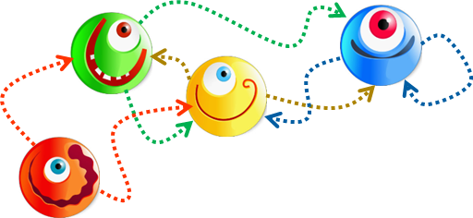
Efficient Graph Processing with Distributed Immutable View
HPDC
2014
Computation
Communication
Rong Chen⁺, Xin Ding⁺, Peng Wang⁺, Haibo Chen⁺, Binyu Zang⁺ and Haibing Guan*
Institute of Parallel and Distributed Systems ⁺
Department of Computer Science *
Shanghai Jiao Tong University
Notes:
Thank you for the introduction
Hi everyone, I’m glad to introduce our work, an efficient graph processing system based on distributed immutable view, which is joint work with my students and colleagues from shanghai Jiao Tong university.

Slide 2
Big Data Everywhere
1.11 Billion Users
100 Hrs of Video
every minute
6 Billion Photos
400 Million Tweets/day
How do we understand and use Big Data?
Notes:
(Since the description to Big data has been mentioned in everywhere, I will keep this short.)
Nowadays, We live in an era of Big Data.

Slide 3
Big Data → Big Learning
1.11 Billion Users
100 Hrs of Video
every minute
6 Billion Photos
400 Million Tweets/day
Machine Learning and Data Mining
NLP
Notes:
The value behind big data attracts data scientists to design a lot of data mining and machine learning algorithms to understand them. They have been widely used to serve social network, recommendation system, and so on.

Slide 4
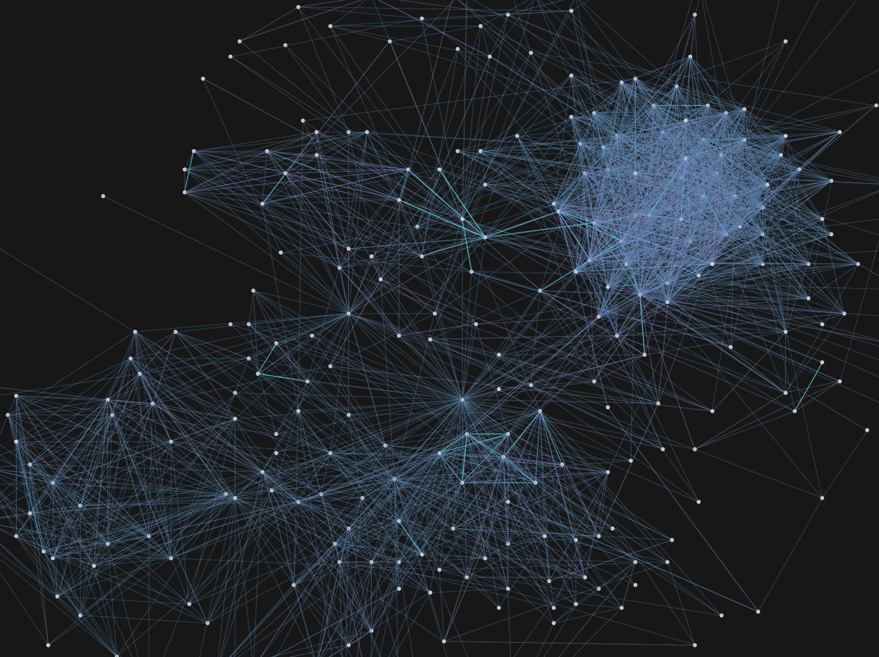
It’s about the graphs ...
Notes:
Most of these algorithms could be abstracted as the computation on graphs.
Thus, how to make the analysis on big graph efficient has become an important and hot topic.

Slide 5
Example: PageRank
4
5
A centrality analysis algorithm to measure the relative rank for each element of a linked set
Characteristics
Linked set → data dependence
Rank of who links it → local accesses
Convergence → iterative computation
3
1
2
$$\sum_{\left(j, i\right) ∈ E}{}$$
$${ R}_{i} =$$
$$α+(1−α)$$
$$ω_{ij}{ R}_{j}$$
4
5
4
5
4
5
3
1
4
3
1
3
1
2
1
4
Notes:
We use PageRank as an example to reveal the key properties of graph algorithms
It can be expressed as an iterative computation on vertex. Each vertex updates its rank as a weighted sum of its neighbors’ rank. The new rank will trigger the re-execution on neighbors until all vertices reached convergence. Convergence in here means the change of vertex data is lower than user-define threshold.
Compared to data-parallel algorithms, such as wordcount on MapReduce, the properties of graph algorithms can be summarized as data dependence (along edges), local accesses (to neighbors) and iterative computation (until convergence).
--
α is the random reset probability
wij is the prob. Transitioning (similarity) form j to i

Slide 6
Existing Graph-parallel Systems
4
5
“Think as a vertex” philosophy
aggregate value of neighbors
update itself value
activate neighbors
3
1
2
compute (v) PageRank
double sum = 0
double value, last = v.get ()
foreach (n in v.in_nbrs)
sum += n.value / n.nedges;
value = 0.15 + 0.85 * sum;
v.set (value);
activate (v.out_nbrs);
1
2
3
Notes:
Aim to these properties, most of existing graph-parallel systems follow “think as a vertex” philosophy.
It means the programmer only need provide a vertex-centric program to model the algorithm, which is executed on vertex in parallel and communicates along edges.
A typical vertex-centric program consists of three steps: 1, 2, and 3.

Slide 7
Existing Graph-parallel Systems
4
5
“Think as a vertex” philosophy
aggregate value of neighbors
update itself value
activate neighbors
3
1
2
1
2
comp.
Execution Engine
sync: BSP-like model
async: dist. sched_queues
3
2
4
3
4
1
comm.
Communication
message passing: push value
dist. shared memory: sync & pull value
barrier
push
1
2
1
1
2
sync
pull
Notes:
To classify existing graph-parallel systems, we introduce two main design choices.
The first one is execution engine.
The synchronous engine schedules the task as a sequence of iterations. Each iteration consists of three phases: computation (to update vertex in parallel), communication (to exchange messages among workers) and a global barrier (to synchronize the progress of workers).
And yet, the asynchronous engine uses distributed scheduling queues to maintain all active vertices in different machines, and simultaneously invokes computation and communication on these vertices without barrier.
For communication mechanism, there are also two choices.
One is message passing, in which the vertex need actively push a messages to its neighbors,
Another one is DSM, in which the vertex only synchronous with its replicas, and neighbors need actively pull data from the replica in local by shared memory.

Slide 8
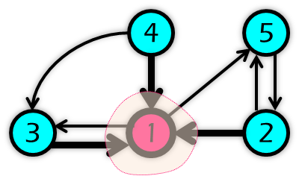
Issues of Existing Systems
Pregel[SIGMOD’09]
Sync engine
Edge-cut + Message Passing
GraphLab[VLDB’12]
PowerGraph[OSDI’12]
w/o dynamic comp.
high contention
2
1
master
2
1
replica
msg
4
x1
x1
3
1
2
keep alive
Notes:
Before introducing our work, we use three representative graph-parallel systems to illustrate main issues of existing design and impl.
The pioneer system, Pregel from Google and its Apache open source alternatives adopt BSP-like model, which uses sync engine for easy to program and debug because of its synchronous and deterministic computation natural
Pregal uses edge-cut to evenly assign vertices to multiple machines, and message passing is used to ensure all resources have been accumulated in local before computation in next iteration.
However, this design can not support dynamic computation for pull-mode algorithms for example PageRank,
since all vertices must keep alive for supplying messages to their neighbors even converged. For example, even there is only one vertex is not converged, all vertices must take part in computation and send messages. It would result in very high computation and communication overhead.
In addition, multiple vertices can simultaneously send messages to the same vertex, which will cause high contention in the receiving end.

Slide 9
Issues of Existing Systems
Pregel[SIGMOD’09]
Sync engine
Edge-cut + Message Passing
GraphLab[VLDB’12]
Async engine
Edge-cut + DSM (replicas)
PowerGraph[OSDI’12]
w/o dynamic comp.
hard to program
high contention
duplicated edges
2
1
master
heavy comm. cost
2
1
replica
high contention
msg
4
replica
4
5
x1
x1
x2
x2
3
1
2
1
1
1
dup
keep alive
3
3
2
2
Notes:
GraphLab adopts asynchronous engine to speedup convergence, but incurs burden to programmers and high performance overhead for distributed consistent scheduling.
To support dynamic computation, GraphLab introduces replication to implement DSM for actively pull-mode accesses, and then the vertex can do all three steps in local by itself, including aggregation, update and activation.
(For example, vertex 1 can aggregate value from vertex 2/3/4 and activate vertex 5 in local.)
However, this design causes that the edges spanning two machines need to be duplicated to provide full local semantic for two endpoint vertices. For example, the edge from vertex 2 to vertex 1 appear in two machines.
Furthermore, since the replica can be activated, one additional message must be used to take back activation state from replica to master. It will incurs more communication cost and high contention on the master.

Slide 10
Issues of Existing Systems
Pregel[SIGMOD’09]
Sync engine
Edge-cut + Message Passing
GraphLab[VLDB’12]
Async engine
Edge-cut + DSM (replicas)
PowerGraph[OSDI’12]
(A)Sync engine
Vertex-cut + GAS (replicas)
w/o dynamic comp.
hard to program
heavy comm. cost
high contention
duplicated edges
high contention
2
1
master
heavy comm. cost
2
1
replica
high contention
msg
4
replica
4
5
4
5
x1
x1
x2
x5
x5
x2
3
1
2
1
1
1
1
1
1
dup
keep alive
3
3
2
2
3
2
Notes:
PowerGraph (the latest version of graphlab) proposes vertex-cut to avoid duplicated edges, and GAS model to address load imbalance problem for power-law graph which splits the workload on single vertex into multiple machines. So replicas can take part in the computation to aggregate and activate neighbors. However, the distribution of computation will also cause heavy communication cost and increase the contention issue, since each replica will incurs up to 5 messages in each iteration, and 2 of them are from replicas to master. (3 for dynamic computation).

Slide 11
Contributions
Distributed Immutable View
Easy to program/debug
Support dynamic computation
Minimized communication cost (x1 /replica)
Contention (comp. & comm.) immunity
Multicore-based Cluster Support
Hierarchical sync. & deterministic execution
Improve parallelism and locality
Notes:
To remedy these issues, we propose a new graph-parallel model, namely Cyclops, which makes two major contributions
First, we design a distributed immutable view abstraction, which is easy to program and support dynamic computation with minimized communication cost, and naturally contention immunity.
Second, we further provide an optimization for multicore-based cluster that preserves the synchronous and deterministic computation nature in hierarchical environment, and improves parallelism and locality.

Slide 12
Outline
Distributed Immutable View
Graph organization
Vertex computation
Message passing
Change of execution flow
Multicore-based Cluster Support
Hierarchical model
Parallelism improvement
Evaluation
Notes:
We start from the introduction of distributed immutable view

Slide 13
General Idea
: For most graph algorithms, vertex only aggregates neighbors’ data in one direction and activates in another direction
e.g. PageRank, SSSP, Community Detection, …
Observation
Local aggregation/update & distributed activation
Partitioning: avoid duplicate edges
Computation: one-way local semantics
Communication: merge update & activate messages
Notes:
The key observation to drive our work is that …
Based on this observation, we design a new synchronous model, that adopts local aggregation/update and distributed activation.
I will provide detail explanation from partitioning, computation and communication in the following talk, to show how new model addresses all issues mentioned above.

Slide 14
Graph Organization
Partitioning graph and build local sub-graph
Normal edge-cut: randomized (e.g., hash-based) or heuristic (e.g., Metis)
Only create one direction edges (e.g., in-edges)
Avoid duplicated edges
Create read-only replicas for edges spanning machines
4
5
M1
4
4
M2
M3
5
3
1
2
3
1
3
1
2
1
2
master
replica
Notes:
For partitioning, we still use randomized or heuristic edge-cut to evenly assign vertices to multiple machines, but we only create one direction edges for each vertex to avoid redundant edges, for example, in-edges.
and read-only replicas are created for edges spanning two machines to construct one-way local sub-graph. The “one-way” in here means that vertex only can pull data from one direction neighbors in local.
(for example, the vertex 1 can pull data from vertex 2/3/4 but not 5).

Slide 15
Vertex Computation
Local aggregation/update
Support dynamic computation
one-way local semantic
Immutable view: read-only access neighbors
Eliminate contention on vertex
4
5
M1
4
4
M2
M3
5
3
1
2
3
1
3
1
2
1
2
read-only
Notes:
Then for computation, since vertex only aggregates neighbors’data in one direction, our one-way local sub-graph is enough to support dynamic computation.
Further, the computation on immutable view constructed by read-only replicas can freely access neighbors without worrying about contention on vertex and consistency issues.

Slide 16
Communication
Sync. & Distributed Activation
Merge update & activate messages
Update value of replicas
Invite replicas to activate neighbors
msg: v|m|s
s
rlist:W1
l-act: 1
value: 8
msg: 4
l-act:3
value:6
msg:3
e.g. 8 4 0
0
8
4
4
5
M1
4
4
M2
M3
5
3
1
2
3
1
3
1
2
1
2
active
Notes:
In communication, we use one message to act as two different roles, updating replica and activating neighbors. For example, the master of vertex 4 sends one message to update its replica’s state. The last field of message is used to present whether to activate neighbors.
Both master and replicas are responsible to activate local neighbors.
--
Specially, for the algorithms need selective activation, for example ALS (Alternating Least Squares), we use an optional field in message to store the list of activated neighbors, and we have further optimized this case to remove unnecessary messages.

Slide 17
Communication
Distributed Activation
Unidirectional message passing
Replica will never be activated
Always master → replicas
Contention immunity
4
5
M1
4
4
M2
M3
5
3
1
2
3
1
3
1
2
1
2
Notes:
Compared to GraphLab/PowerGraph, replica in our design will never be activated, since there is no edge from the direction for activation. For example, replicas have no in-edges under our partitioning.
So we don’t need additional messages from replicas to master to take back activation state. In other words, the communication between master and replica is unidirectional, and always from master to replicas. Further, each replica will only receive one message from one source, its master, which implies that our communication is contention immunity.

Slide 18
Change of Execution Flow
thread
vertex
4
message
Original Execution Flow (e.g. Pregel)
M2
M3
computation
sending
out-queues
receiving
1
M3
4
2
M1
5
7
high contention
8
10
in-queues
11
parsing
M1
high overhead
Notes:
At last, we summarize the change of execution flow. For original model, in each iteration, one worker sequentially runs user-defined compute function on all active vertices and buffers the messages in out queues according to destination. After that, all messages are batched and sent. In the receiving end, multiple RPC threads will simultaneously receive and buffer these messages to one in-queue. So there is high contention on the buffer. These messages will be further parsed to the message set of each vertex, which will cause additional overhead in memory and CPU.

Slide 19
Change of Execution Flow
thread
master
4
replica
4
Execution Flow on Distributed Immutable View
M2
M3
computation
sending
out-queues
receiving
lock-free
2
1
7
4
1
M3
3
4
3
2
7
4
M1
3
no contention
7
6
4
5
8
7
1
4
6
8
9
10
low overhead
1
11
M1
Notes:
The computation and sending end of communication phase in new model is similar, except the cached messages in message set are replaced by read-only replicas and messages are used to synchronize replicas.
But in receiving end, inspired by active message, multiple RPC threads will directly update replicas in parallel without any blocking, since each replica will be updated at most once. Thus, there is no contention and low overhead in memory and CPU.

Slide 20
Outline
Distributed Immutable View
Graph organization
Vertex computation
Message passing
Change of execution flow
Multicore-based Cluster Support
Hierarchical model
Parallelism improvement
Evaluation
Notes:
We further discuss how to support multicore-based cluster

Slide 21
Multicore Support
Two Challenges
Two-level hierarchical organization
Preserve synchronous and deterministic computation nature (easy to program/debug)
Original BSP-like model is hard to parallelize
High contention to buffer and parse messages
Poor locality in message parsing
Notes:
With the prevalence of multicore-based clusters, graph-parallel systems require to sufficiently utilize this resource. the two-level hierarchical organization raises new challenges and opportunities. The first is how to preserve synchronous and deterministic computation nature. The second is how to efficiently parallelize tasks with low contention and good locality.
--
We also need to consider the asymmetric degree of parallelism for CPUs and NICs.

Slide 22
Hierarchical Model
Design Principle
Three level: iteration → worker → thread
Only the last-level participants perform actual tasks
Parents (i.e. higher level participants) just wait until all children finish their tasks
local barrier
global barrier
task
loop
task
iteration
task
worker
thread
Level-2
Level-1
Level-0
Notes:
We first apply a hierarchical design to schedule tasks, which uses a three-level schema: the main task in iteration(level 0) is first partitioned into machines in cluster (level 1), and the worker on each machine further partitions the sub-task to multiple threads running on multicore hardware (level 2). The scheduling rule of our synchronous engine is that, at any time, only the last-level threads perform tasks. Their parents, i.e., the workers in higher levels, just wait until all child threads finish their tasks. Finally, a hierarchical barrier is used to replace original single global barrier for preserving synchronous and deterministic computation nature.

Slide 23
Parallelism Improvement
thread
vertex
4
message
Original BSP-like model is hard to parallelize
M2
M3
computation
sending
out-queues
receiving
1
M3
4
2
M1
5
7
8
10
in-queues
11
parsing
M1
Notes:
On the other hand, it is non-trivial to parallelize tasks in each iteration using multi-thread for BSP-like model

Slide 24
Parallelism Improvement
thread
vertex
4
message
Original BSP-like model is hard to parallelize
M2
M3
computation
sending
priv. out-queues
receiving
1
high contention
M3
4
2
M1
5
7
M3
8
10
M1
in-queues
poor locality
11
parsing
M1
Notes:
Since even the computation phase can be simply parallelized using data-parallel and multiple private out-queues, however, in receiving end, using multiple threads to simultaneously parse messages will result in high contention on the message set of vertex, and random accesses also causes poor locality and interference.

Slide 25
Parallelism Improvement
thread
master
4
replica
4
Distributed immutable view opens an opportunity
M2
M3
computation
sending
out-queues
receiving
2
1
7
4
1
M3
3
4
3
2
7
4
M1
6
7
3
4
5
8
7
4
1
6
8
9
10
1
11
M1
Notes:
Fortunately, our distributed immutable view opens an opportunity to efficiently parallelize receiving tasks without contention, since we don’t need locks to protect replicas when updating.

Slide 26
Parallelism Improvement
thread
master
4
replica
4
Distributed immutable view opens an opportunity
M2
M3
computation
sending
lock-free
priv. out-queues
receiving
2
1
4
1
M3
3
4
3
2
4
M1
6
7
3
4
5
8
7
7
M3
4
poor locality
6
8
9
10
1
7
M1
1
11
M1
Notes:
However, the locality issue still exists, since the order to update replicas is still random.

Slide 27
Parallelism Improvement
thread
master
4
replica
4
Distributed immutable view opens an opportunity
M2
M3
computation
sending
lock-free
priv. out-queues
receiving
2
1
4
1
M3
3
4
3
2
4
M1
3
7
6
6
5
8
7
7
M3
4
1
8
9
10
7
M1
4
11
no interference
1
M1
Notes:
To remedy this issue, we first group replicas according to the location of their masters to eliminate interference between receiving threads. For example, the replica of vertex 1/4/7 in machine 3 are grouped together, and the footprint of corresponding receiving thread is limited within the group, so no interference.

Slide 28
Parallelism Improvement
thread
master
4
replica
4
Distributed immutable view opens an opportunity
M2
M3
computation
sending
lock-free
priv. out-queues
receiving
2
1
4
1
M3
3
4
3
2
4
M1
3
7
6
6
5
8
7
7
M3
4
1
8
9
10
7
M1
sorted
1
11
good locality
4
M1
Notes:
Then, we further sort replicas within the group according to the global vertex-id when graph ingress. After that, the order of masters, messages and replicas are matched, which implies good locality with a sequential update to replicas.
--
Finally, distributed immutable view also supports separately configure the number of thread for computation and communication according to different degree of parallelism for CPUs and NICs. For example, we can use 16 threads for computation, but just 2 RPC threads.

Slide 29
Outline
Distributed Immutable View
Graph organization
Vertex computation
Message passing
Change of execution flow
Multicore-based Cluster Support
Hierarchical model
Parallelism improvement
Implementation & Experiment

Slide 30
Implementation
Cyclops(MT)
Based on (Java & Hadoop)
~2,800 SLOC
Provide mostly compatible user interface
Graph ingress and partitioning
Compatible I/O-interface
Add an additional phase to build replicas
Fault tolerance
Incremental checkpoint
Replication-based FT [DSN’14]
Notes:
We have implemented our system, namely Cyclops and its optimizations based on Apache Hama, which uses Java language and Apache platform libraries.
Cyclops provides mostly compatible user interface. We also preserve the I/O-interface in graph ingress and only use an additional phase to build replicas for Cyclops.
In addition, Cyclops also provides fault tolerance using incremental checkpoint or replication-based solution

Slide 31
Experiment Settings
Platform
6X12-core AMD Opteron (64G RAM, 1GigE NIC)
Graph Algorithms
PageRank (PR), Community Detection (CD), Alternating Least Squares (ALS), Single Source Shortest Path (SSSP)
Workload
7 real-world dataset from SNAP¹
1 synthetic dataset from GraphLab²
Dataset | |V| | |E|
Amazon | 0.4M | 3.4M
GWeb | 0.9M | 5.1M
LJournal | 4.8M | 69M
Wiki | 5.7M | 130M
SYN-GL | 0.1M | 2.7M
DBLP | 0.3M | 1.0M
RoadCA | 1.9M | 5.5M
¹http://snap.stanford.edu/data/
²http://graphlab.org
Notes:
(Due to the time limit, I have to bypass the evaluation)
All experiments are performed on an in-house 6-machine multicore cluster.
We evaluate our systems against the baseline system Hama using four typical graph algorithms with a collection of large scale real-world and synthetic graphs.

Slide 32
Overall Performance Improvement
48 workers
8.69X
6 workers(8)
2.06X
PageRank
ALS
CD
SSSP
Push-mode
Notes:
First, we evaluate the overall speedup of Cyclops and multi-thread version over Hama using 48 workers. CyclopsMT runs 6 workers (one per machines) and configues 8 threads in each worker. The Y-axis is the normalized speedup to Hama. For PageRank, the speedup increases with the growing size of input graph, and reaches more than 8 times for Wiki. For SSSP with RoadCA, the performance improvement is relative small. Because SSSP is a typical push-mode algorithm, and can not benefit from dynamic computation.

Slide 33
Performance Scalability
50.2
workers
threads
Amazon
GWeb
LJournal
Wiki
SYN-GL
DBLP
RoadCA
Notes:
To evaluate scalability, we increase the number of workers for Hama and Cyclops, and the number of threads for CyclopsMT. The Y-axis is normalized speedup to Hama using 6 workers.
due to exploiting the parallelism and locality of communication, CyclopsMT has better scalability than Hama and Cyclops with the increase of threads.

Slide 34
Performance Breakdown
Hama
Cyclops
CyclopsMT
PageRank
ALS
CD
SSSP
Notes:
Further, we categorize the source of performance improvement through a breakdown of execution time. Cyclops and CyclopsMT significantly outperform Hama for pull-mode applications because of two major benefits.
The first is from the elimination of redundant computation and messages for converged vertices by dynamic computation. You can find that the number of active vertices and messages in each iteration is obviously decreased in cyclops, but fixed in hama.
The second is due to exploit the parallelism and locality of communication and eliminates heavy contention on messages, which is also effective for push-mode algorithms, like sssp.
--
The significant improvement in sync phase also benefits from the load balance in each iteration and hierarchical barrier.

Slide 35
Comparison with PowerGraph¹
Preliminary Results
Cyclops-like engine on GraphLab¹ Platform
Dataset | COMP%
Amazon | 11%
GWeb | 15%
LJournal | 25%
Wiki | 39%
²
²
¹http://graphlab.org
²synthetic 10-million vertex regular (even edge) and power-law (α=2.0) graphs
¹C++ & Boost RPC lib.
Notes:
Finally, we compare Cyclops with PowerGraph using PageRank, which is developed by much efficient C++ language and Boost libraries. In despite of the language (Java vs. C++) and platform differences, CyclopsMT can provide comparable performance with PowerGraph, especially for the cases that the percent of computation time is lower, such as Amazon and GWeb dataset.
The main improvement is from communication phase with significant fewer messages, fewer than one fifth.
We also implement cyclops-like engine on GraphLab platform for apple to apple comparison. The preliminary results shows that Cyclops can obviously outperform PowerGraph for regular graphs.
--
No surprise, the performance of Cyclops for skewed natural graph is worse than PowerGraph due to load imbalance and poor partitioning.

Slide 36
Conclusion
Cyclops: a new synchronous vertex-oriented graph processing system
Preserve synchronous and deterministic computation nature (easy to program/debug)
Provide efficient vertex computation with significantly fewer messages and contention immunity by distributed immutable view
Further support multicore-based cluster with hierarchical processing model and high parallelism
Source Code: http://ipads.se.sjtu.edu.cn/projects/cyclops
Notes:
At the end of my talk, to conclude our work, we propose a new synchronous graph-parallel system that is easy to program and provide efficient computation and communication relying on distributed immutable view. We further optimize Cyclops to support multicore-based cluster with hierarchical model and high parallelism.

Slide 37
Thanks
Institute of Parallel and Distributed Systems
IPADS
Questions
Cyclops
http://ipads.se.sjtu.edu.cn/projects/cyclops.html
Notes:
That’s all. Thank you for your attention, I’d like to take any questions

Slide 38
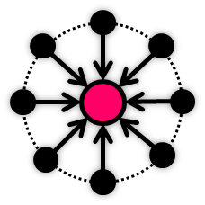
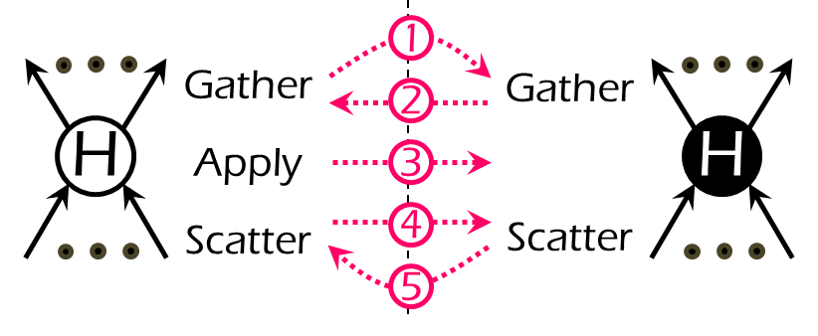
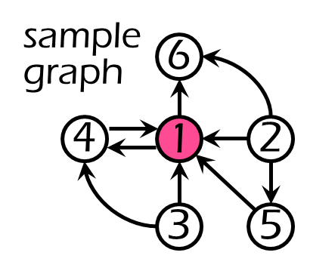
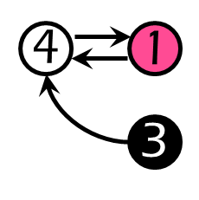
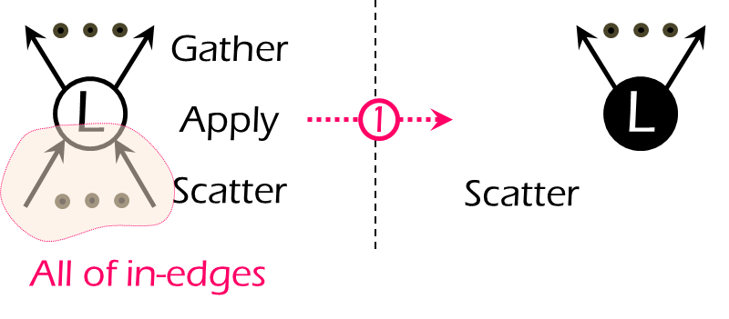
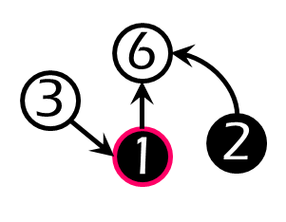
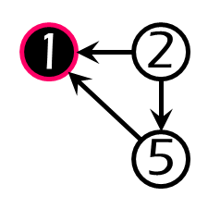
What’s Next?
Power-law: “most vertices have relatively few neighbors while a few have many neighbors”
PowerLyra: differentiated graph computation and partitioning on skewed natural graphs
Hybrid engine and partitioning algorithms
Outperform PowerGraph by up to 3.26X for natural graphs
http://ipads.se.sjtu.edu.cn/projects/powerlyra.html
Preliminary Results
Cyclops
PG
High
PL
3
Low
1
2
Notes:
What’s the next? Cyclops is a graph-parallel system for regular graphs. (Cyclops is a research project to show how efficient we can do for general graphs, without considering special features).
In practical, we need further exploit typical and important graph features to provide optimal performance, such as power-law and bipartite. Cyclops is not efficient for them, but we also believe PowerGraph is also not the best choice due to inefficient computation and communication on low-degree vertex. We designed and implemented a prototype on GraphLab platform, which follows a differentiated computation and partitioning philosophy. Welcome to visit our project homepage and try it, which is absolutely compatible to all GraphLab applications. Further discussion is also welcome with me in offline.

Slide 39
Generality
Algorithms: aggregate/activate all neighbors
e.g. Community Detection (CD)
Transfer to undirected graph and duplicate edges
4
5
M1
M2
M3
4
4
5
3
1
2
3
1
3
1
2
1
2
4
5
M1
4
M2
4
5
M3
5
3
1
2
3
1
3
1
2
1
2

Slide 40
Generality
Algorithms: aggregate/activate all neighbors
e.g. Community Detection (CD)
Transfer to undirected graph and duplicate edges
Still aggregate in one direction (e.g. in-edges) and activate in another direction (e.g. out-edges)
Preserve all benefits of Cyclops
x1 /replica & contention immunity & good locality
4
5
M1
4
M2
4
5
M3
5
3
1
2
3
1
3
1
2
1
2

Slide 41
Generality
Difference between Cyclops and GraphLab
How to construct local sub-graph
How to aggregate/activate neighbors
4
5
M1
M2
M3
4
4
5
5
3
1
2
3
1
3
1
2
1
2
4
5
M1
4
M2
4
5
M3
5
3
1
2
3
1
3
1
2
1
2

Slide 42
Improvement of CyclopsMT
Cyclops
CyclopsMT
#[M]achines
#[T]hreads
MxWxT/R
#[W]orkers
#[R]eceivers
Notes:
To illustrate the effect of hierarchical Cyclops (CyclopsMT) on multicore-based clusters, we evaluate PageRank algorithm on Cyclops with different configurations.
The configuration labeled on X-axis corresponds to the number of machines, workers, threads and RPC receivers, respectively. The Y-axis is execution time.
Cyclops with single thread configuration can efficiently parallelize computation phase, but not for communication and synchronization due to the increase of messages and machines. It incurs performance degradation when the number of workers exceed 24.
The overhead of communication and synchronization for CyclopsMT is stable due to fixed number of workers.
The only contention in CyclopsMT is from the underlying hardware. Too many receiving threads would contend on network resources. CyclopsMT provides separate configuration, and achieve best performance with only 2 receiving threads.

Slide 43
Communication Efficiency
W1
send + buffer + parse (contention)
W2
Hama:
PowerGraph:
Cyclops:
Hadoop RPC lib (Java)
Boost RPC lib (C++)
Hadoop RPC lib (Java)
W0
W3
W4
message: (id,data)
send + update
(contention)
W5
31.5%
50M
25.6X
55.6%
25M
16.2X
25.0%
5M
12.6X
Notes:
To show the efficiency of our communication mechanism, we design a microbenchmark, which launches five workers to concurrently send messages to update the element of an array in master worker. Both Hama and PowerGraph use the original design for message passing, while cyclops adopts our new contention immunity design. The implementation of Hama and Cyclops are based on Hadoop RPC lib, while PowerGraph uses Boost RPC lib. There is one order of magnitude performance slowdown between the implementations on Hama and PowerGraph. However, Cyclops can provide comparable performance to PowerGraph due to the elimination of buffering and contention.

Slide 44
Using Heuristic Edge-cut (i.e. Metis)
48 workers
23.04X
6 workers(8)
5.95X
PageRank
ALS
CD
SSSP
Notes:
Hama can not obviously benefit from the heuristic partitioning algorithms, since heuristic edge-cut only focus on reduce the number of edges spanning machines, which may result in load imbalance and high contention on partial workers. Dynamic computation can reduce these issues.

Slide 45
Memory Consumption
Memory Behavior¹ per Worker (PageRank with Wiki dataset)
Configuration | Max Cap (GB) | Max Usage (GB) | Young GC² (#) | Full GC² (#)
Hama/48 | 1.7 | 1.5 | 132 | 69
Cyclops/48 | 4.0 | 3.0 | 45 | 15
CyclopsMT/6x8 | 12.6/8 | 11.0/8 | 268/8 | 32/8
¹ jStat
² GC: Concurrent Mark-Sweep
Notes:
Max usage of Cyclops is large since replicas, which is reached after graph ingress (we use an additional round to create replica).
However, the number of Young and Full GC in Cyclops is actually less than Hama due to the elimination of redundant messages.
CyclopsMT overall consumes much less memory than Cyclops and Hama, since it shares replicas among threads.

Slide 46
Ingress Time
Hama
Cyclops
Dataset | LD |  | REP |  | INIT |  | TOT
 | H | C | H | C | H | C | H | C
Amazon | 6.2 | 5.9 | 0.0 | 2.5 | 1.7 | 1.5 | 7.9 | 9.9
GWeb | 7.1 | 6.8 | 0.0 | 2.8 | 2.6 | 1.9 | 9.7 | 11.4
LJournal | 27.1 | 31.0 | 0.0 | 44.7 | 17.9 | 9.2 | 45.0 | 84.9
Wiki | 46.7 | 46.7 | 0.0 | 62.2 | 33.4 | 20.4 | 80.0 | 129.3
SYN-GL | 4.2 | 4.0 | 0.0 | 2.6 | 2.4 | 1.8 | 6.6 | 8.4
DBLP | 4.1 | 4.1 | 0.0 | 1.5 | 1.3 | 0.9 | 5.4 | 6.5
RoadCA | 6.4 | 6.2 | 0.0 | 3.9 | 0.9 | 0.6 | 7.3 | 10.7
Notes:
Long graph ingress time is due to an additional round to create replicas.
Currently, we reuse all existing ingress code of Hama, We believe it can be optimized if we rewrite this code from scratch.

Slide 47
Selective Activation
*Selective Activation (e.g. ALS)
Sync. & Distributed Activation
Merge update & activate messages
Update value of replicas
Invite replicas to activate neighbors
msg: v|m|s|l
Option: Activation_List
msg: v|m|s
s
rlist:W1
l-act: 1
value: 8
msg: 4
l-act:3
value:6
msg:3
e.g. 8 4 0
0
8
4
4
5
M1
4
4
M2
M3
5
3
1
2
3
1
3
1
2
1
2
active
Notes:
Specially, for the algorithms need selective activation, for example ALS (Alternating Least Squares), we use an optional field in message to store the list of activated neighbors, and we have further optimized this case to remove unnecessary messages.

Slide 48
Parallelism Improvement
thread
master
4
replica
4
Distributed immutable view opens an opportunity
M2
M3
computation
sending
lock-free
out-queues
receiving
2
1
4
1
M3
3
4
3
2
4
M1
3
7
6
6
5
8
7
7
M3
4
1
8
9
10
7
M1
sorted
1
11
good locality
4
M1
separate
configuration
comp.
threads
comm. threads
vs.
Notes:
Finally, distributed immutable view also supports separately configure the number of thread for computation and communication according to different degree of parallelism for CPUs and NICs. For example, we can use 16 threads for computation, but just 2 RPC threads.

Slide 49
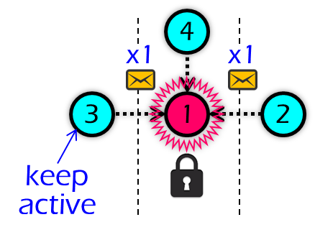
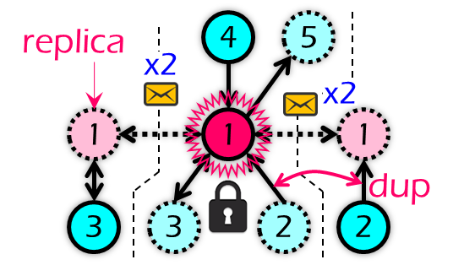
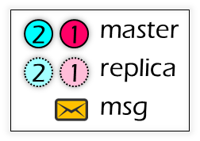
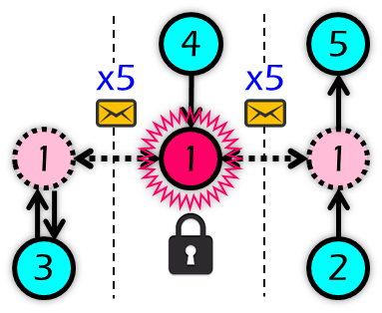
Cyclops
Existing graph-parallel systems (e.g., Pregel, GraphLab, PowerGraph)
Cyclops(MT)
Distributed Immutable View
hard to program
easy to program
w/o dynamic comp.
w/ dynamic comp.
duplicated edges
duplicated edges
heavy comm. cost
low comm. cost
high contention
no contention
replica
4
5
x1
x1
1
1
1
3
3
2

Slide 50
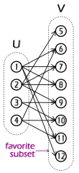
What’s Next?
BiGraph: bipartite-oriented distributed graph partitioning for big learning
A set of online distributed graph partition algorithms designed for bipartite graphs and applications
Partition graphs in a differentiated way and loading data according to the data affinity
Outperform PowerGraph with default partition by up to 17.75X, and save up to 96% network traffic
http://ipads.se.sjtu.edu.cn/projects/powerlyra.html

Slide 52
Multicore Support
Two Challenges
Two-level hierarchical organization
Preserve synchronous and deterministic computation nature (easy to program/debug)
Original BSP-like model is hard to parallelize
High contention to buffer and parse messages
Poor locality in message parsing
Asymmetric degree of parallelism for CPU and NIC
Notes:
With the prevalence of multicore-based clusters, graph-parallel systems require to sufficiently utilize this resource. the two-level hierarchical organization raises new challenges and opportunities. The first is how to preserve synchronous and deterministic computation nature. The second is how to efficiently parallelize tasks with low contention and good locality. We also need to consider the asymmetric degree of parallelism for CPUs and NICs.

