Slide 1
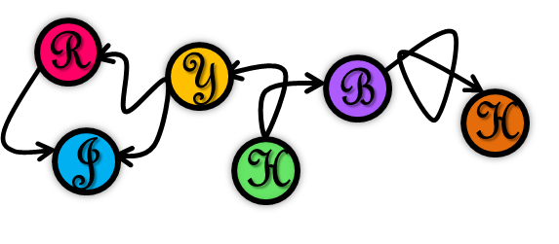
BiGraph: Bipartite-oriented Distributed Graph Partitioning for Big Learning
Institute of Parallel and Distributed Systems
IPADS
Rong Chen, Jiaxin Shi, Binyu Zang, Haibing Guan
Institute of Parallel and Distributed Systems (IPADS)
Shanghai Jiao Tong University
http://ipads.se.sjtu.edu.cn/
Notes:
Hi everyone, I’m glad to introduce our work 《BiGraph: Bipartite-oriented Distributed Graph Partitioning for Big Learning》

Slide 2
Bipartite graph
All vertices are divided into two disjoint sets U and V
Each edge connects a vertex in U to one in V
4
1
5
2
6
3
7
8

Slide 3
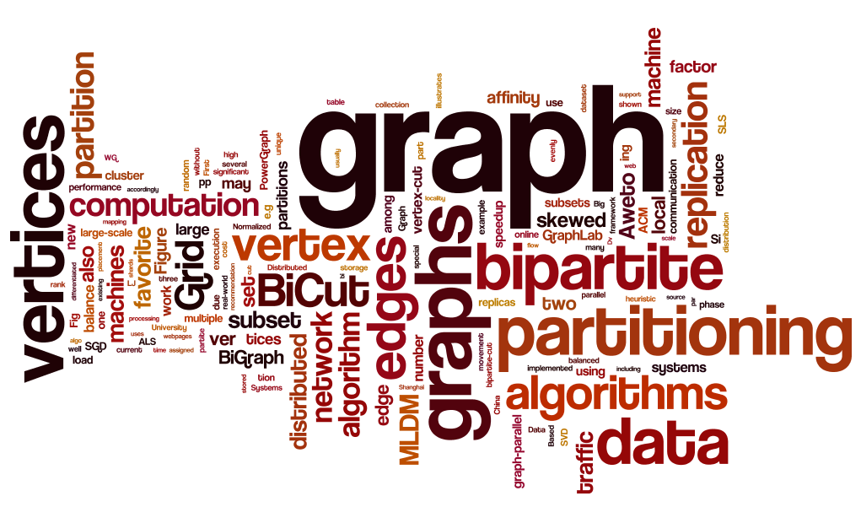
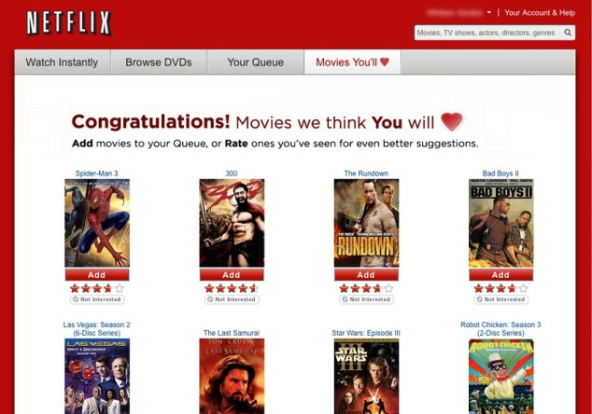
Bipartite graph
A lot of Machine Learning and Data Mining (MLDM) algorithms can be modeled as computing on bipartite graphs
Recommendation (movies & users)
Topic modeling (topics & documents)

Slide 4
Issues of existing partitioning algorithms
Offline bipartite graph partitioning algorithms
Require full graph information
Cause lengthy execution time
Not scalable to large graph dataset
Notes:
Before introducing our work, we first illustrate the main issues of existing partitioning algorithms

Slide 5
Issues of existing partitioning algorithms
General online partitioning algorithms
Constrained vertex-cut [GRADES ’13]
A lot of replicas and network communication

Slide 6
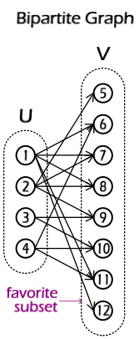
Randomized Vertex-cut
Load edges from HDFS
Distribute edges using hash
e.g. (src+dst)%m+1
Create mirror and master

Slide 7
Randomized Vertex-cut
1. Distribute the edges
part1
part2
part3
part4
1
8
2
8
1
6
1
7
1
12
4
6
2
5
1
11
2
7
4
10
2
9
3
9
3
10
4
11

Slide 8
Randomized Vertex-cut
2. Create local sub-graph
part1
part2
part3
part4
8
2
8
1
6
7
1
12
4
6
2
5
1
11
2
7
10
9
3
9
3
10
4
11

Slide 9
Randomized Vertex-cut
3. Set vertex as master or mirror
part1
part2
part3
part4
8
2
8
1
6
7
1
12
4
6
2
5
1
11
2
7
10
9
3
9
3
10
4
11
mirror
master

Slide 10
Constrained Vertex-cut
Load edges from HDFS
Distribute edges using grid algorithm
Create mirror and master

Slide 11
Constrained Vertex-cut
1
2
Arrange machines as a “grid”
Each vertex has a set of shards
e.g. Hash(s)=1, shard(s)={1,2,3}
Assign edges to the intersection of shards.
e.g. Hash(t)=4, shard(t)={2,3,4} Then edge <s,t> will be assigned to machine 2 or 3
Each vertices has at most 3 replicas.
3
4

Slide 12
Existing General Vertex-cut
If the graph is dense, the replication factor of randomized vertex-cut will close to M. (M: #machines)
If M=p*q , the replication factor of constrained vertex-cut has an upbound p+q-1
General Vertex-cut is oblivious to the unique features of bipartite graphs

Slide 13
Challenge and Opportunities
Real-world bipartite graphs for MLDM are usually skewed
e.g. netflix dataset
17,770 movies and 480,189 users
Notes:
The key observation to drive our work is that

Slide 14
Challenge and Opportunities
The workload of many MLDM algorithms may also be skewed
e.g. Stochastic Gradient Descent (SGD)
Only calculates new cumulative sums of gradient updates for user vertices in each iteration

Slide 15
Challenge and Opportunities
The size of data associated with vertices can be critical skewed
e.g. Probabilistic inference on large astronomical images
Data of observation vertex can reach several TB, while the latent stellar vertex has only very few data

Slide 16
Our contributions
Bipartite-cut and greedy heuristic
Reduce memory consumption (62% replicas)
Reduce network traffic (78%-96% network traffic)
Data affinity
Further reduce network traffic in partitioning phase (from 4.23GB to 1.43MB)

Slide 17
Bipartite-oriented Partitioning
Observation
If the related edges of a vertex are all in the same machine, then the vertex will not have any mirrors
Main idea
Completely avoid mirrors for all vertices in favorite subset
Replication factor is close to 1 for skewed graphs

Slide 18
Bipartite-cut algorithm
Choose a favorite subset from the two sets
Usually the subset with more vertices
Evenly assign the favorite vertices to machine with all adjacent edges
Construct masters and mirrors for non-favorite subset
No mirrors for favorite vertices!

Slide 19
Bipartite-cut
Assign edges according to the favorite subset
U
1
V
2
7
part1
part2
part3
3
4
1
7
2
7
3
7
8
5
4
8
5
8
3
8
6
6
7
6
8
Favorite
subset

Slide 20
Bipartite-cut
U
V
part1
part2
part3
1
No mirrors for favorite vertices!
2
7
1
7
2
7
3
7
3
Upbound: (U+V*M)/(U+V)≈1
4
8
5
8
6
8
4
8
5
6
Favorite
subset

Slide 21
Greedy Heuristic
Observation:
Arbitrarily partitioning of favorite subset may not introduce any replicas
Favorite vertex knows the location of neighbors
Main idea:
Use an additional round of edge exchange to reduce the mirrors of non-favorite vertices

Slide 22
Greedy Heuristic
U
1
V
part1
part2
part3
2
7
1
7
2
7
3
7
3
4
8
5
8
3
8
4
8
6
7
5
6
6
8
Favorite
subset

Slide 23
Greedy Heuristic
U
1
V
part1
part2
part3
2
7
1
7
4
8
3
7
3
2
5
6
8
4
8
5
6
Favorite
subset

Slide 24
Greedy Heuristic Algorithm
Evenly assign the favorite vertices to machine with all adjacent edges
For every favorite vertices v, Use formula $\left|N\left(v\right)∩ Si\right|−\sqrt{\left|Ei\right|}$ to decide target machine.
Neighbors of v in machine i

Slide 25
Greedy Heuristic Algorithm
Evenly assign the favorite vertices to machine with all adjacent edges
For every favorite vertices v, Use formula $\left|N\left(v\right)∩ Si\right|−\sqrt{\left|Ei\right|}$ to decide target machine.
keep balance
Neighbors of v in machine i

Slide 26
Greedy Heuristic Algorithm
Evenly assign the favorite vertices to machine with all adjacent edges
For every favorite vertices v, Use formula $\left|N\left(v\right)∩ Si\right|−\sqrt{\left|Ei\right|}$ to decide target machine.
Resend v with adjacent edges to target machine.
Construct masters and mirrors for non-favorite subset

Slide 27
Greedy Heuristic Algorithm
1
7
1
8
1
10
4
7
4
8
4
10
4
11
4
12
part1
part2
part3
… …
E: 0 0 0
Favorite
subset

Slide 28
Greedy Heuristic Algorithm
$\left|N\left(v\right)∩ Si\right|−\sqrt{\left|Ei\right|}：$
2$−\sqrt{0}$ 1$−\sqrt{0}$ 0$−\sqrt{0}$
1
7
1
8
1
10
4
7
4
8
4
10
4
11
4
12
part1
part2
part3
… …
E: 0 0 0
Favorite
subset

Slide 29
Greedy Heuristic Algorithm
$\left|N\left(v\right)∩ Si\right|−\sqrt{\left|Ei\right|}：$
2$−\sqrt{0}$ 1$−\sqrt{0}$ 0$−\sqrt{0}$
4
7
1
7
4
8
1
8
4
10
1
10
4
11
4
12
part1
part2
part3
… …
E: 3 0 0
Favorite
subset

Slide 30
Greedy Heuristic Algorithm
$\left|N\left(v\right)∩ Si\right|−\sqrt{\left|Ei\right|}：$
2$−\sqrt{3}$ 2$−\sqrt{0}$ 1$−\sqrt{0}$
4
7
1
7
4
8
1
8
4
10
1
10
4
11
4
12
part1
part2
part3
… …
E: 3 0 0
Favorite
subset

Slide 31
Greedy Heuristic Algorithm
4
7
4
8
1
7
4
10
1
8
4
11
1
10
4
12
part1
part2
part3
… …
E: 3 5 0
Favorite
subset

Slide 32
Execution Flow of Existing Systems
Load file from HDFS (network)
Distribute edges and vertices data (network)
Construct local graph
Computation
What if the data size of one subset is very large?

Slide 33
Execution Flow of Existing Systems
Load file from HDFS (network)
Distribute edges and vertices data (network)
Construct local graph
Computation
What if the data size of one subset is very large?

Slide 34
Exploiting Data Affinity
Main idea
Choose that subset as favorite subset (no mirrors)
split files into multiple blocks and stored on multiple machines (load from local machine)
Construct Mapping Table (id->machine) for favorite subset
Distribute Mapping Table instead of favorite vertices data
Distributed edges using Mapping Table.

Slide 35
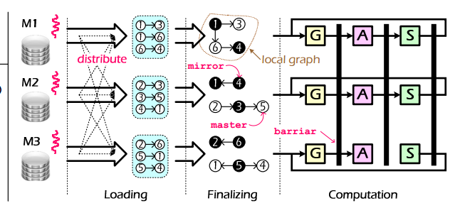
Execution Flow of Existing Systems
Edges and all vertices

Slide 36
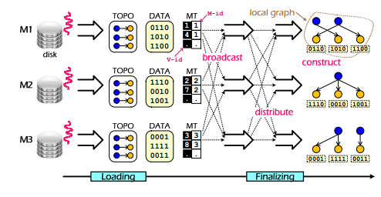
Execution Flow with Data Affinity
Edges and non-favorite vertices

Slide 37
tradeoff
 | Data size (s) | Vertices number (n)
U | Large | Small
V | Small | large
Need some tradeoff
select the subset with larger s*n
select the subset which will be updated frequently

Slide 38
Implementation
BiGraph
Based on latest version of GraphLab
Compatible with all existing applications
BiCut and Aweto (Greedy Heuristic)
Source Code: http://ipads.se.sjtu.edu.cn/projects/powerlyra

Slide 39
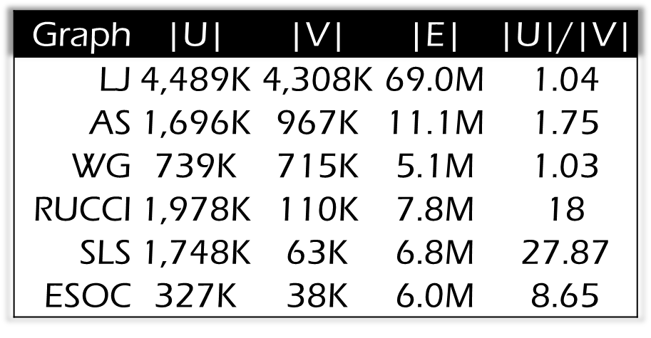
Experiment Settings
Platform
6X12-core AMD Opteron (64G RAM, 1GigE NIC)
Graph Algorithms
SVD , ALS , SGD
Workload
6 real-world dataset¹
¹ http://snap.stanford.edu/data/ and http://www.cise.ufl.edu/research/sparse/matrices/index.html

Slide 40
Replication Factor of Partitioning

Slide 41
Computation Speedup

Slide 42
Partitioning Speedup

Slide 43
Weak Scalability
Netflix ：|U|=480K,|V|=18K,|E|=100M

Slide 44
Data Affinity Evaluation
Case Study: calculate the occurrences of a user-defined keyword touched by Users on a collection of Webpages
Experiment Setting
84,000 webpages: 10-100 KB
4,000 users: 4 bytes integer

Slide 45
Data Affinity Evaluation
Result comparing with Grid
Rep-factor: 1.23 vs. 3.55
Network traffic (partitioning): 1.43MB vs. 4.23GB
Performance (partitioning): 6.7s vs. 55.7s

Slide 46
Conclusion
We identified the main issues in large-scale graph analytics framework for bipartite graphs
We propose a new set of graph partitioning algorithms , leveraged three key observations from bipartite graph

Slide 47
Thanks
Institute of Parallel and Distributed Systems
IPADS
Questions
BiGraph
http://ipads.se.sjtu.edu.cn/projects/powerlyra.html
Notes:
That’s all. Thank you for your attention, I’d like to take any questions

