Slide 1
Sub-millisecond Stateful
Stream Querying over
Fast-evolving Linked Data
Yunhao Zhang, Rong Chen, Haibo Chen
Institute of Parallel and Distributed Systems (IPADS)
Shanghai Jiao Tong University

Slide 2
Stream Query is Important
Multiple data sources are continuously generating streaming data in high velocity

Slide 3
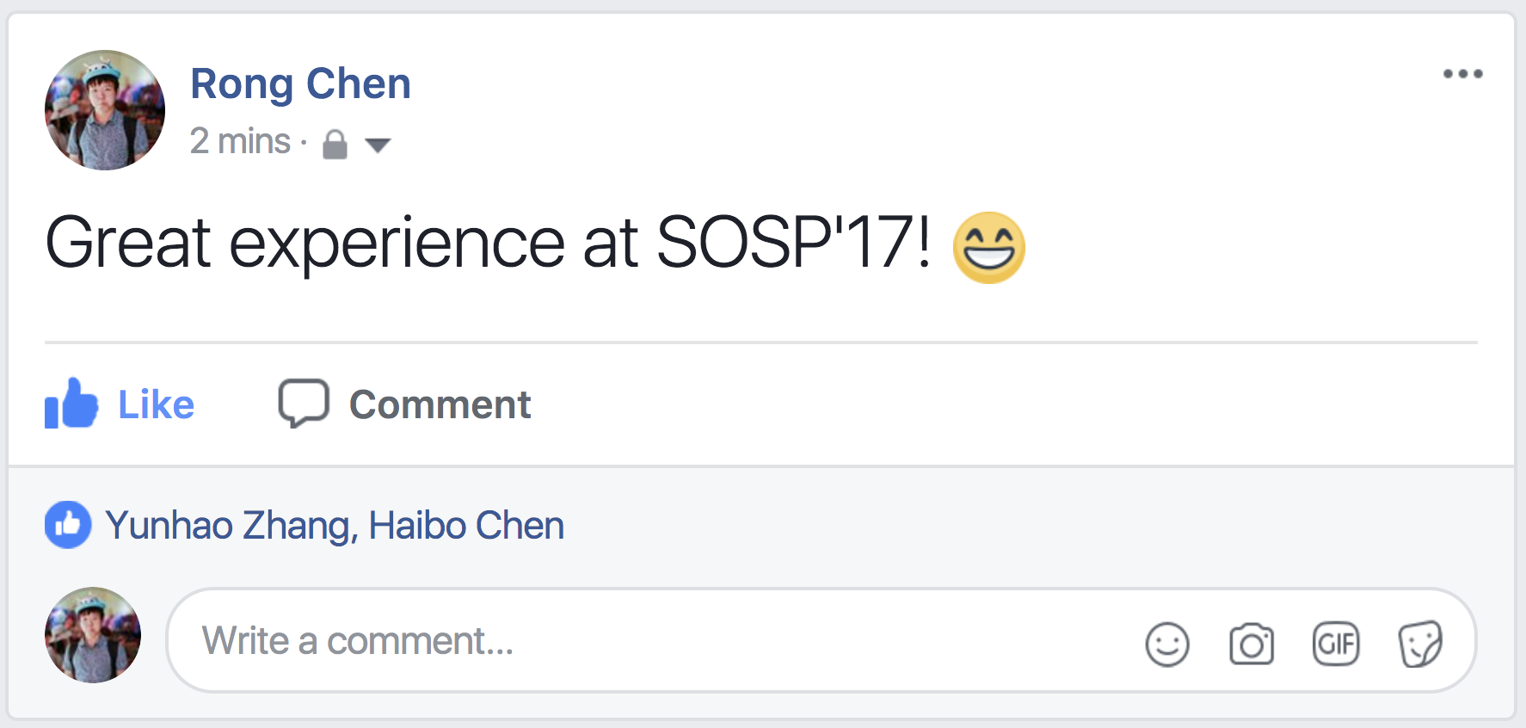
Stateful Stream Query
A stateful stream query needs to integrate streaming data with stored data
Streaming Data:
high velocity
Stored Data:
large & evolving
Real-time
User Activity
Durable
Social Graph

Slide 4
Example Dataset for Stateful Stream Query
IPADS
<Rong, creates, Feed>. 12:30
<Feed, hash_tag, SOSP>. 12:30
<Yunhao, likes, Feed>. 12:31
<Haibo, likes, Feed>. 12:40
System
@Cornell
Streaming Data
Stored Data

Slide 5
Connectivity Property of Data
Linked data represents information as entities and relations between the entities
Rong
Feed
member_of
Rong
#SOSP#
12:30
IPADS
Feed
create
hash tag
Haibo
member_of
Like
12:31
Yunhao
like
member_of
like
Yunhao
Cornell
12:40
Haibo
Stored Data
Streaming Data

Slide 6
Example Continuous Query
In the last 30 minutes, which IPADS members created feeds that are liked by other IPADS members?
time
?X
Registered by user
create
member_of
Triggered by system
?Feed
IPADS
Triggered by system
…
?Y
like
member_of
Triggered by system
Canceled by user

Slide 7
Example Continuous Query
In the last 30 minutes, which IPADS members created feeds that are liked by other IPADS members?
Feed
Rong
12:30
Rong
create
Feed
Feed
Rong
member_of
Like
12:31
Yunhao
like
IPADS
like
12:40
Haibo
Haibo
member_of
Haibo
Streaming Data
Stored Data

Slide 8
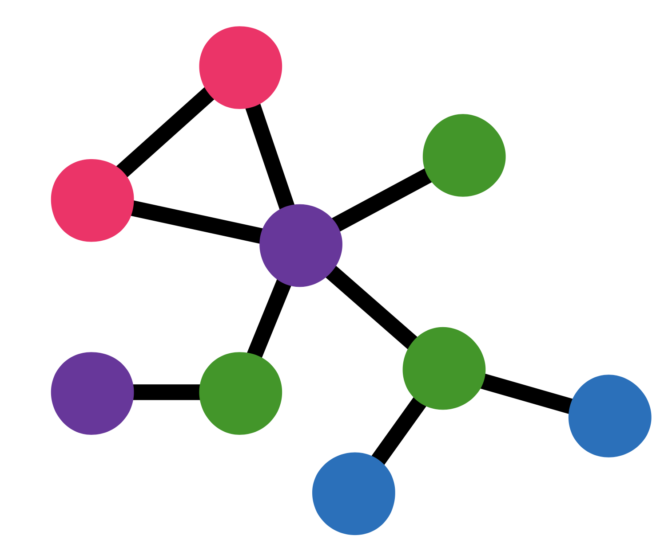
Workload Characteristics
Connectivity
property
Stateful queries integrate Stored and Streaming
Data
Stored data
evolves by absorbing streaming data
Notes:
workload特性总结

Slide 9
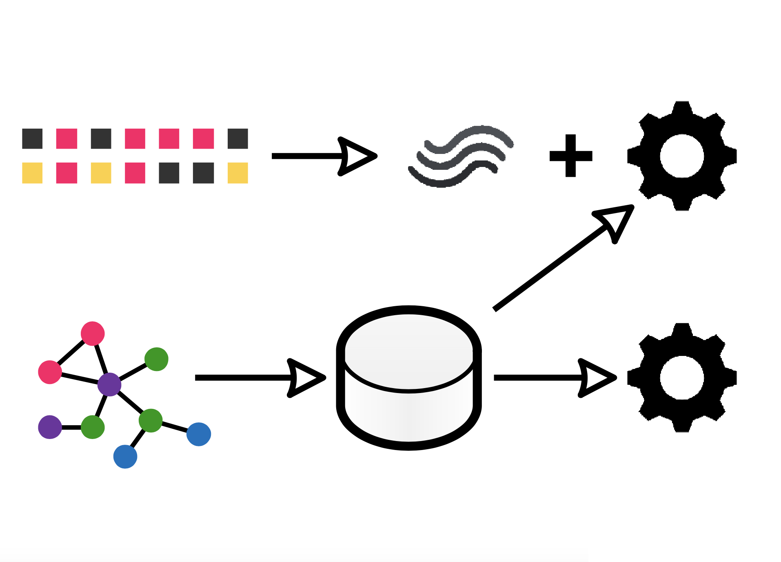
Conventional Approach
Streaming
Data
Continuous
Query
Stream Processing System
Graph Store
System
One-shot
Query
Stored Data

Slide 10
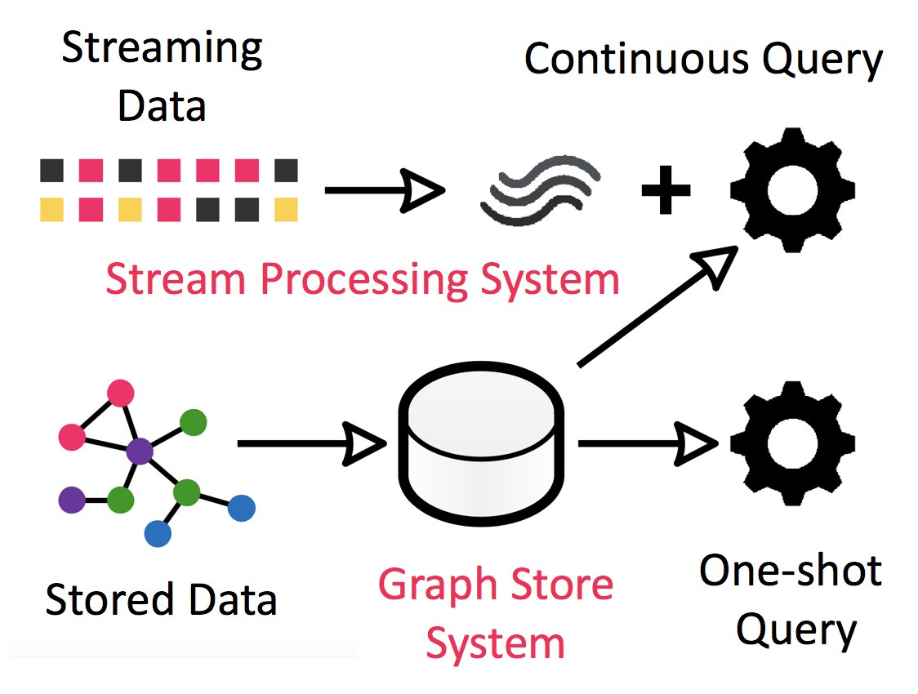
Composite Design
Composite Design
Example
Apache
Storm
Stream Processing System
Wukong
OSDI’16
Graph Store System

Slide 11
Composite Design Observations
1. Cross-system Cost
~40% execution time wasted due to data transformation and transmission
2. Inefficient Query Plan
Composite Design: high latency
low throughput
Semantic gap between the two systems impair query optimization
3. Limited Scalability
Stream processing systems dedicate all resources to the improve performance of a single job

Slide 12
Design Overview
Wukong+S
uses a novel integrated design for stateful stream query over fast-evolving linked data
Integrated Design
manages streaming data and stored data in a single system
Eliminate cross-system cost
Global semantics for query optimization
Better scalability by sharing data between the queries

Slide 13
Design Outline
Implementing integrated design is not trivial
Decisions for efficient integrated design:
Hybrid Store: efficiently handle streaming data and fast-evolving stored data
Stream Index: fast path to access streaming data in a certain time interval
Consistent Data View: through decentralized vector timestamps and bounded snapshot scalarization

Slide 14
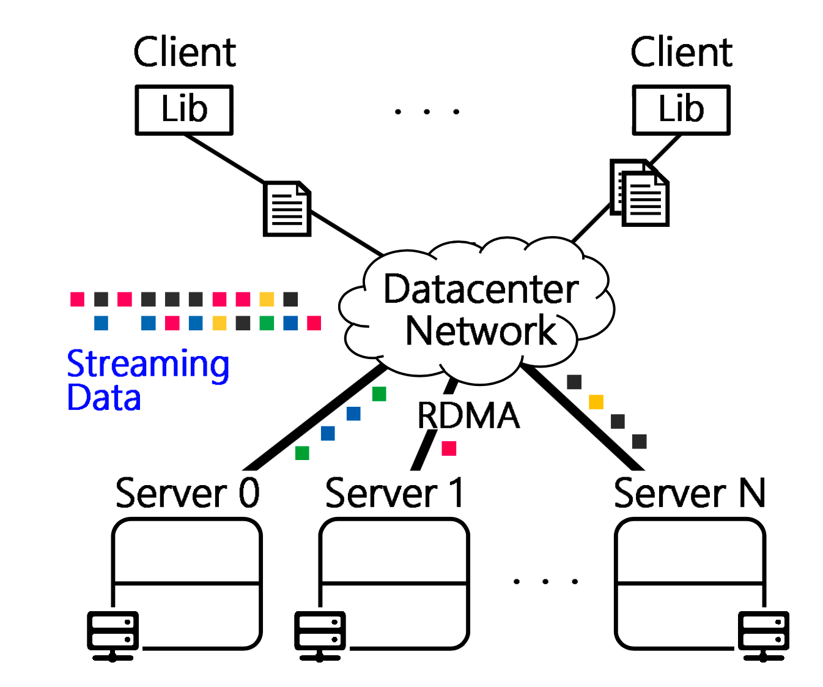
Wukong+S Architecture
Continuous
Query
One-shot
Query
Serve queries
Engine
Engine
Engine
Hold data partition
Store
Store
Store
Data is partitioned and stored on multiple servers

Slide 15
Hybrid Store
How to gracefully integrate streaming data and stored data?
Strawman: using different graph stores according to “where from”, namely streaming and stored data
Hybrid Store: using different graph stores according to “how to use”, namely timeless and timed data

Slide 16
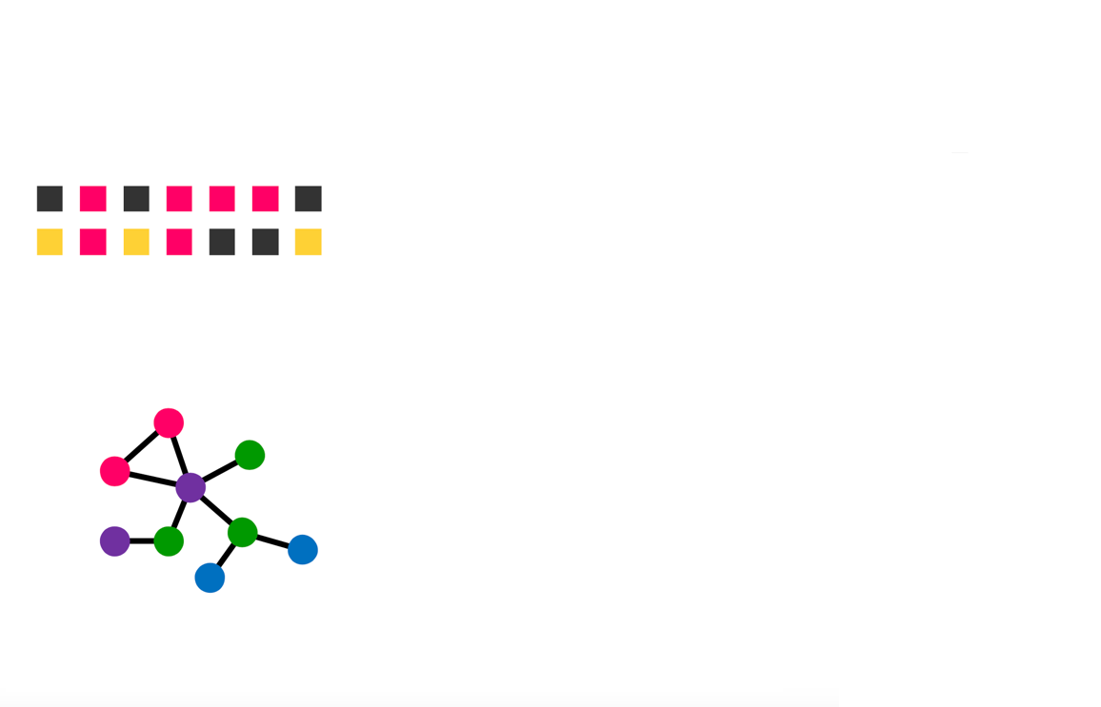
Explicit Separation of Streaming Data
Timed
Streaming Data
user-defined
predicate
Continuous
Query
Timeless
One-shot
Query
Stored Data

Slide 17
Benefit of Hybrid Store
No interference between timeless data and timed data
Design data stores separately and optimize for different operation pattern:
Timeless Data: continuous persistent store
Timed Data: time-based transient store

Slide 18
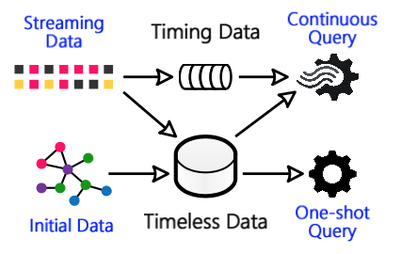
Hybrid Store
Continuous Persistent Store
Continuously absorb the timeless portion of streams
Goal: support stateful continuous query and up-to-date one-shot query
Timed Data

Slide 19
Hybrid Store
Time-based Transient Store
Timed data will only be accessed by relevant continuous queries in a time interval
Goal: support fast garbage collection (GC) for the timed portion of streams
Timed Data

Slide 20
Consistent Data Snapshot
How to provide consistent view over dynamic data with memory efficiency?
Streaming data contains order information
Early output from a stream source should always be visible before later output
No order relation across data sources

Slide 21
Decentralized Vector Timestamp (VTS)
8:00
8:01
8:02
Continuous Query
Time
Source0:
4
5
Stable_VTS
Source1:
11
12
4
11
12
5
Local_VTS
Server0
Server1
Local_VTS
4
11
5
12
Data is partitioned and stored on multiple servers

Slide 22
Snapshot Scalarization
One-shot Query
4
11
12
5
Key
Server0
√
[4,10]
2
×
SN: Snapshot Number
VTS: Vector Timestamp
[4,11]
Encoded in Key
×
[4,12]
SN-VTS Plan
√
[5,12]
3
SN=2:[4,10]
SN=3:[5,12]
Visible
snapshot
SN=4:[7,14]

Slide 23
Benefit of Snapshot Scalarization
Memory
Efficiency
Injection
Speed
bound
number of
visible snapshot
stream
query
scenario
decouple
data sources from
underlying store
Staleness of
Stored Data
control
staleness by
SN_VTS Plan

Slide 24
Other Designs of Wukong+S
Stream index & locality-aware partitioning
Data-driven query trigger
One-shot query execution
Fault tolerance
Leveraging RDMA

Slide 25
Evaluation
Baseline: 6 state-of-the-art systems
CSPARQL-engine, Heron+Wukong, Storm+Wukong
Spark Streaming, Spark Structured Streaming, Wukong/ext
Platforms: a rack-scale 8-machine cluster
Each: two 12-core Intel Xeon, 128GB DRAM, w/ RDMA Mellanox 56Gbps InfiniBand NIC, 40Gbps IB Switch
Benchmarks:
LSBench: Social Networking Benchmark w/ 3.75B initial stored data & 5 streams totally 134K tuple/second stream
CityBench: Smart City Benchmark w/ 11 real-world data streams

Slide 26
Single Query Latency
Outperform: state-of-the-art systems
Wukong+S: sub-millisecond
13.7X speedup vs. Storm+Wukong
3 orders of magnitude speedup vs. Spark Streaming
219
527
712
346
2215
1422
49.03
40.77
31.14
latency (msec)
0.10
0.08
0.11
0.23
1.64
2.62
1.78
3.50
1.68

Slide 27
Single Query Latency
Unavoidable reason for high latency
Cross-system Cost for Storm+Wukong
Joining large stored data (3.75B) for Spark Streaming
219
527
712
346
2215
1422
49.03
40.77
31.14
latency (msec)
0.10
0.08
0.11
0.23
1.64
2.62
1.78
3.50
1.68

Slide 28
Throughput of Mixed Workloads
Wukong+S: ~1M queries/second on 8 nodes
Mixture of 3 queries: 1.08M queries/second
Add complex queries: 802K queries/second
throughput
(kilo query/second)
throughput
(kilo query/second)
#machine
#machine
Mixture of LSBench 1-3
Mixture of LSBench 1-6

Slide 29
Other Evaluations
Influence of different stream rate
Data insertion latency
Performance of one-shot queries
Memory consumption
Fault-tolerance overhead

Slide 30
Conclusion
Existing systems cannot satisfy demands of
stateful stream query over fast-evolving linked data
: A distributed stream querying engine adopting a novel integrated desgin for stateful stream queries over fast-evolving linked data
Wukong+S
Achieving sub-millisecond latency and throughput
exceeding one million queries per second
http://ipads.se.sjtu.edu.cn/projects/wukong

Slide 31
Thanks
Wukong+S
Questions
http://ipads.se.sjtu.edu.cn/projects/wukong
Institute of Parallel and
Distributed Systems

Slide 32
Backup: LSBench w/o RDMA

