Slide 1

Fast and Concurrent RDF Queries using RDMA-assisted GPU
Graph Exploration
Siyuan Wang, Chang Lou, Rong Chen, Haibo Chen
Institute of Parallel and Distributed Systems (IPADS)
Shanghai Jiao Tong University
http://ipads.se.sjtu.edu.cn

Slide 2

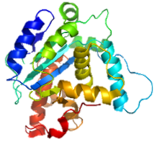
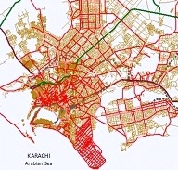
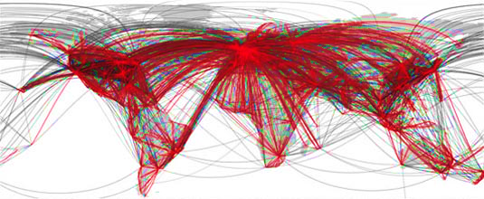

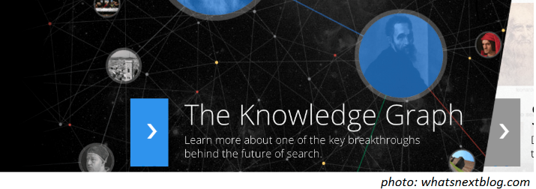

Graphs are Everywhere
Online graph query plays a vital role for
searching, mining and reasoning linked data
TAO
Unicorn

Slide 3
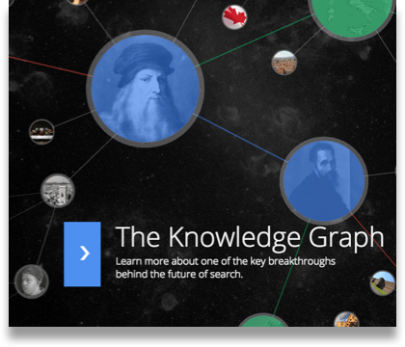



RDF and SPARQL
    Resource Description Framework (RDF)
    Representing linked data on the Web
    Public knowledge bases: DBpedia, Wikidata, PubChemRDF
    Google’s knowledge graph

Slide 4
RDF and SPARQL
mo: MemberOf
ad: ADvisor
to: TeacherOf
tc: TakeCourse
    RDF is a graph composed by a set of
    ⟨Subject, Predicate, Object⟩ triples
to
to
DS
Rong
DS
tc
Rong
Rong | to | DS
Rong | mo | IPADS
Siyuan | ad | Rong
Siyuan | tc | OS
Haibo | to | OS
Haibo | mo | IPADS
Jiaxin | ad | Haibo
. . .
triple
mo
Chang
ad
Siyuan
tc
IPADS
to
OS
mo
Haibo
tc
ad
Jiaxin

Slide 5
RDF and SPARQL
    SPARQL is standard query language for RDF
Triple Pattern
SELECT ?X ?Y ?Z WHERE {
?X teacherof ?Y .
?Z takecourse ?Y .
?Z adivsor ?X .
}
to
TP1
Rong
DS
tc
TP2
Variable
Chang
mo
TP3
ad
Siyuan
tc
IPADS
OS
to
OS
mo
to
Haibo
Haibo
Professor (?X) advises (ad) student (?Z) who also takes (tc) a course (?Y) taught by (tc) the professor
tc
tc
Jiaxin
ad
Jiaxin
ad

Slide 6
Queries are Heterogeneous
SELECT ?X ?Y ?Z WHERE {
?X teacherof ?Y .
?Z takecourse ?Y .
?Z adivsor ?X . }
    Heavy Query (Q_{H})
    Start from a set of vertices
    Explore a large part of graph
to
Rong
DS
tc
mo
Chang
ad
Siyuan
tc
    Light Query (Q_{L})
IPADS
to
OS
mo
Haibo
tc
ad
Jiaxin

Slide 7
Queries are Heterogeneous
SELECT ?X ?Y ?Z WHERE {
?X teacherof ?Y .
?Z takecourse ?Y .
?Z adivsor ?X . }
    Heavy Query (Q_{H})
    Start from a set of vertices
    Explore a large part of graph
TP1
to
to
DS
Rong
DS
tc
Rong
mo
Chang
ad
Siyuan
tc
    Light Query (Q_{L})
IPADS
OS
to
OS
mo
to
Haibo
Haibo
tc
ad
Jiaxin

Slide 8
Queries are Heterogeneous
SELECT ?X ?Y ?Z WHERE {
?X teacherof ?Y .
?Z takecourse ?Y .
?Z adivsor ?X . }
    Heavy Query (Q_{H})
    Start from a set of vertices
    Explore a large part of graph
TP1
TP2
TP3
to
to
DS
DS
tc
Rong
tc
Rong
Chang
mo
Chang
ad
ad
Siyuan
Siyuan
tc
tc
    Light Query (Q_{L})
IPADS
OS
to
OS
mo
to
Haibo
Haibo
tc
tc
Jiaxin
ad
Jiaxin
ad

Slide 9
Queries are Heterogeneous
SELECT ?X ?Y ?Z WHERE {
?X teacherof ?Y .
?Z takecourse ?Y .
?Z adivsor ?X . }
    Heavy Query (Q_{H})
    Start from a set of vertices
    Explore a large part of graph
TP1
TP2
TP3
to
to
DS
DS
tc
Rong
tc
Rong
Chang
mo
Chang
ad
ad
Siyuan
Siyuan
tc
tc
    Light Query (Q_{L})
IPADS
OS
to
OS
mo
to
Haibo
Haibo
tc
tc
Jiaxin
ad
Jiaxin
ad

Slide 10
Queries are Heterogeneous
SELECT ?X WHERE {
?X advisor Rong .
?X takecourse OS . }
    Heavy Query (Q_{H})
    Start from a set of vertices
    Explore a large part of graph
to
Rong
DS
tc
mo
Chang
ad
Siyuan
tc
    Light Query (Q_{L})
    Start from a given vertex
    Explore a small part of graph
IPADS
to
OS
mo
Haibo
tc
ad
Jiaxin

Slide 11
Queries are Heterogeneous
SELECT ?X WHERE {
?X advisor Rong .
?X takecourse OS . }
    Heavy Query (Q_{H})
    Start from a set of vertices
    Explore a large part of graph
to
Rong
DS
tc
Rong
mo
Chang
ad
ad
Siyuan
Siyuan
tc
tc
    Light Query (Q_{L})
    Start from a given vertex
    Explore a small part of graph
IPADS
OS
to
OS
mo
Haibo
tc
ad
Jiaxin

Slide 12
Queries are Heterogeneous
    Heavy Query (Q_{H})
    Start from a set of vertices
    Explore a large part of graph
Q7*
390 ms
Incompetent to handle heavy queries efficiently
3000X
    Light Query (Q_{L})
    Start from a given vertex
    Explore a small part of graph
Q5*
0.13 ms
* Wukong on a 10-server cluster for LUBM-10240 dataset

Slide 13
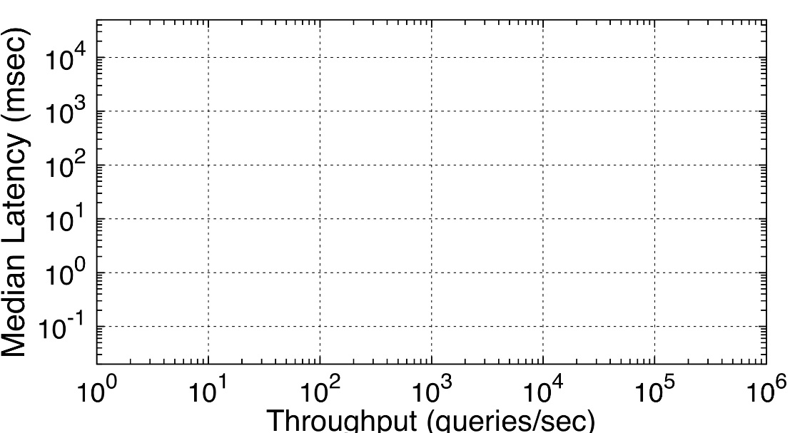
Concurrent Workload
    logarithmic scale
    Latency
    better
    Throughput

Slide 14
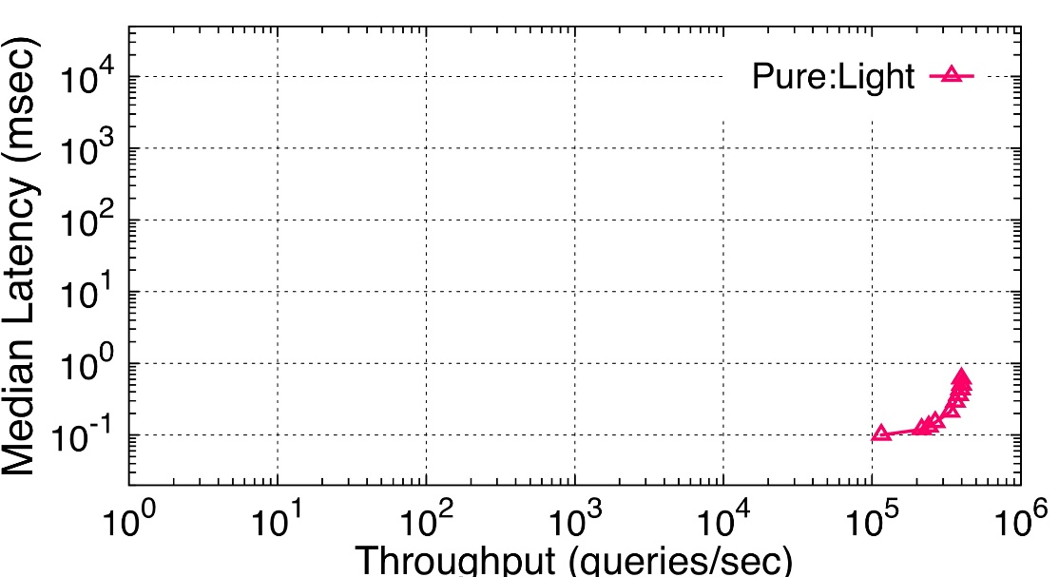
Concurrent Workload
    logarithmic scale
    PURE light query workload
    Latency
    Thpt: 398K q/s
    Lat: 0.10 ms
    Throughput

Slide 15
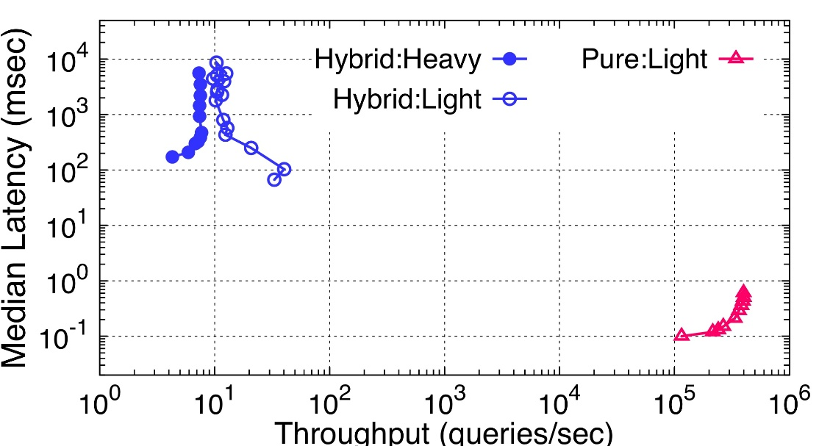
Concurrent Workload
    HYBRID light & heavy query workload
    Thpt: 10 q/s
    Lat: 8,600 ms
    logarithmic scale
poor performance when facing hybrid workload
    PURE light query workload
    Latency
    Thpt: 40 q/s
    Lat: 100 ms
    Thpt: 398K q/s
    Lat: 0.10 ms
    Throughput

Slide 16
Advanced Hardware
    Heterogeneity
    GPU has many cores and high memory bandwidth
CPU
GPU
    Fast Communications
    RDMA enables direct data transfer between machines

Slide 17
General Idea
Heterogeneous
Workload
Heterogeneous
Hardware
Light Query
CPU
Heavy Query
GPU

Slide 18

System Overview
Wukong+G
    : a distributed graph query system that can leverage CPU/GPU to handle hybrid workload
    GPU-enable graph exploration
    GPU-friendly RDF store
    Heterogeneous RDMA Communication
    Performance improvement
  Latency: 2.3X - 9.0X speedup for heavy query
  Throughput: 345K queries/sec in hybrid workloads

Slide 19
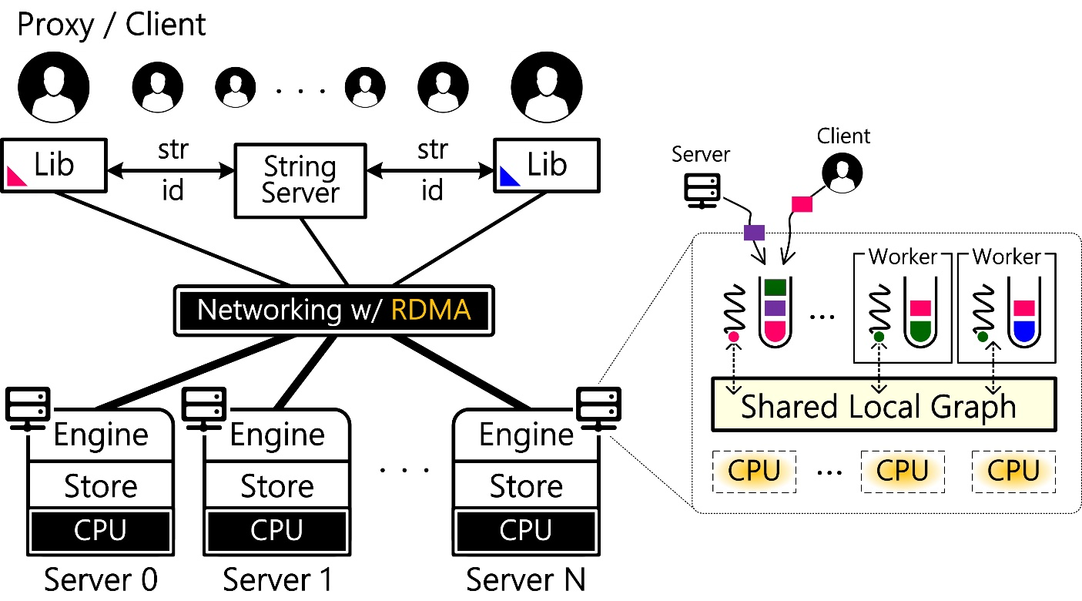
Wukong Architecture
SPARQL queries

Slide 20
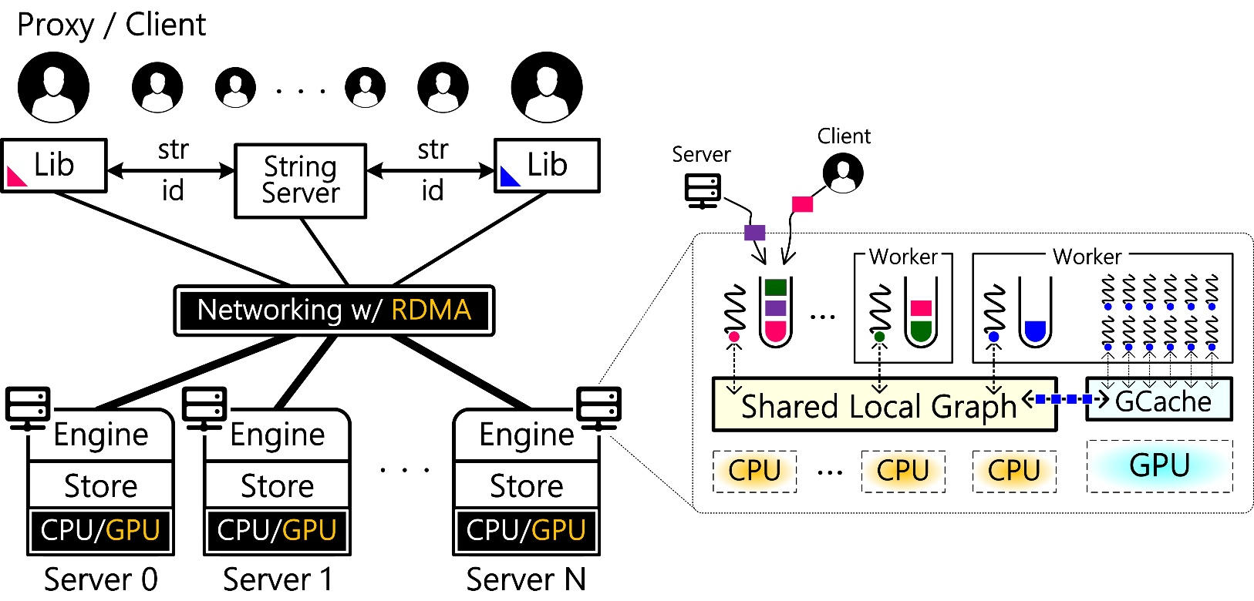
Wukong+G Architecture
Agent

Slide 21
Query Execution on CPU
SELECT ?X ?Y ?Z WHERE {
?X teacherof ?Y .
?Z takecourse ?Y .
?Z adivsor ?X . }
Work Thread
Metadata
Graph Store
Intermediate
Result

Slide 22
Query Execution on CPU
SELECT ?X ?Y ?Z WHERE {
?X teacherof ?Y .
?Z takecourse ?Y .
?Z adivsor ?X . }
Work Thread
Metadata
Graph Store
Intermediate
Result

Slide 23
Query Execution on CPU
SELECT ?X ?Y ?Z WHERE {
?X teacherof ?Y .
?Z takecourse ?Y .
?Z adivsor ?X . }
TP1
TP2
TP3
Work Thread
Metadata
Graph Store
Intermediate
Result

Slide 24
Query Execution on CPU
SELECT ?X ?Y ?Z WHERE {
?X teacherof ?Y .
?Z takecourse ?Y .
?Z adivsor ?X . }
TP1
TP2
TP3
Work Thread
Metadata
Graph Store
Observation: all of traversal paths can be explored independently
Intermediate
Result

Slide 25
Query Execution on CPU
SELECT ?X ?Y ?Z WHERE {
?X teacherof ?Y .
?Z takecourse ?Y .
?Z adivsor ?X . }
TP1
TP2
TP3
Work Thread
Metadata
Graph Store
Intermediate
Result

Slide 26
Query Execution on GPU
SELECT ?X ?Y ?Z WHERE {
?X teacherof ?Y .
?Z takecourse ?Y .
?Z adivsor ?X . }
TP1
TP2
TP3
Work Thread
Agent Thread

Slide 27
Query Execution on GPU
SELECT ?X ?Y ?Z WHERE {
?X teacherof ?Y .
?Z takecourse ?Y .
?Z adivsor ?X . }
TP1
TP2
TP3
Work Thread
Agent Thread
Prefecthing

Slide 28
Challenges
    Small GPU memory
    Limited PCIe bw.
    Long comm. path
GPU (2880)
CPU (16)
68GB/s
288GB/s
256GB
DRAM
256GB
DRAM
10GB/s
10GB/s
16GB DRAM
NETWORK
16GB DRAM

Slide 29
  Smart data prefetching
  GPU-friendly key/value store
  Heterogeneous RDMA comm.
  Evaluation

Slide 30
Smart Data Prefetching
SELECT ?X ?Y ?Z WHERE {
?X teacherof ?Y .
?Z takecourse ?Y .
?Z adivsor ?X . }
TP1
TP2
Time
TP3
Entire RDF graph
X
Out-of-memory
//
Case study: Q7 on LUBM-2560
OB1: a query only touches a part of RDF data
Granularity | Memory Footprint | Data Transfer
Entire graph | 16.3GB | Failed
OB2: the predicate of TP is commonly known

Slide 31
Smart Data Prefetching
SELECT ?X ?Y ?Z WHERE {
?X teacherof ?Y .
?Z takecourse ?Y .
?Z adivsor ?X . }
TP1
TP2
Time
TP3
Entire RDF graph
X
Out-of-memory
//
Per-query
load time
compute time
Case study: Q7 on LUBM-2560
Granularity | Memory Footprint | Data Transfer
Entire graph | 16.3GB | Failed
Per-query | 5.6GB | 5.6GB
OB3: TPs of a query will be executed in sequence

Slide 32
Smart Data Prefetching
SELECT ?X ?Y ?Z WHERE {
?X teacherof ?Y .
?Z takecourse ?Y .
?Z adivsor ?X . }
TP1
TP2
Time
TP3
Entire RDF graph
X
Out-of-memory
//
Per-query
load time
compute time
Case study: Q7 on LUBM-2560
Per-pattern
Granularity | Memory Footprint | Data Transfer
Entire graph | 16.3GB | Failed
Per-query | 5.6GB | 5.6GB
Per-pattern | 2.9GB | 5.6GB
IDX
TP1
TP2
TP3
Pipeline

Slide 33
Smart Data Prefetching
SELECT ?X ?Y ?Z WHERE {
?X teacherof ?Y .
?Z takecourse ?Y .
?Z adivsor ?X . }
TP1
TP2
Time
TP3
Entire RDF graph
X
Out-of-memory
//
Per-query
load time
compute time
Case study: Q7 on LUBM-2560
Per-pattern
Granularity | Memory Footprint | Data Transfer
Entire graph | 16.3GB | Failed
Per-query | 5.6GB | 5.6GB
Per-pattern | 2.9GB | 5.6GB
Per-block | 2.9GB | 0.7GB*
IDX
TP1
TP2
TP3
Pipeline
Per-block
* evaluated on 6GB GPU memory

Slide 34
  GPU-enable query processing
  GPU-friendly key/value store
  Heterogeneous RDMA comm.
  Evaluation

Slide 35
Original RDF Store (Wukong)
    Predicate-based decomposition
    Efficient query processing on CPU
    Provide possibility to prefetching triples with a certain predicate
vtx, pred, dir
Hash( )
Triples with the same predicate are sprinkled all over the store

Slide 36
GPU-friendly RDF Store
RDF Store (CPU)
    Predicate-based grouping
pred, dir
SEG_OFFSET( )
+ Hash( )
vtx
pred, dir
% SEG_SZ( )
Segment

Slide 37
GPU-friendly RDF Store
RDF Store (CPU)
    Predicate-based grouping
    Segment: prefetching in batch
    Hashing: lookup efficiency
    Occupancy rate of segment:
    Prefetching Cost
    vs.
    Lookup Overhead
Tradeoff
Segment

Slide 38
GPU-friendly RDF Store
RDF Store (CPU)
    Predicate-based grouping
    Fine-grained swapping
Block
RDF Cache (GPU)
Prefetching
Segment
=
N x Blocks

Slide 39
GPU-friendly RDF Store
RDF Store (CPU)
    Predicate-based grouping
    Fine-grained swapping
    Pairwise caching
    Look-ahead replacement
    (see paper)

Slide 40
Agenda
  GPU-enable query processing
  GPU-friendly key/value store
  Heterogeneous RDMA comm.
  Evaluation

Slide 41
Heterogeneous RDMA Communication
    Metadata: Query
    Data: History Table

Slide 42
Heterogeneous RDMA Communication
    Metadata: Query
    Data: History Table

Slide 43
Heterogeneous RDMA Communication
    (Native) RDMA
    Metadata: Query
    CPU → CPU (RDMA)
    Data: History Table
    GPU → CPU (PCIe)
    CPU → CPU (RDMA)
    CPU → GPU (PCIe)
    GPU → CPU (PCIe)
    CPU → CPU (RDMA)
①
⑤
②
③
④

Slide 44
Heterogeneous RDMA Communication
    RDMA with GPUDirect
    Metadata: Query
    CPU → CPU (RDMA)
    Data: History Table
    GPU → CPU (PCIe)
    CPU → CPU (RDMA)
    CPU → GPU (PCIe)
    GPU → CPU (PCIe)
    CPU → CPU (RDMA)
①
⑤
②
③
④

Slide 45
Heterogeneous RDMA Communication
    RDMA with GPUDirect
    Metadata: Query
    CPU → CPU (RDMA)
    Data: History Table
    GPU → CPU (PCIe)
    GPU → CPU (RDMA+G)
    CPU → GPU (PCIe)
    GPU → CPU (PCIe)
    CPU → CPU (RDMA)
①
⑤
②
①
①
③
④

Slide 46
Heterogeneous RDMA Communication
    RDMA with GPUDirect
    Metadata: Query
    CPU → CPU (RDMA)
    Data: History Table
    GPU → CPU (PCIe)
    GPU → CPU (RDMA+G)
    CPU → GPU (PCIe)
    GPU → CPU (PCIe)
    GPU → CPU (RDMA+G)
①
⑤
②
①
②
①
③
④

Slide 47
  GPU-enable query processing
  GPU-friendly key/value store
  Heterogeneous RDMA comm.
  Evaluation

Slide 48
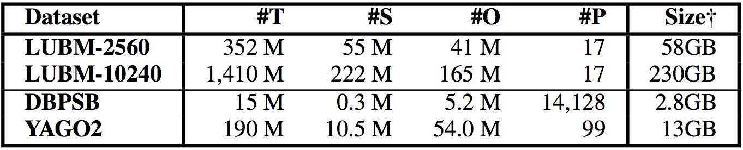
Evaluation
CPU
CPU
Server
RDMA
GPU
GPU
    Baseline: state-of-the-art systems
    Wukong, TriAD (distributed triple store)
    Platforms: 10 servers on a rack-scale 5-node cluster
    RDMA: Mellanox 56Gbps IB NIC, 40Gbps IB Switch
    Two servers run on a single machine
    Each server: 12-core Intel Xeon, 128GB DRAM,
    NVIDIA Tesla K40m (2880 cores, 12GB DRAM)
    Benchmarks
    Synthetic: LUBM
    Real-life: DBPSB, YAGO2
40Gbps IB Switch

Slide 49
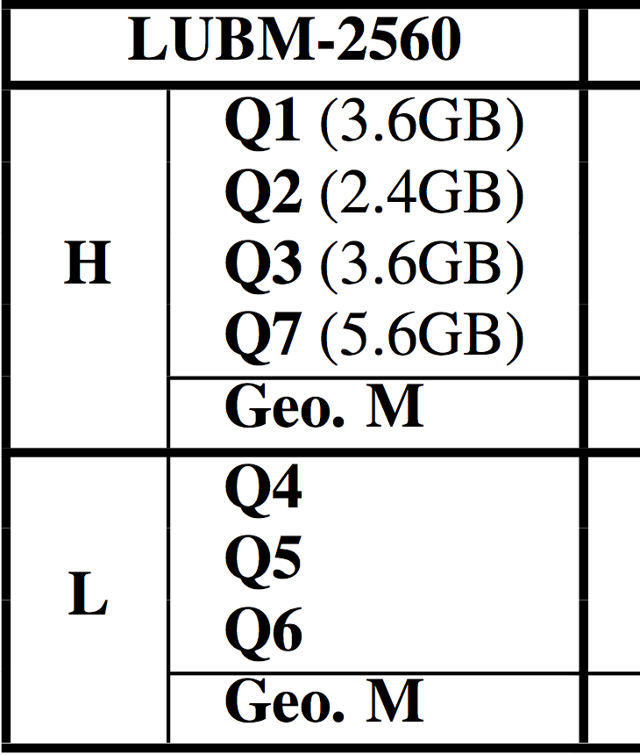
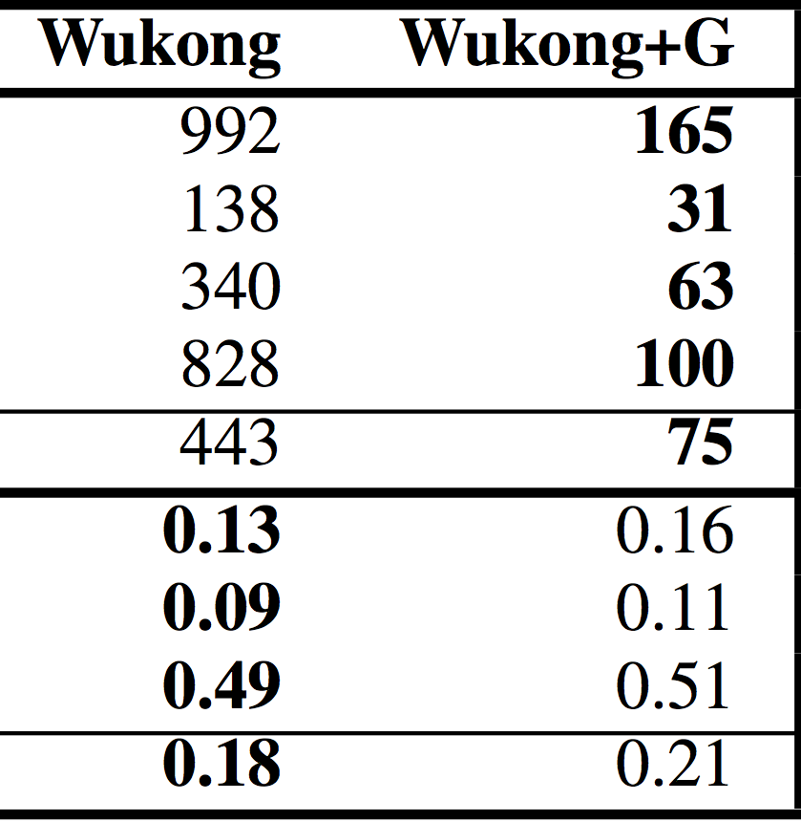
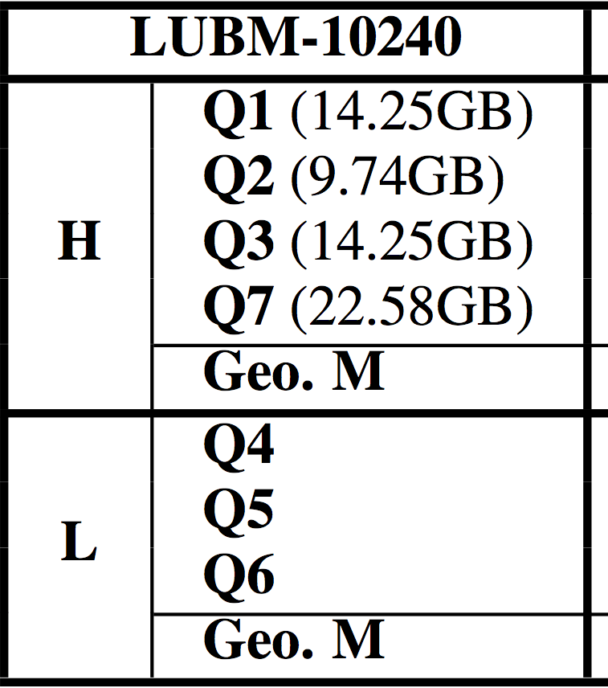
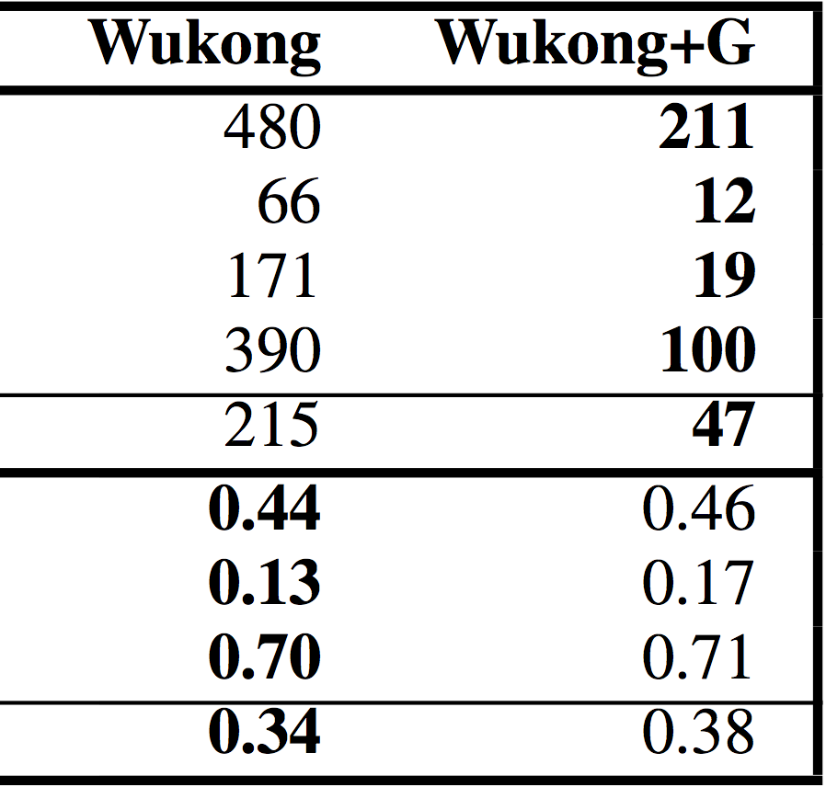
Single Query Latency (msec)
Heavy queries (Q1-Q3, Q7)
Light queries (Q4-Q6)
    Start from a set of vertices
    Touch a large part of graph
    Speedup: 2.3X~9X vs. Wukong
    Start from a given vertex
    Touch a small part of graph
    Negligible slowdown
single server
10-server cluster

Slide 50

Performance of Hybrid Workloads
    WKD (default)
    Heavy/Light: ALL of CPUs (10)
    WKI (Isolation)
    Heavy: HALF of CPUs (5)
    Light: HALF of CPUs (5)
    WKG (+G)
    Heavy: CPU (1) + GPUs (1)
    Light: REST of CPU (9)
    Workload: 6 classes of light queries + 4 classes of heavy queries

Slide 51
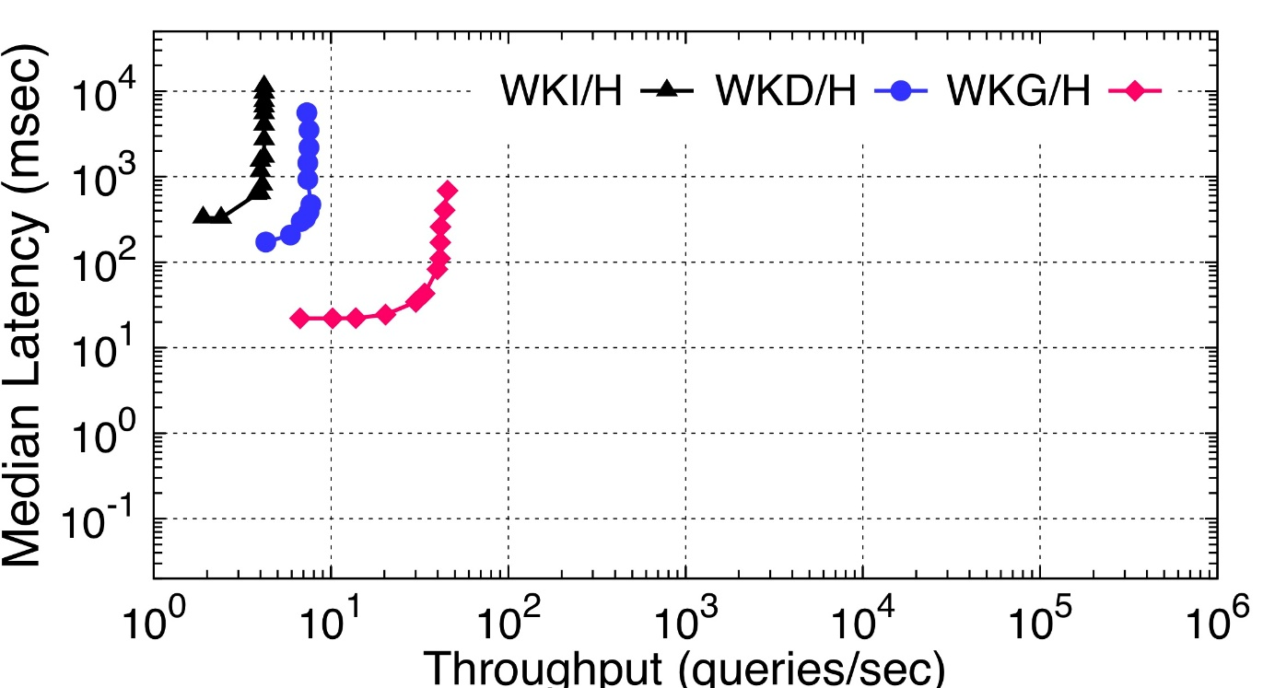
Performance of Hybrid Workloads
1.8x
5.7x
    WKD (default)
    Heavy/Light: ALL of CPUs (10)
1.9x
    WKI (Isolation)
    Heavy: HALF of CPUs (5)
    Light: HALF of CPUs (5)
7.8x
    WKG (+G)
    Heavy: CPU (1) + GPUs (1)
    Light: REST of CPU (9)
    Workload: 6 classes of light queries + 4 classes of heavy queries

Slide 52
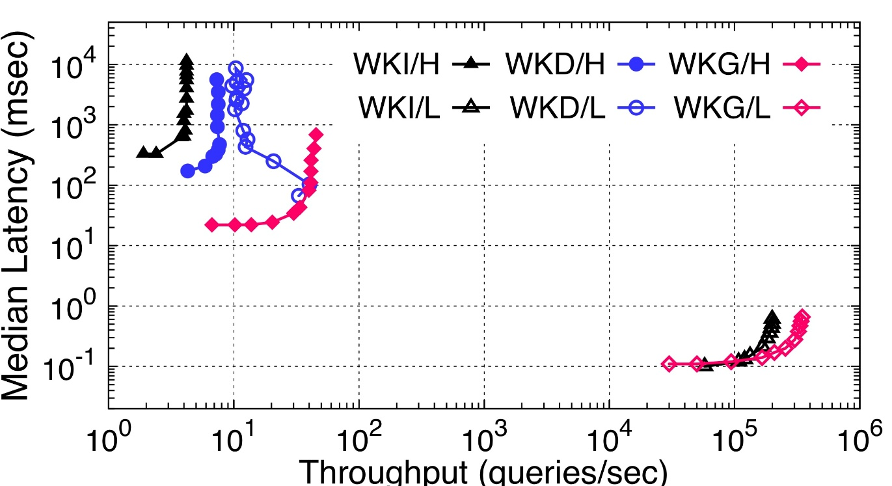
Performance of Hybrid Workloads
15,000x
1.7x
    WKD (default)
    Heavy/Light: ALL of CPUs (10)
    WKI (Isolation)
    Heavy: HALF of CPUs (5)
    Light: HALF of CPUs (5)
604x
    WKG (+G)
    Heavy: CPU (1) + GPUs (1)
    Light: REST of CPU (9)
    Workload: 6 classes of light queries + 4 classes of heavy queries

Slide 53

Conclusion
Hardware heterogeneity opens opportunities
for hybrid workloads on graph data
    : a distributed RDF query system supports heterogeneous CPU/GPU processing
    for hybrid queries on graph data
    Outperform prior state-of-the-art systems by more than one order of magnitude when facing hybrid workloads
Wukong+G
Website: http://ipads.se.sjtu.edu.cn/projects/wukong
GitHub: https://github.com/SJTU-IPADS/wukong

Slide 54


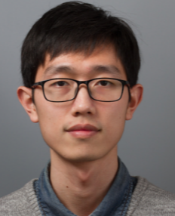

Thanks
Wukong+G
Questions
GitHub: https://github.com/SJTU-IPADS/wukong
Institute of Parallel and Distributed Systems
Shanghai Jiao Tong University

Slide 56
Distinguish Heavy & Light Queries
    Query plan optimizer
  Query plan: the order of triple patterns
  Using a cost-model to estimate the execution time of different plans for a given query
  For SPARQL query, cost model is roughly based on #paths may be explored
    Wukong+G uses a user-defined threshold for #paths to distinguish heavy and light queries

Slide 57
GPU Memory Size Limitation
    Too large predicate segment
  Load one part of segment to GPU memory
  Do traversal work
  Repeat 1 and 2
    Too large intermediate results
  Load one part of history table to GPU memory
  Do traversal work
  Repeat 1 and 2

Slide 58
Multi-GPUs Support
  Run a separate server for each GPU card and several co-located CPU cores (usually a socket)
  All servers comply with the same communication mechanism via GPUDirect RDMA operations
CPU
CPU
Server
RDMA
GPU
GPU
40Gbps IB Switch

Slide 59
Graph Analytics vs. Graph Query
 | Graph Analytics | Graph Query
Graph Model | Property Graph | Semantic (RDF) Graph
Working Set | A whole Graph | A small frac. of Graph
Processing | Batched & Iterative | Concurrent
Metrics | Latency | Latency & Throughput
Notes:
Compared to graph analytics (Pregel, GraphLab, GraphX), Graph query has several different features,
First, it models data as Semantic graph, like RDF ,rather than property graph.
Second, graph-query only touch a small fraction of the input graph.
Finally, it need to handle concurrent queries, and it cares about both latency and throughput.

Slide 60
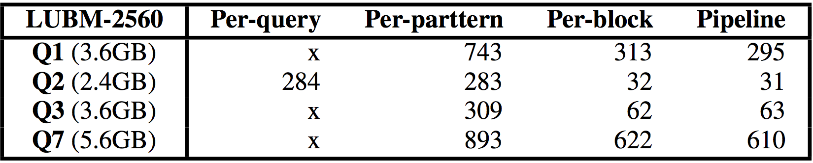
Factor Analysis of Improvement
    Single Server w/ 3GB GPU memory
    LUBM-2560

Slide 61
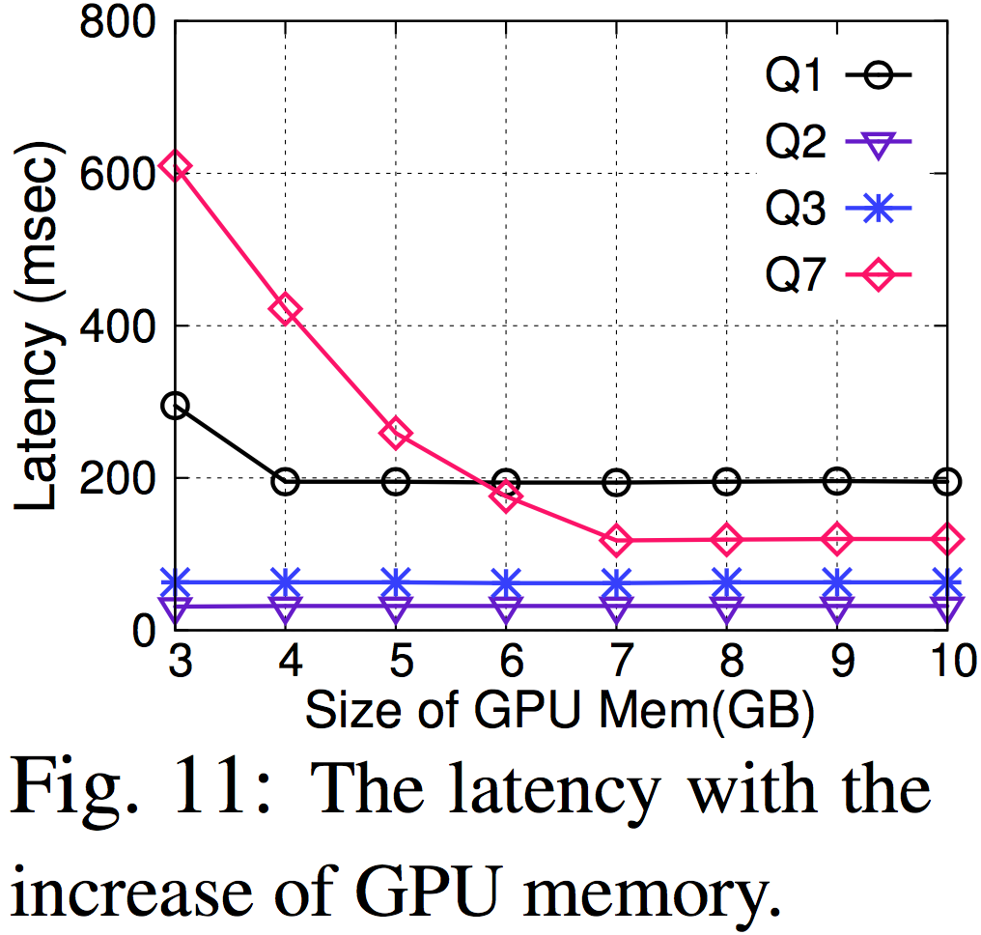
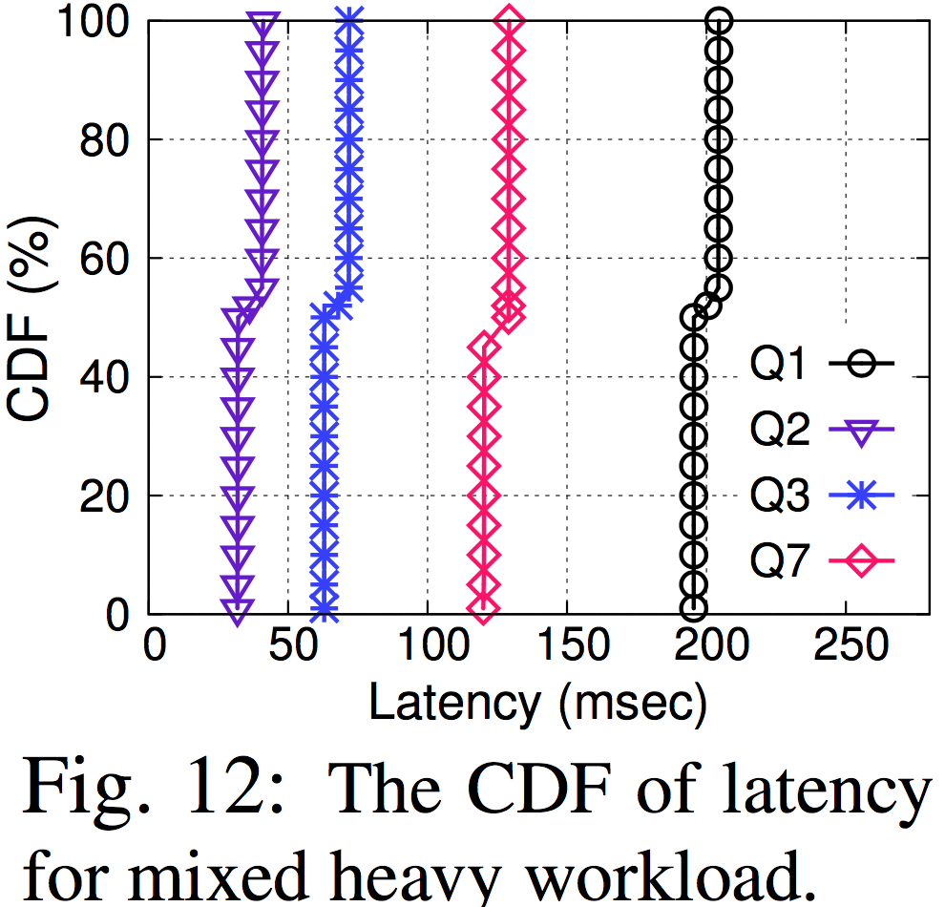
RDF Cache of GPU
    LUBM-2560
    10GB GPU Memory
    LUBM-2560

