Slide 1
Fast and Concurrent RDF Queries with RDMA-based Distributed Graph Exploration
JIAXIN SHI, YOUYANG YAO RONG CHEN, HAIBO CHEN
Institute of Parallel and Distributed Systems (IPADS)
Shanghai Jiao Tong University
FEIFEI LI
School of Computing
University of Utah
http://ipads.se.sjtu.edu.cn/projects/wukong
Notes:
Thanks for the introduction. It is my pleasure to present our work on improving the performance of RDF queries using advanced hardware features.
Which is a joint work with Youyang, and my advisors Rong and Haibo From IPADS, SJTU, as well as Feifei from Utah.

Slide 2
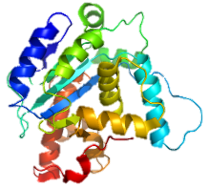
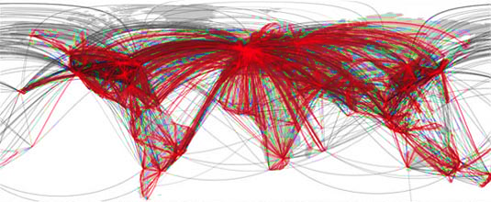
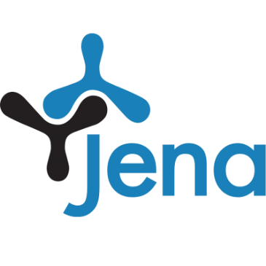
Graphs are Everywhere
Online graph query plays a vital role for searching, mining and reasoning linked data
TAO
Unicorn
Notes:
Graph structure is widely used to model linked data in many area, like social network, recommend systems, and biology.
Online graph query plays a vital role for searching, mining and reasoning such linked data.

Slide 3
Graph Analytics vs. Graph Query
 | Graph Analytics | Graph Query
Graph Model | Property Graph | Semantic (RDF) Graph
Working Set | A whole Graph | A small frac. of Graph
Processing | Batched & Iterative | Concurrent
Metrics | Latency | Latency & Throughput
Notes:
Compared to graph analytics, Like Cube and Gemini, Graph query has several different features,
First, it models data as Semantic graph, like RDF ,rather than property graph.
Second, graph-query only touch a small fraction of the input graph.
Finally, it need to handle concurrent queries, and it cares about both latency and throughput.

Slide 4
RDF and SPARQL
Resource Description Framework (RDF)
Representing linked data on the Web
Public knowledge bases: DBpedia, PubChemRDF, Bio2RDF
Google’s knowledge graph
Notes:
RDF is recommended to representing linked data for graph-query
And many public knowledge bases are represented as RDF graphs，like Dbpedia and google’s knowledge graph

Slide 5
RDF and SPARQL
mo: MemberOf
ad: ADvisor
to: TeacherOf
tc: TakeCourse
RDF is a graph composed by a set of
⟨Subject, Predicate, Object⟩ triples
to
Rong
DS
tc
Haibo | mo | IPADS
Haibo | to | OS
Jiaxin | ad | RONG
Jiaxin | tc | OS
Rong | mo | IPADS
Rong | to | DS
Xingda | ad | Haibo
. . .
triple
mo
Youyang
ad
Jiaxin
IPADS
tc
IPADS
OS
mo
Haibo
Haibo
to
tc
ad
Xingda
Notes:
So What is RDF? RDF is a graph composed by a set of subject, predicate, object triples,
Each triple expresses a relationship between the subject and the object
For example, this RDF dataset describe relationship among Teachers, Students, Courses and research groups

Slide 6
RDF and SPARQL
SPARQL is standard query language for RDF
variable
triple pattern
to
Rong
DS
tc
SELECT ?Y WHERE {
?X mo IPADS .
?X to ?Y .
}
mo
Youyang
ad
Jiaxin
IPADS
tc
constant
OS
mo
Haibo
to
Courses (?Y) taught by Teachers (?X) from IPADS
tc
ad
Xingda
Notes:
SPARQL is the standard query language for RDF dataset
It use a set of triple patterns to query the matching data
Element in Each triple pattern is either variable or constant.
For example, this sparql want to know all courses taught by teachers from IPADS.

Slide 7
RDF and SPARQL
SPARQL is standard query language for RDF
?X
?Y
variable
triple pattern
to
to
DS
Rong
DS
tc
Rong
SELECT ?Y WHERE {
?X mo IPADS .
?X to ?Y .
}
mo
Youyang
mo
ad
Jiaxin
IPADS
tc
IPADS
OS
constant
OS
mo
mo
Haibo
Haibo
to
to
Courses (?Y) taught by Teachers (?X) from IPADS
tc
ad
Xingda
Notes:
After querying the sample graph, we will get courses: OS and DS as the final result.

Slide 8
Existing Solutions
Triple Store and Triple Join
Store RDF data as a set of triples in RDBMS
Triple Store
SELECT ?X ?Y ?Z WHERE {
?X to ?Y .
?Z tc ?Y .
?Z ad ?X . }
①
Jiaxin | ad | Rong
Rong | mo | IPADS
.. | .. | ..
②
Node1
③
①
②
③
Haibo | mo | IPADS
Xingda | ad | Haibo
.. | .. | ..
N1
Node2
N2
?X ?Y ?Z
Triple Join
Notes:
there are two approaches adopted in existing state-of-the-art RDF systems. One is Triple-Store and Triple Join, it store and index RDF data as a set of triples in relational databases,
To handle SPARQL, it scan the triple store to generate a temporary table for each of the pattern.
After that, it use triple join to produce the final query result

Slide 9
Existing Solutions
Triple Store and Triple Join
Store RDF data as a set of triples in RDBMS
Triple Store
SELECT ?X ?Y ?Z WHERE {
?X to ?Y .
?Z tc ?Y .
?Z ad ?X . }
①
Costly distributed join
Large intermediate results
Jiaxin | ad | Rong
Rong | mo | IPADS
.. | .. | ..
②
Node1
③
①
②
③
Haibo | mo | IPADS
Xingda | ad | Haibo
.. | .. | ..
N1
Node2
N2
?X ?Y ?Z
Triple Join
Notes:
But This approach has limitations, it rely on costly distributed join ,
and it will generate large intermediate results.

Slide 10
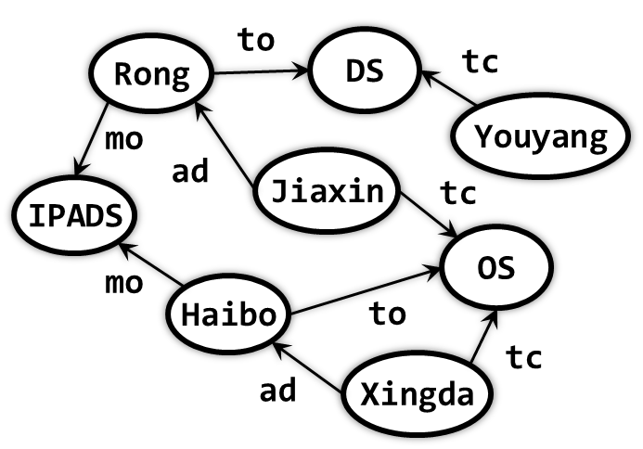
Existing Solutions
Graph Store and Graph Exploration
Store RDF data in a native graph model
Graph Store
SELECT ?X ?Y ?Z WHERE {
?X to ?Y .
?Z tc ?Y .
?Z ad ?X . }
①
Node1
②
?X ?Y ?Z
③
?X
?Y
?Y
?Z
?Z
?X
N1
①
②
Node2
N2
③
Final Join
One-step pruning
Notes:
Another approach is storing RDF data as native graph, and use graph exploration to process SPARQL queries.
For each query step, it starts from the known vertex set, do exploration through related edges,
Then synchronize with other machines to get the active vertex set for next query step.
But the X at last query step is not always matched with the X at first query step
Due to using one-step pruning. so it requires a final join to prune out non-matching results.

Slide 11
Existing Solutions
Graph Store and Graph Exploration
Store RDF data in a native graph model
Graph Store
SELECT ?X ?Y ?Z WHERE {
?X to ?Y .
?Z tc ?Y .
?Z ad ?X . }
①
Node1
Costly final join (90%)
Synchronized execution
②
?X ?Y ?Z
③
?X
?Y
?Y
?Z
?Z
?X
N1
①
②
Node2
N2
③
Final Join
One-step pruning
Notes:
The main limitations are costly final join and synchronized execution. sometimes the final join may take up more than 90% execution time.
And the synchronization after every step make system hard to handle concurrent queries.

Slide 12
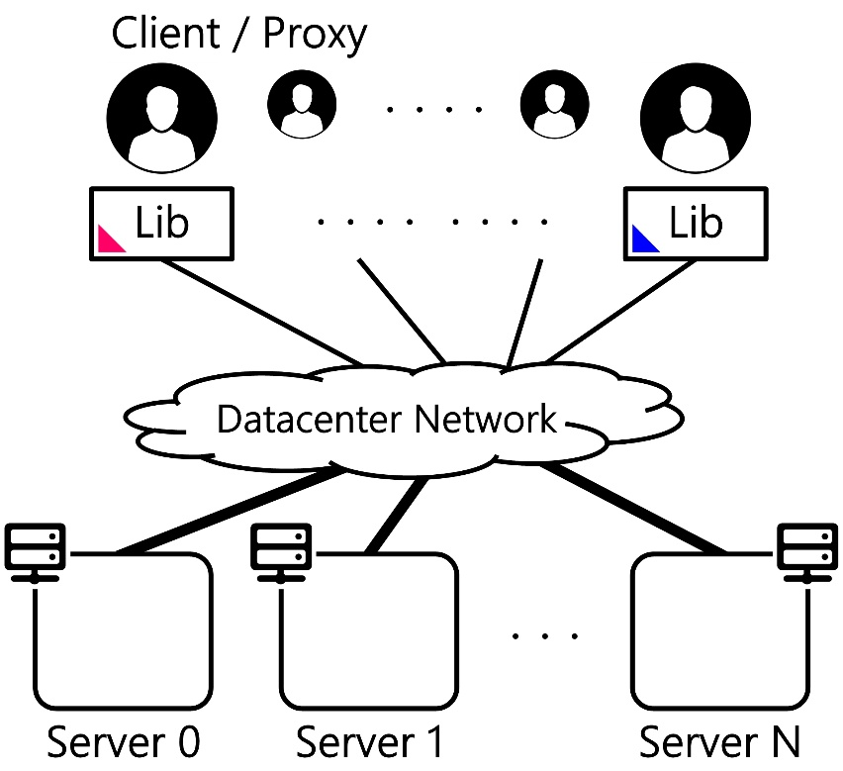
System Overview
: A distributed in-memory RDF store
Wukong
SPARQL queries
RDMA
Notes:
To address these problems, I will introduce Wukong, a distributed in-memory RDF store.
Clients send SPARQL queries to a machine in a cluster, which is connected by RDMA networks.

Slide 13
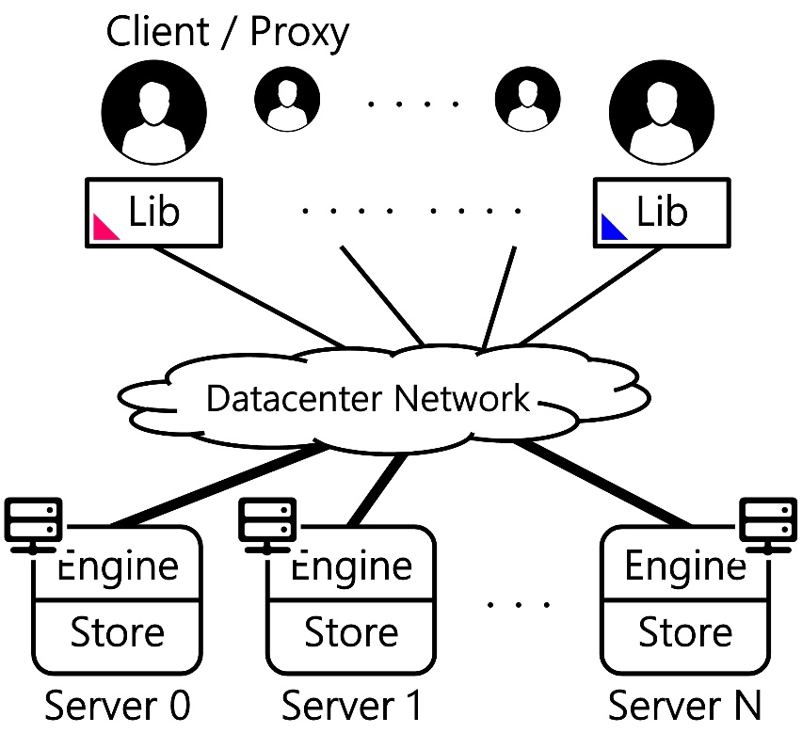
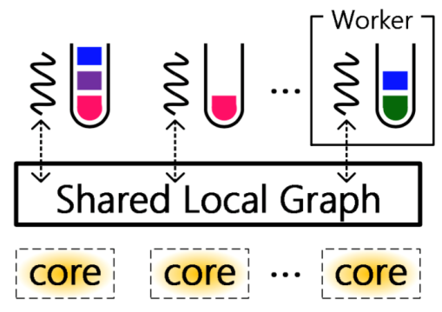
System Overview
: A distributed in-memory RDF store
Wukong
SPARQL queries
RDMA
Notes:
Each machine contains a query processing engine and a graph store. And employs a worker-thread model by running n worker threads on the shared graph, each worker thread executes a query at a time.

Slide 14
System Overview
: A distributed in-memory RDF store
Wukong
RDMA-friendly graph model
RDMA-based join-free graph exploration
Concurrent query processing
Results vs. state-of-the-art (TriAD/Trinity.RDF)
Latency: 11.9X – 28.1X reduction
Throughput: 269K queries/sec (up to 740X improvement)
Notes:
Wukong adopts a RDMA-friendly graph model and join-free graph exploration, to support fast and concurrent query, which outperform the state of the art by orders of magnitude for both latency and throughput.

Slide 15
Agenda
Graph-based Model & Store
Query Processing Engine
Evaluation
Notes:
(about 5 min)
I will start from the graph-based model and graph store

Slide 16
Graph Model and Indexes
Predicate index
tc
SELECT ?X ?Y
WHERE {
?X tc ?Y .
?X type Student .
}
DS
OS
SELECT ?X WHERE {
Jiaxin tc ?X .
}
tc
tc
tc
Jiaxin
Xingda
Student
Easy to start from a constant
Hard to query
w/o indexing
Course
Type index
Notes:
Wukong use a directed graph to model and store RDF data, just like traditional graph-based rdf store; Simple query that querying information of existing vertex is easy to handle by directly using graph-exploration.
However, for complex queries that doesn’t have any constant subject or object, or queries that want to find all vertices belongs to the same type, this simple directed graph is not enough, There is not any vertex we can start the exploration from.
To solve this problem, we add two types of index vertex: predicated indexes and type indexes, and they will point to corresponding subject and object. After that, we can handle complex query by starting the exploration from index vertex.

Slide 17
Differentiated Graph Partitioning
tc
SELECT ?X WHERE {
Jiaxin tc ?X .
}
DS
OS
Jiaxin
Xingda
Student
Start from normal vertex
Exploit locality
Course
SELECT ?X ?Y
WHERE {
?X tc ?Y .
?X type Student .
}
Start from index vertex
Exploit parallelism
Notes:
In distributed environment, these two types of queries have different requirement,
Simple query usually start from normal vertex, and only touch a small subset of input graph, which means that it require data locality to get better performance.
Complex query usually start from index vertex, and touch a very large subset of input graph, which means that it need parallelism instead of locality.

Slide 18
Differentiated Graph Partitioning
tc
SELECT ?X WHERE {
Jiaxin tc ?X .
}
DS
OS
Normal vertex : Distributed
Jiaxin
Xingda
Index vertex : Partitioned
Student
Start from normal vertex
Exploit locality
tc
tc
Course
DS
OS
OS
tc
tc
SELECT ?X ?Y
WHERE {
?X tc ?Y .
?X type Student .
}
Jiaxin
tc
Xingda
Course
Course
Student
Student
Start from index vertex
Exploit parallelism
Inspired by PoweLyra [Eurosys’15]
Notes:
Inspired by powerlyra, we choose differentiate mechanisms to partition rdf graph, to satisfied requirements of both types of queries.
First, we randomly assign normal vertices with all its edges to different machines, to achieve data locality for simple query.
Then we split all index vertices into different machines, and each index vertex only connect to local normal vertex, to achieve better parallelism for complex query.

Slide 19
Predicate-based KV Store
Vertex (S/O)
Predicate
to
DS
Direction
Rong
Rong
in
ad
Jiaxin
to
mo
…
Rong
out
mo
IPADS
to
DS
to
. . .
ad
IPADS
Jiaxin
SELECT ?X WHERE {
Rong to ?X .
}
constant
Inefficient lookup
Unnecessary data transfer
Notes:
Finally, we use KV-store to store the local graph, This is because that graph-query system is latency-centric, Kvstore is better choice compared with big arrays.
Intuitive solution is to store the data as in-edge lists and out-edge lists, and each element in the edge lists is predicate and vertex pair.
However, In most SPARQL, predicates are constant, For example, this query only want to know courses taught by Rong, but using intuitive solution，we still need to iterate over out-edge list of Rong to filter out useless data. This is inefficient , and at the same time, read kv pairs from remote machines will incur unnecessary data transfer.

Slide 20
Predicate-based KV Store
Vertex (S/O)
Predicate
to
DS
Direction
Rong
Rong
in
ad
Jiaxin
to
mo
…
Rong
out
mo
IPADS
to
DS
to
. . .
ad
IPADS
Jiaxin
SELECT ?X WHERE {
Rong to ?X .
}
Rong
ad
in
Jiaxin
Move predicate to key-side
Rong
mo
out
IPADS
constant
Rong
to
out
DS
. . .
Inefficient lookup
Unnecessary data transfer
Finer-grained vertex decomposition
Notes:
Based on this observation, we move the predicate from value-side to key-side, and split original kv pair into more fine-grained kv pairs.
To solve the query, we only need to read the third key-value pair， it’s much more efficient, and if in distributed environment, it can reduce the network overhead.

Slide 21
Agenda
Graph-based Model & Store
Query Processing Engine
Evaluation
Notes:
(about 9 min)
Next I will talk about our query processing engine.

Slide 22
Query Processing
The teacher advises the student
who also takes a course
taught by the teacher
to
Rong
DS
tc
mo
Youyang
ad
Jiaxin
IPADS
tc
SELECT ?X ?Y ?Z WHERE {
?X to ?Y .
?Z tc ?Y .
?Z ad ?X .
}
OS
mo
Haibo
to
tc
?Z
ad
Xingda
ad
tc
mo: MemberOf
ad: ADvisor
to: TeacherOf
tc: TakeCourse
?X
?Y
to
Notes:
This is the sample graph and we want to know all
teachers, courses and students such that the
Teacher advises the student who also takes a course taught by the teacher.

Slide 23
Observation
SELECT ?X ?Y ?Z WHERE {
?X to ?Y .
?Z tc ?Y .
?Z ad ?X . }
①
Costly final join (90%)
Synchronized execution
②
?X
?Y
?Y
?Z
?Z
?X
③
N1
①
②
N2
③
Final Join
One-step pruning
Notes:
Existing systems use one-step pruning to handle sparql query.
Even though one-step pruning can save the network bandwidth,
It require final-join and synchronized execution

Slide 24
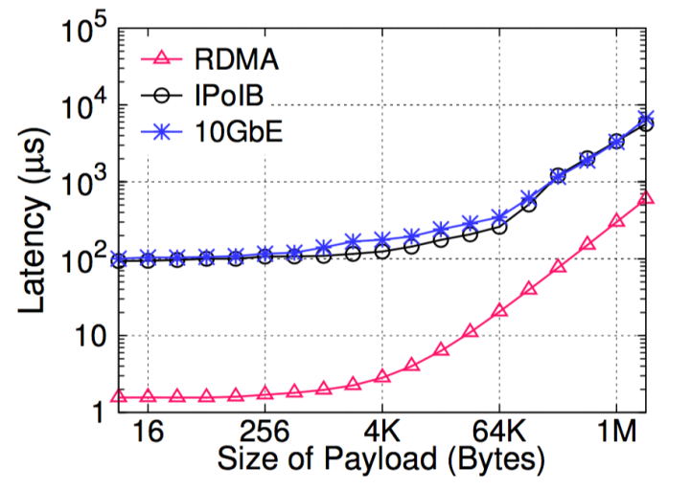
Observation
SELECT ?X ?Y ?Z WHERE {
?X to ?Y .
?Z tc ?Y .
?Z ad ?X . }
Costly final join (90%)
Synchronized execution
?X
?Y
?Y
?Z
?Z
?X
N1
①
②
N2
③
Final Join
One-step pruning
the latency of RDMA is relatively insensitive to payload sizes (~2K)
e.g. 8B/1.56μs vs. 2KB/2.25μs
Graph exploration w/ full-history pruning
Notes:
At the same time, RDMA has an interesting feature that
the cost of RDMA operations is insensitive to the payload size when it is smaller than a certain size.
Based on this observation, Wukong adopts a full-history pruning approach such that Wukong passes the full exploration history to the next step, to fully remove final-join and synchronization.

Slide 25
Full-History Pruning
SELECT ?X ?Y ?Z WHERE {
?X to ?Y .
?Z tc ?Y .
?Z ad ?X . }
Query
Query
to
to
Parallel execution on predicate index
to
DS
Rong
Youyang
mo
tc
ad
Jiaxin
tc
IPADS
mo
to
Haibo
OS
ad
tc
Xingda
Notes:
I will introduce how wukong use Full-history pruning to handle sparql.
The execution is parallelly started from the teacherof predicate index at different machines.
Let’s first focus on machine 1.

Slide 26
Full-History Pruning
SELECT ?X ?Y ?Z WHERE {
?X to ?Y .
?Z tc ?Y .
?Z ad ?X . }
Full-history
to
to
Rong
H:Rong
to
to
DS
Rong
Youyang
mo
tc
ad
Jiaxin
DS
H:Rong DS
tc
IPADS
mo
to
Haibo
OS
tc
ad
tc
Youyang
H:Rong DS Youyang
Xingda
ad
Notes:
Machine 1 will explore to Rong using predicate index, and record the Full-History of this processing. Next step is DS, then Youyang, and the size of History is keep increasing. but when this query is locally executed, it will not result in network traffic.
Since Youyang doesn’t have any advisor, so this result is pruned out.

Slide 27
Full-History Pruning
SELECT ?X ?Y ?Z WHERE {
?X to ?Y .
?Z tc ?Y .
?Z ad ?X . }
Full-history
to
to
Rong
H:Rong
Haibo
H:Haibo
to
to
to
DS
Rong
Youyang
mo
tc
ad
Jiaxin
DS
H:Rong DS
OS
H:Haibo OS
tc
IPADS
mo
to
Haibo
OS
tc
tc
ad
tc
Youyang
H:Rong DS Youyang
Jiaxin
H:Haibo OS Jiaxin
Haibo OS Xingda
Xingda
Xingda
ad
Jiaxin
H:Haibo OS Jiaxin
ad
ad
Haibo OS Xingda Haibo
Haibo
Rong
Haibo OS Jiaxin Rong
Notes:
Similarly, machine 2 will explore to Haibo, OS, Jiaxin and Xingda, and the size of full-history is keep increasing.
Then it find that Xingda has an advisor Haibo, and it’s matched with haibo at first query step, accroding to the Full-History, so this result is valid.
Jiaxin is not a local vertex, its edge data is in machine 1, so we need to send this query with Full-history to machine 1 , to continue the execution.
Finally, We explore to Rong, and find that Rong is not matched with haibo at first query step, so this result is pruned out. Thanks to the full-history, it doesn’t need to synchronize with machine 2 .

Slide 28
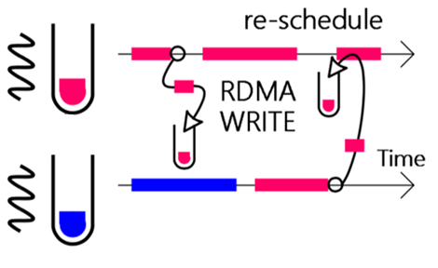
Migrate Execution or Data
Fork-join (migrate exec)
Send sub-query by RDMA WRITE
Async exploration w/ full-History
Exploit parallelism
Notes:
As previously described, when accessing remote vertex, we will split current queries into sub-queries, and use RDMA WRITE to directly write sub-queries and corresponding Full-History to remote machine. After remote machine finish its current work, it will recv this sub-query , execute it , then reply back to original machine.
We call this Fork-join mode, it will use more CPU to handle one query, to achieve better parallelism, which is critical for complex query.
However, sending query to remote machine is not always the best choice.
remote machine may be busy and cannot response immediately, which will cause long latency, especially for simple query which start from normal vertex.

Slide 29
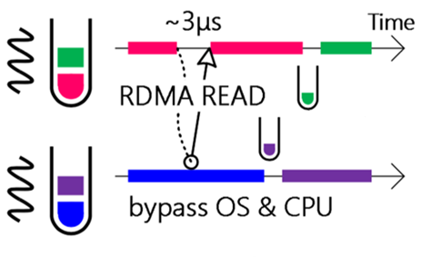
Migrate Execution or Data
Fork-join (migrate exec)
In-place (migrate data)
Dynamic switch at runtime
Send sub-query by RDMA WRITE
Async exploration w/ full-History
Exploit parallelism
Fetch data by RDMA READ
Bypass remote CPU & OS
Exploit low latency
Notes:
To address this problem , we have In-place execution mode, which means using RDMA READ to read remote KV pairs, and continue to execute query at local machine.
it can totally bypass remote CPU, and provide very low latency.
We will choose execution mode at runtime based on the number of RDMA operations

Slide 30
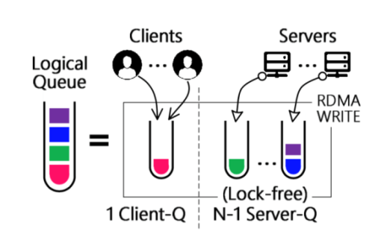
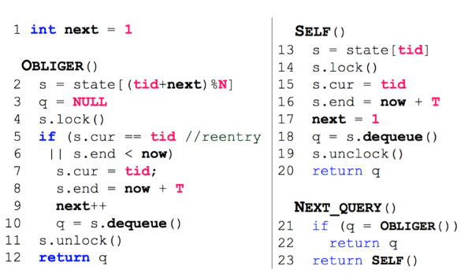
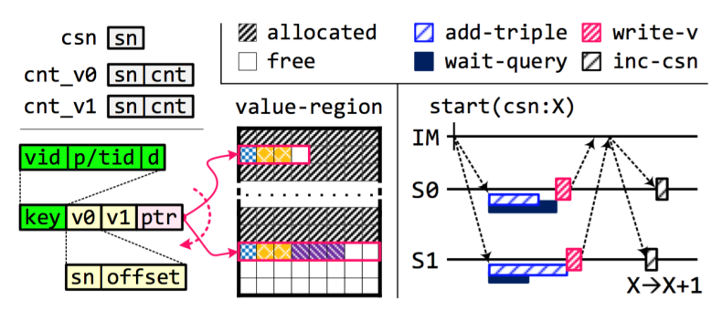
Other Designs of Wukong
Logical task queues
Multi-threading large-query
Latency-centric work stealing
Support Evolving graph
Notes:
For other designs of Wukong, such as how to support evolving graph.
You can refer our paper for more details.

Slide 31
Agenda
Graph-based Model & Store
Query Processing Engine
Evaluation
Notes:
(about 14 min)
Here is the evaluation part.

Slide 32
Evaluation
10xCore
10xCore
56GBps IB NIC
Baseline: state-of-the-art systems
Centralized: RDF-3X, BitMat
Distributed: TriAD, Trinity.RDF, SHARD
Platforms: a rack-scale 6-machine cluster
Each: two 10-cores Intel Xeon, 64GB DRAM, Mellanox 56Gbps InfiniBand NIC w/ RDMA¹
Benchmarks
Synthetic: LUBM, WSDTS
Real-life: DBPSB, YAGO2
RDMA
40Gbps IB Switch
¹ All machines run Ubuntu 14.04 with Mellanox OFED v3.0-2.0.1 stack.
Notes:
We compare Wukong with state-of-the-art systems on popular Synthetic and Real-life benchmarks.
All experiments are conducted on at a 6-node local cluster with RDMA-enable networking.

Slide 33
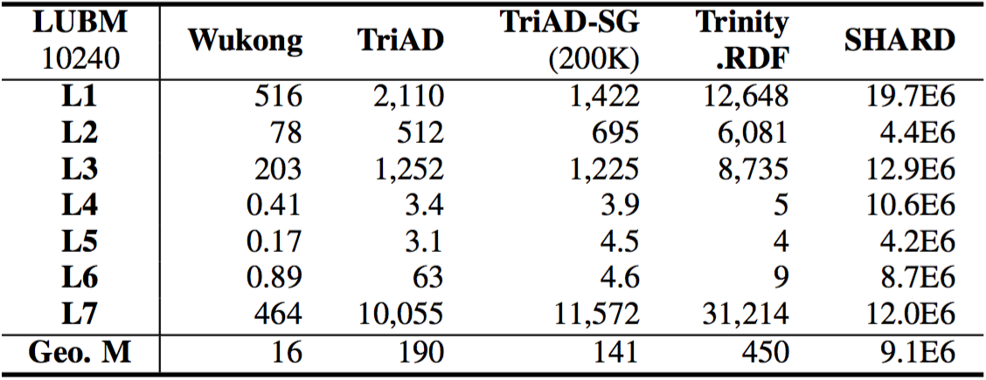
Single Query Latency (msec)
Group I (L1-3,7): large queries
Group II (L4-6): small queries
Start from index vertex
Touch a large subset of graph
Speedup: 4.1X - 21.7X
Start from normal vertex
Touch a small subset of graph
Speedup: 8.4X – 70.6X
Outperform state-of-the-art systems (Geometric Mean)
vs. Trinity.RDF: 28.1X
vs. TriAD: 11.9X
Notes:
We first show our single query performance compared with other systems.TriAD is the state of art Join-based rdf store and Trinity.RDF is the state of art graph-based rdf store. Overall, Wukong can get more than 10 times speedup compared to existing systems.
queries L1,2,3,7 are large queries that Start from index vertex and touch a large subset of input graph , wukong can achieve up to 21 times speed up due to Diff. Partition & Full-History
queries L4-6 are small queries that Start from normal vertex and only touch a small subset of the input graph, wukong can achieve up to 70.6 times speed up due to In-place mode & Predicated Based Store

Slide 34
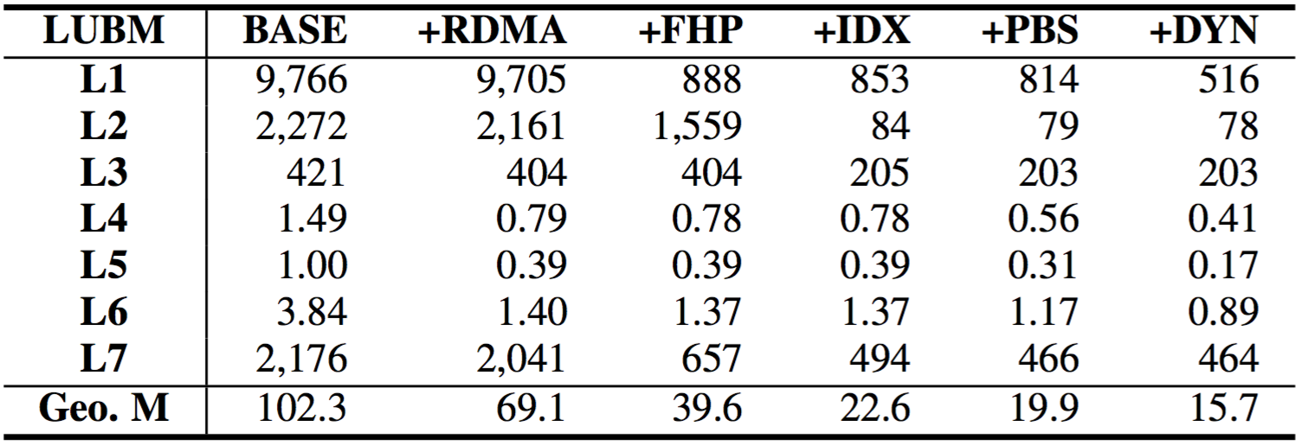
Factor Analysis of Improvement (msec)
BASE
Graph-exploration
One-step pruning
Comm. w/ TCP/IP
+PBS
Predicate-base fine-grained Store
+FHP
Full-history pruning
+IDX
Index vertex
Diff. partitioning
+DYN
In-place execution
Dynamic switching
+RDMA
Comm. w/ RDMA
Notes:
We further conduct experiments to analyse the improvement.
This is the base performance using graph-exploration and one-step pruning without RDMA
Simply add RDMA as faster network doesn’t improve the performance of large query, since the main bottleneck is final join
After using Full-history pruning, the bottleneck of final join is removed .
After add Index vertex and Differentiated partitioning, large query can get more parallelism.
Finally, after we add predicate-base kv store and dynamic mode switch, the small query get a lot of improvement

Slide 35
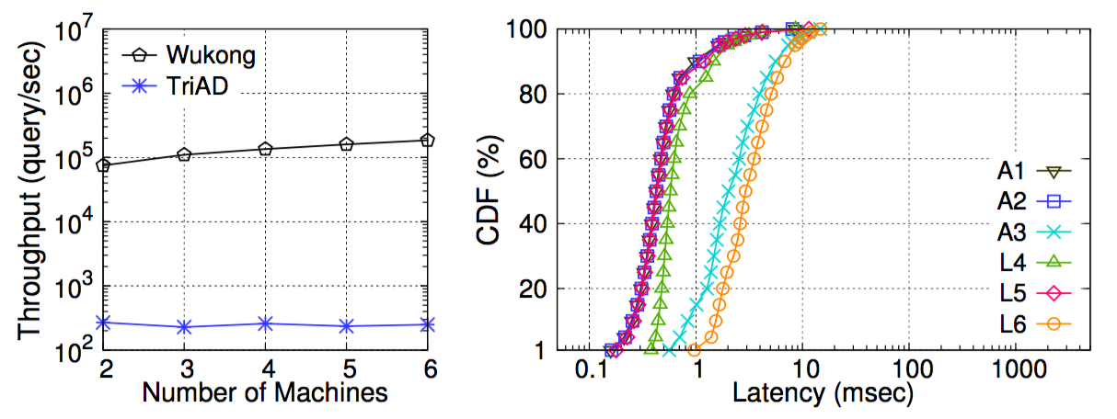
Throughput of Mixed Workloads
Mixed workload: 6 classes of small queries¹
50th: 0.80 ms
99th: 5.90 ms
269K queries/sec
278~740X
¹ The templates of 6 classes of queries are based on group (II) queries (L4, L5 and L6) and three additional queries from official website (A1, A2 and A3).
Notes:
Finally, we evaluate the throughput of mixed workloads;
Thanks to the in-place execution mode, every thread can handle query by itself,
which makes wukong scales very well.
Throughput of wukong is orders of magnitude higher than other systems,
since they cannot handle concurrent queries well.
At the same time, wukong has very low latency, most of queries can finished in 10 minisecond

Slide 36
Conclusion
Poster Session (Thu. Nov. 3)
Wukong+S: Streaming Meets Querying on RDF Streams
New hardware technologies open opportunities
: a distributed in-memory RDF store that leverages RDMA-based graph exploration to support fast and concurrent RDF queries
Achieving orders-of-magnitude lower latency & higher throughput than prior state-of-the-art systems
Wukong
http://ipads.se.sjtu.edu.cn/projects/wukong
Notes:
In conclusion , advanced hardware-features such as RDMA opens up new space for us to improve the performance of Graph-query systems, and Wukong’s design can achieve orders-of-magnitude lower latency & higher throughput than prior state-of-the-art systems
The source code of wukong is available at our group website.
That’s all.
Thanks you for your listening.

Slide 37
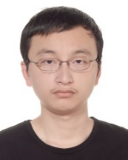
Thanks
Wukong, short for Sun Wukong, who is known as the Monkey King and is a main character in the Chinese classical novel “Journey to the West”. Since Wukong is known for his extremely fast speed (21,675 kilometers in one somersault) and the ability to fork himself to do massive multi-tasking, we term our system as Wukong.
Questions
http://ipads.se.sjtu.edu.cn/projects/wukong

Slide 38
Backup

Slide 39
Predicate-based KV Store
Vertex (S/O)
Predicate
to
DS
Direction
Rong
to
mo
…
Rong
predicate
in
ad
ad
IPADS
Jiaxin
Rong
predicate
out
mo
to
SELECT ?X ?Y WHERE {
Rong ?X ?Y .
}
Rong
ad
in
Jiaxin
Rong
mo
out
IPADS
Rong
to
out
DS
. . .

Slide 40
Planner
Wukong
Manually select exploration order
In-progress
project
1. Prepare statistic data at initialization
2. Estimate size of Full-History
using different order
3. Choose best order

Slide 41
Student as normal vertex
type
Start at Student
No parallelism
DS
OS
Jiaxin
Xingda
Start at type
Will exploration to 4 vertices at first step
type
type
type
Student
type
SELECT ?X ?Y
WHERE {
?X type Student .
?X tc ?Y .
}
Course

Slide 42
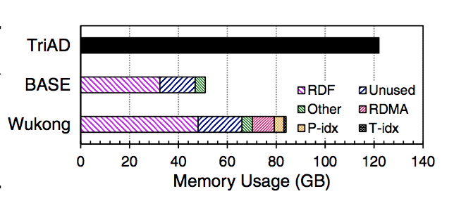
Memory
Notes:
Triple stores rely on redundant six primary SPO permutation indexes

