Slide 1
Replication-based Fault-tolerance for Large-scale Graph Processing
Peng Wang, Kaiyuan Zhang, Rong Chen, Haibo Chen, Haibing Guan
Shanghai Jiao Tong University

Slide 2
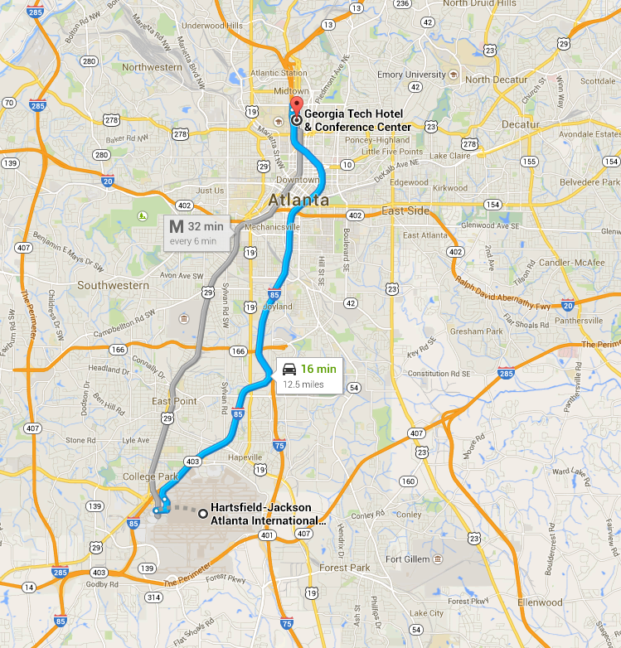
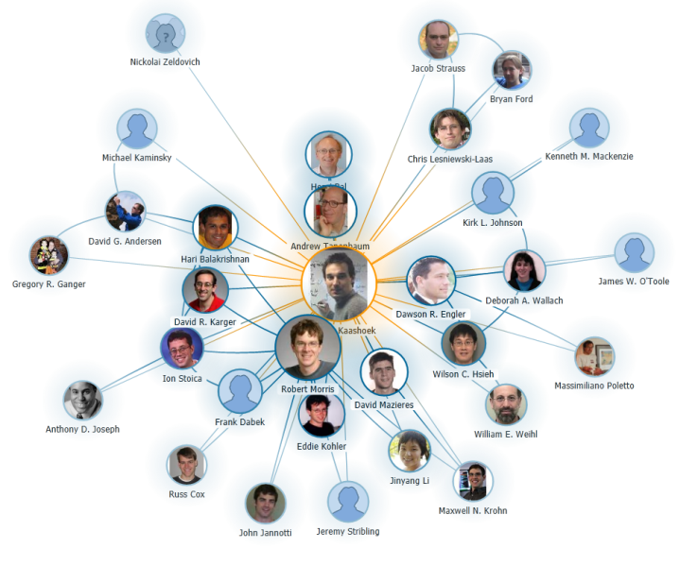
Graph
Useful information in graph
Many applications
SSSP
Community Detection
……

Slide 3
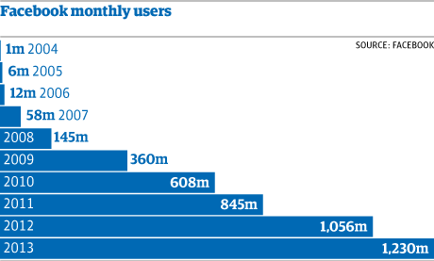
Graph computing
Graphs are large
Require a lot of machines
Fault tolerance is important

Slide 4
How graph computing works
LoadGraph
LoadGraph
PageRank(i)
// compute its own rank
total = 0
foreach ( j in in_neighbors(i)) :
total = total + R[j] * W_{ji}
R[i] = 0.15 + total
// trigger neighbors to run again
if R[i] not converged then
activate all neighbors
Compute
Compute
SendMsg
SendMsg
EnterBarrier
Commit
Commit
LeaveBarrier
2
2
1
Master
1
1
1
1
Replica
3
3
W1
W2

Slide 5
Related work about fault tolerance
Simple re-execution (MapReduce)
Complex data dependency
Coarse-grained FT (Spark)
Fine-grained update on each vertex
State-of-the-art fault tolerance for graph computing
Checkpoint
Trinity, PowerGraph, Pregel, etc.

Slide 6
How checkpoint works
global barrier
checkpoint
recovery
Loading Graph
Iter X
Iter X+1
Recovery
W1
1
3
5
7
2
6
1
5
1
5
W2
3
2
4
6
1
4
6
4
6
Crash
DFS
Partition && Topology
Iter X

Slide 7
Problems of checkpoint
Large execution overhead
Large amount of states to write
Synchronization overhead
PageRank on LiveJournal
Execution time (sec)
Checkpoint period

Slide 8
Problems of checkpoint
Large overhead
Slow recovery
A lot of I/O operations
Require standby node
Second
w/o CKPT
Checkpoint Period

Slide 9
Observation and motivation
Reuse existing replicas to provide fault tolerance
Reuse existing replicas → small overhead
Replicas distributed in different machines → fast recovery
Vertices without replica
Almost all the vertices have replicas
0.84%
0.96%
0.26%
0.13%

Slide 10
Contribution
Imitator: a replication based fault tolerance system for graph processing
Small overhead
Less than 5% for all cases
Fast recovery
Up to 17.5 times faster than the checkpoint one

Slide 11
Outline
Execution flow
Replication management
Recovery
Evaluation
Conclusion

Slide 12
Normal execution flow
LoadGraph
LoadGraph
Adding FT support
Extending normal synchronization message
Compute
Compute
SendMsg
SendMsg
EnterBarrier
Commit
Commit
LeaveBarrier

Slide 13
Failure before barrier
LoadGraph
LoadGraph
Compute
Compute
Compute
Crash
SendMsg
Newbie joins
SendMsg
SendMsg
EnterBarrier
enterBarrier
EnterBarrier
Rollback && Recovery
Recovery
Commit
Commit
Commit
LeaveBarrier
LeaveBarrier

Slide 14
Failure during barrier
LoadGraph
LoadGraph
Compute
Compute
Compute
SendMsg
Newbie boot
SendMsg
SendMsg
EnterBarrier
leaveBarrier
EnterBarrier
Crash
Recovery
Commit
Commit
Commit
LeaveBarrier
LeaveBarrier
Recovery

Slide 15
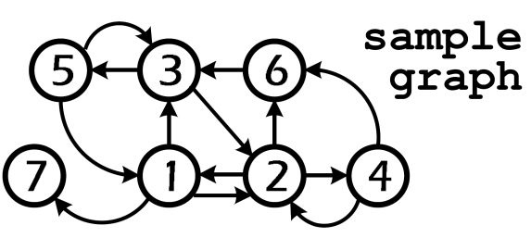
Management of replication
Fault tolerance replicas
every vertex has at least f replicas
to tolerate f failures
Full state replica (mirror)
Existing replica lacks meta information
Such as replication location
Master
Node1
Replica
5
1
7
2
4
6
Node2
4
2
1
7
5
3
Vertex: 5
Master: n2
Replicas: n1 | n3
Node3
1
3
5
4
6
2

Slide 16
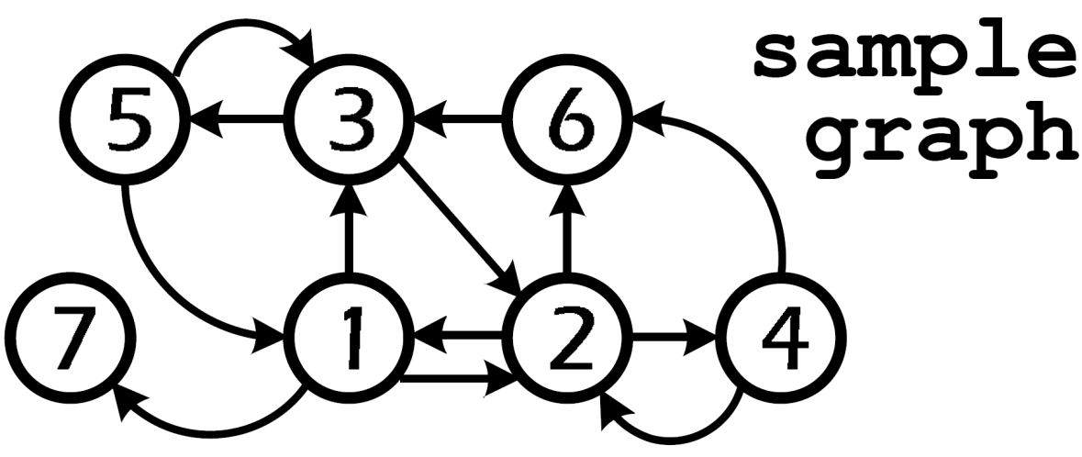
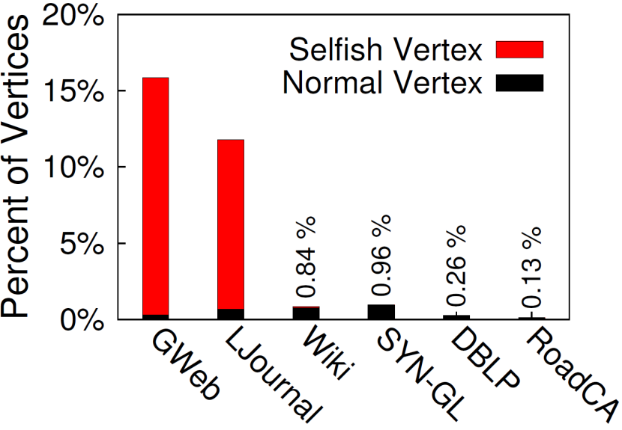
Optimization: selfish vertices
States of selfish vertices have no consumer
Their states may only decided by their neighbors
Opt: get their states by re-computation

Slide 17
How to recover
Challenges
Parallel recovery
Consistent state after recovery

Slide 18
Problems of recovery
Crash
Master
1
5
1
7
4
2
1
1
3
5
Mirror
1
2
4
6
7
5
3
4
6
2
Replica
1
Node1
Node2
Node3
Which vertices have crashed?
How to recover without a central coordinator?
Rules:
1. Master recovers replicas
2. If master crashed, mirror recovers master and replicas
Replication Location
Vertex 3:
Master: n3
Mirror: n2

Slide 19
Rebirth
Crash
Master
1
5
1
7
4
2
1
1
3
5
Mirror
1
2
4
6
7
5
3
4
6
2
Replica
1
Node1
Node2
Node3
5
1
1
7
4
2
2
1
2
4
4
6
6
7
5
5
3
3
Node1
Newbie3
Node2
Rule:
1. Master recovers replicas
2. If master crashed, mirror recovers master and replicas

Slide 20
Problems of Rebirth
Standby machine
A single newbie machine
Migrate tasks to surviving machines

Slide 21
Migration
Crash
Master
1
5
1
7
4
2
1
1
3
5
Mirror
1
2
4
6
7
5
3
4
6
2
Replica
1
Node1
Node2
Node3
5
1
7
4
2
1
2
4
6
6
7
5
3
Node2
Node1
Procedure:
1. Mirrors upgrade to masters and broadcast
2. Reload missing graph structure and reconstruct

Slide 22
Inconsistency after recovery
Compute
Compute
Replica 2 on W1
Rank
Activated | false
Master 2 on W2
Rank | 0.1
Activated
0.1
0.2
true
SendMsg
SendMsg
false
EnterBarrier
2
2
Commit
Commit
1
1
LeaveBarrier
3
3
W1
W2

Slide 23
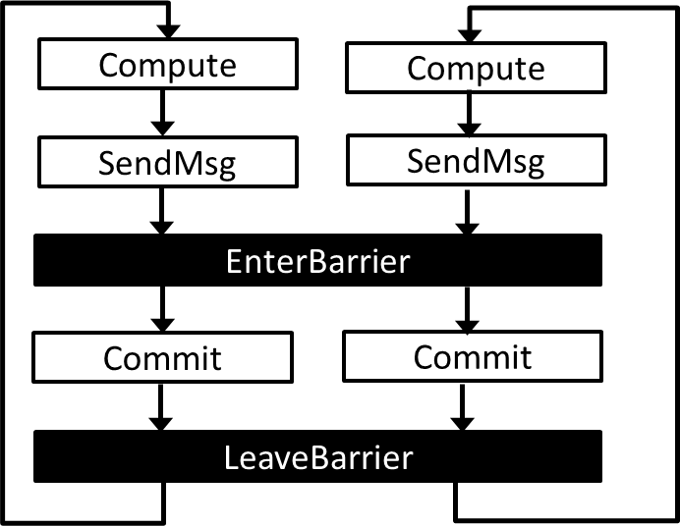
Replay Activation
Replica 2 on W1
Rank
Activated | false
Master 2 on W2
Rank | 0.1
Activated
0.1
0.2
false
true
2
2
1
1
Master 1 on W1
Rank | 0.2
Activated | false
ActNgbs | true
Replica 1 on W2
Rank
Activated | false
ActNgbs
0.2
3
3
0.4
W1
W2
true
false

Slide 24
Evaluation
50 VMs (10G memory 4cores)
HDFS (3 Replications)
Applications
Application | Graph | Vertices | Edge
PageRank | GWeb | 0.87M | 5.11M
 | LJournal | 4.85M | 70.0M
 | Wiki | 5.72M | 130.1M
ALS | SYN-GL | 0.11M | 2.7M
CD | DBLP | 0.32M | 1.05M
SSSP | RoadCA | 1.97M | 5.53M

Slide 25
Speedup over Hama
Imitator is based on Hama, a open source clone of Pregel
Replication for dynamic computing [Distributed Graphlab, VLDB’12]
Evaluated systems
Baseline: Imitator without fault tolerance
REP: Baseline + Replication based FT
CKPT: Baseline + Checkpoint based FT

Slide 26
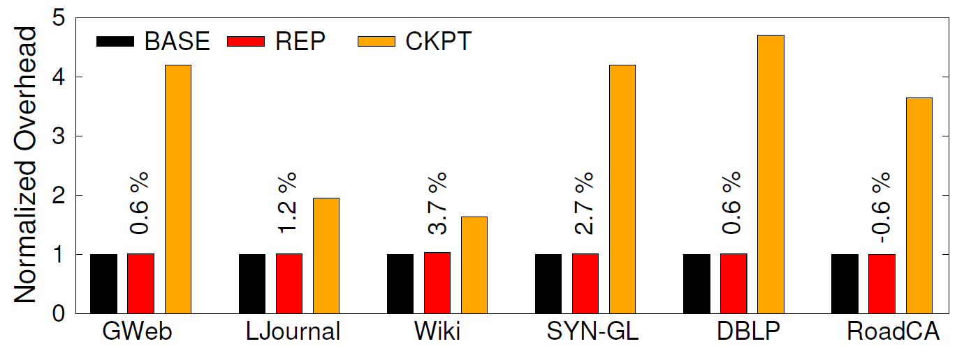
Normal execution overhead
Replication has negligible execution overhead

Slide 27
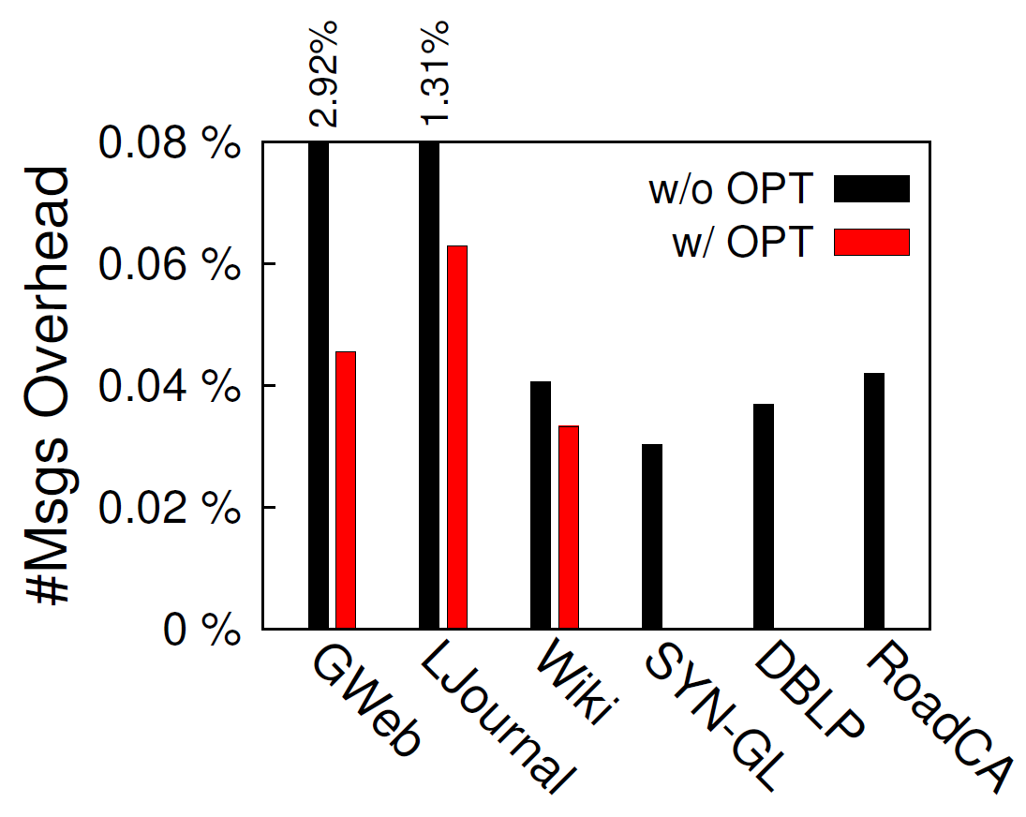
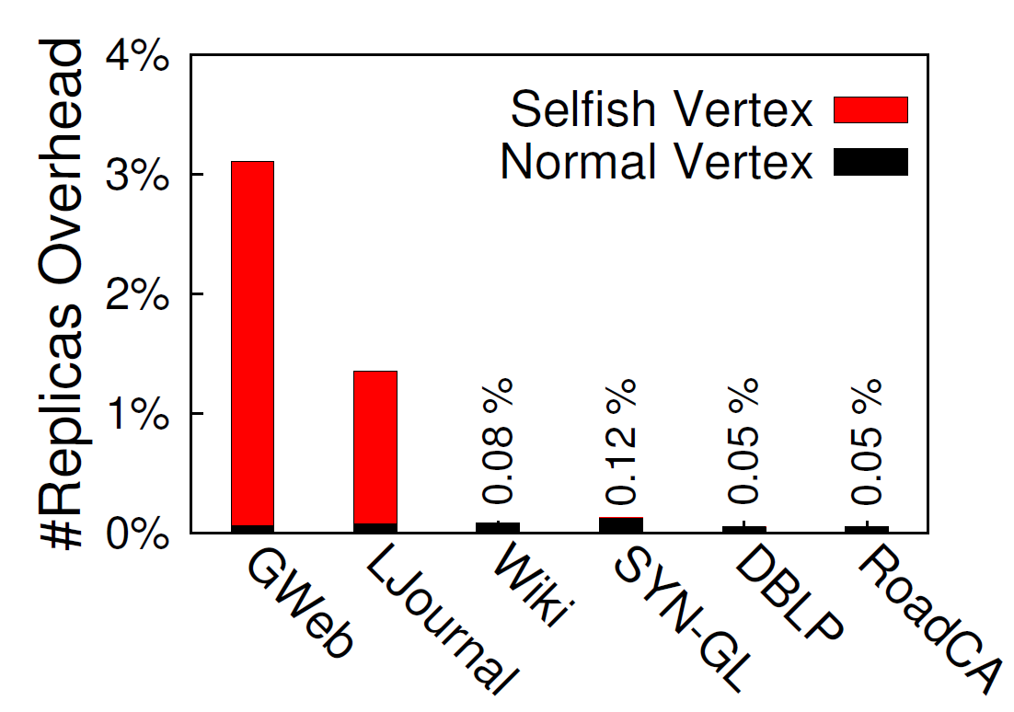
Communication Overhead

Slide 28
Performance of recovery
Execution Time (Second)
41
56

Slide 29
Recovery Scalability
Recovery Time (Second)
The more machines, the faster the recovery

Slide 30
Simultaneous failure
Execution Time (Second)
Add more replicas to tolerate more than 1 machines simultaneous failure

Slide 31
Case study
Finished iterations
2.6
8.8
45
Replay
Detect Failure
Execution time (Second)
Application: PageRank on the dataset of LiveJournal
A checkpoint for every 4 iterations
A Failure is injected between the 6th iteration and the 7th iteration

Slide 32
Conclusion
Imitator: a graph engine which supports fault tolerance
Imitator’s execution overhead is negligible because it leverages existing replicas
Imitator’s recovery is fast because of its parallel recovery approach
Notes:
You are welcome to raise any question!

Slide 33
Backup

Slide 34
Memory Consumption

Slide 35
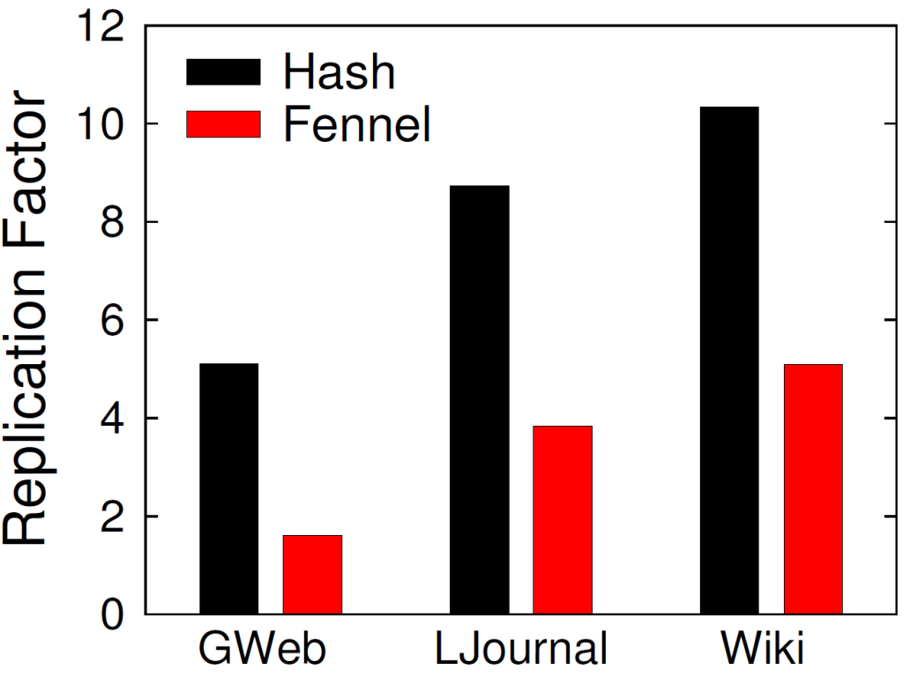
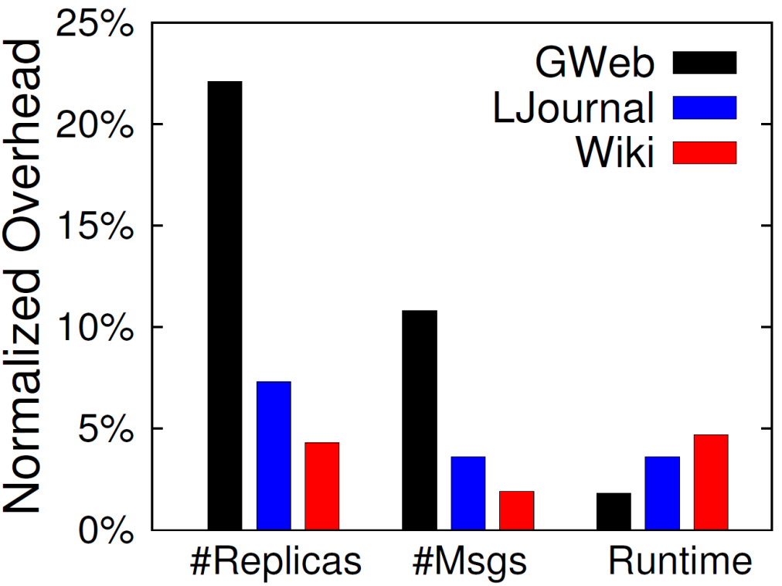
Partition Impact

