Slide 1


DrTM
Fast In-memory Transaction Processing using RDMA and HTM
XINDA WEI, JIAXIN SHI, YANZHE CHEN,
RONG CHEN, HAIBO CHEN
Institute of Parallel and Distributed Systems
Shanghai Jiao Tong University, China

Slide 2



Transaction: Key Pillar for Many Systems
$9.3 billion/day
Demand Speedy Distributed Transaction
Over Large Data Volumes
9.56 million tickets/day
11. 6 million payments/day

Slide 3
High COST for Distributed TX
    Many scalable systems have low performance
    Usually 10s~100s of thousands of TX/second
    High COST¹ (config. that outperform single thread)
    e.g., HStore, Calvin^{SIGMOD’12}
    Emerging speedy TX systems not scale-out
    Achieve over 100s of thousands TX/second
    e.g., Silo^{SOSP’13}, DBX^{EuroSys’14}
Dilemma:
single-node perf. vs. scale-out
¹ Salability! But at what Cost? HotOS 2015

Slide 4
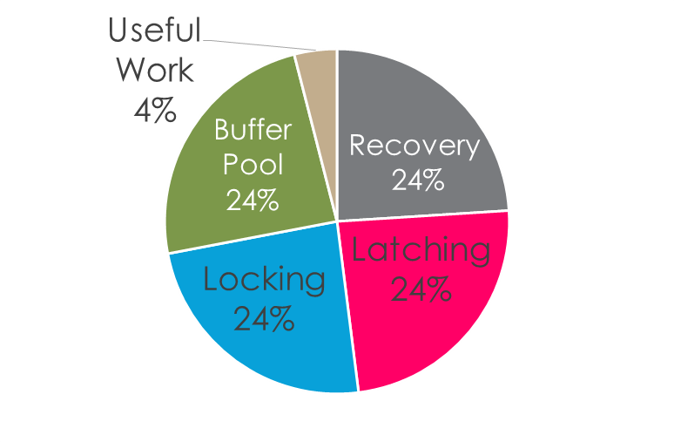
Why (Distributed) TXs are Slow?
Only 4% of wall-clock time spent on useful data processing, while the rest is occupied with buffer pools, locking, latching, recovery.¹
-- Michael Stonebraker
¹ “The Traditional RDBMS Wisdom is All Wrong”

Slide 5
Opportunities: (not so) New HW Features
    HTM: Hardware Transaction Memory
    Allow a group of load & store instructions to execute in an atomic, consistent and isolated (ACI) way
    RDMA: Remote Direct Memory Access
    Provide cross-machine accesses with high speed,
    low latency and low CPU overhead
Rethink the design of low-COST
scalable in-memory transaction systems

Slide 6
Opportunities with HTM & RDMA
    HTM: Hardware Transaction Memory
  a non-transactional code will unconditionally abort a transaction when their accesses conflict
Strong Atomicity
    RDMA: Remote Direct Memory Access

Slide 7
Opportunities with HTM & RDMA
    HTM: Hardware Transaction Memory
  a non-transactional code will unconditionally abort a transaction when their accesses conflict
Strong Atomicity
    RDMA: Remote Direct Memory Access
  one-sided RDMA operations are cache-coherent
  with local accesses
Strong Consistency

Slide 8
Opportunities with HTM & RDMA
    HTM: Hardware Transaction Memory
  a non-transactional code will unconditionally abort a transaction when their accesses conflict
    RDMA: Remote Direct Memory Access
  one-sided RDMA operations are cache-coherent
  with local accesses
HTM Strong Atomicity
RDMA Strong Consistency
RDMA ops will abort conflicting HTM TX

Slide 9
Opportunities with HTM & RDMA
    HTM: Hardware Transaction Memory
  a non-transactional code will unconditionally abort a transaction when their accesses conflict
    RDMA: Remote Direct Memory Access
  one-sided RDMA operations are cache-coherent
  with local accesses
HTM Strong Atomicity
RDMA Strong Consistency
RDMA ops will abort conflicting HTM TX
Basis for Distributed TM

Slide 10
Overall Idea
    Use HTM’s ACI properties for local TX execution
    Use one-sided RDMA to glue multiple HTM TXs
In-Memory Logging with NVM
Use HTM’s ACI features
In-Memory Store
One-sided RDMA Ops

Slide 11
System Overview
DrTM
    : Distributed TX with HTM & RDMA
    Target: OLTP workloads over large volume of data
    Two independent components using HTM&RDMA
    Transaction layer & memory store
    Low COST distributed TX
      Achieve over 5.52 million TXs/sec for TPC-C on 6 nodes
Worker Threads
Transaction Layer
key/value ops
key/value ops
Memory Store

Slide 12
Agenda
  Transaction Layer
  Memory Storage
  Implementation
  Evaluation

Slide 13
Challenge#1: Restriction of HTM
    HTM is only a compelling hardware feature for single machine platform
    Distributed TX cannot directly benefit from it
    Some instructions & system events (e.g. network I/O) will unconditionally abort HTM transactions
    Like any RDMA ops: READ/WRITE, CAS, SEND/RECV
    How to glue multiple HTM transactions together by RDMA while preserving serializability?

Slide 14

Combining HTM with 2PL
    Using 2PL to accumulate all remote records prior to accesses in an HTM transaction
    Transform a distributed TX to a local one
    Limitation: require advanced knowledge of read/write sets of transactions¹
Worker Threads
HTM
Transaction Layer
key/value ops
RDMA
key/value ops
Memory Store
2PL
¹ This is similar with prior work (e.g. Sinfonia & Calvin) and the case for typical OLTP workloads

Slide 15
DrTM’s Concurrency Control
    Local TX vs. Local TX: HTM
    Distributed TX vs. Distributed TX: 2PL
    Local TX vs. Distributed TX: abort local TX

Slide 16
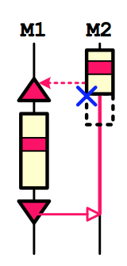
DrTM’s Concurrency Control
    Local TX vs. Local TX: HTM
    Distributed TX vs. Distributed TX: 2PL
    Local TX vs. Distributed TX: abort local TX
D-TX prior to L-TX
RDMA op will abort local TX
    RDMA (strong consistency) + HTM (strong atomicity)

Slide 17
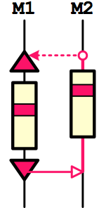
DrTM’s Concurrency Control
    Local TX vs. Local TX: HTM
    Distributed TX vs. Distributed TX: 2PL
    Local TX vs. Distributed TX: abort local TX
D-TX prior to L-TX
Local accesses need check the state of records

Slide 18
Challenge#2: Limit of RDMA Semantics
    RDMA provides three communication options
    IPoIB, SEND/RECV and one-sided RDMA ops
Good performance (e.g. latency) and without involving the host CPU
    One-sided RDMA has much limited interfaces
    READ, WRITE, CAS and XADD
    How to support exclusive and shared accesses in 2PL protocol using one-sided RDMA ops

Slide 19
DrTM’s Lock
    RDMA CAS: atomic compare-and-swap
    Similar to the semantic of normal CAS
    (i.e. local CAS)
      DrTM’s exclusive lock
      Spinlock: use RDMA CAS to acquire & release
      DrTM’s shared lock
      Lease-based protocol

Slide 20
Shared (Read) Lock
    Lease-based protocol
    Grant read right to the lock holder in a time period
    No need to explicit release or invalidate the lock
exclusive & shared lock
State:
55
8
1
Lease’s end-time
machine-ID¹
exclusive-bit
000...000₂ unlocked
State is atomically compare and swap using RDMA CAS
000...yy1₂ exclusive locked
xxx...000₂ shared locked
¹ Machine ID is only used by recovery

Slide 21
Shared (Read) Lock
    Lease-based protocol
    Grant read right to the lock holder in a time period
    No need to explicit release or invalidate the lock
    Synchronized time is provided by PTP²
exclusive & shared lock
State:
55
8
1
Lease’s end-time
machine-ID¹
exclusive-bit
000...000₂ unlocked
DELTA is used to tolerate the time bias among machines
000...yy1₂ exclusive locked
xxx...000₂ shared locked
EXPIRED: if now > end-time + DELTA
INVALID: if now < end-time - DELTA
¹ Machine ID is only used by recovery
² PTP: precision time protocol, http://sourceforge.net/p/ptpd/wiki/Home/

Slide 22
Transaction Execution Flow
    DrTM’s Transaction: START + LOCALTX + COMMIT
REMOTE READ/WRITE
START(remote_writeset,remote_readset)
foreach key in remote_writeset
value = Exclusive_lock_fetch(key)
cache[key] = value
foreach key in remote_readset
value = Shared_lease_fetch(key)
cache[key] = value
XBEGIN()
remote_writeset,remote_readset
START
TIME

Slide 23
Transaction Execution Flow
    DrTM’s Transaction: START + LOCALTX + COMMIT
REMOTE READ/WRITE
START(remote_writeset,remote_readset)
foreach key in remote_writeset
value = Exclusive_lock_fetch(key)
cache[key] = value
foreach key in remote_readset
value = Shared_lease_fetch(key)
cache[key] = value
XBEGIN()
START
Exclusive_lock_fetch
Shared_lease_fetch
TIME

Slide 24
Transaction Execution Flow
    DrTM’s Transaction: START + LOCALTX + COMMIT
REMOTE READ/WRITE
START(remote_writeset,remote_readset)
foreach key in remote_writeset
value = Exclusive_lock_fetch(key)
cache[key] = value
foreach key in remote_readset
value = Shared_lease_fetch(key)
cache[key] = value
XBEGIN()
START
HTM TX
XBEGIN
TIME

Slide 25
Transactional Read & Write
    DrTM’s Transaction: START + LOCALTX + COMMIT
REMOTE READ/WRITE
READ(key)
if key.is_remote() == true
return cache[key]
else return LOCAL_READ(key)
WRITE(key, value)
if key.is_remote() == true
cache[key] = value
else LOCAL_WRITE(key, value)
READ
START
HTM TX
LOCALTX
WRITE
TIME

Slide 26
Transactional Read & Write
    DrTM’s Transaction: START + LOCALTX + COMMIT
REMOTE READ/WRITE
READ(key)
if key.is_remote() == true
return cache[key]
else return LOCAL_READ(key)
WRITE(key, value)
if key.is_remote() == true
cache[key] = value
else LOCAL_WRITE(key, value)
START
cache
HTM TX
LOCALTX
cache
REMOTE
READ/WRITE
TIME

Slide 27
Transactional Read & Write
    DrTM’s Transaction: START + LOCALTX + COMMIT
REMOTE READ/WRITE
READ(key)
if key.is_remote() == true
return cache[key]
else return LOCAL_READ(key)
WRITE(key, value)
if key.is_remote() == true
cache[key] = value
else LOCAL_WRITE(key, value)
START
LOCAL_READ
HTM TX
LOCALTX
LOCAL
READ/WRITE
LOCAL_WRITE
TIME

Slide 28
Transactional Read & Write
    DrTM’s Transaction: START + LOCALTX + COMMIT
REMOTE READ/WRITE
READ(key)
if key.is_remote() == true
return cache[key]
else return LOCAL_READ(key)
WRITE(key, value)
if key.is_remote() == true
cache[key] = value
else LOCAL_WRITE(key, value)
START
LOCAL_READ
HTM TX
LOCALTX
LOCAL READ/WRITE
LOCAL_READ(key)
if states[key].w_lock == W_LOCKED
ABORT()
else
return values[key]
TIME

Slide 29
Transactional Read & Write
    DrTM’s Transaction: START + LOCALTX + COMMIT
REMOTE READ/WRITE
READ(key)
if key.is_remote() == true
return cache[key]
else return LOCAL_READ(key)
WRITE(key, value)
if key.is_remote() == true
cache[key] = value
else LOCAL_WRITE(key, value)
START
HTM TX
LOCALTX
LOCAL READ/WRITE
LOCAL_WRITE
LOCAL_WRITE(key, value)
if states[key].w_lock == W_LOCKED
ABORT()
else if EXPIRED(END_TIME(states[key]))
values[key] = value
else ABORT()
TIME

Slide 30
Transactional Read & Write
    DrTM’s Transaction: START + LOCALTX + COMMIT
REMOTE READ/WRITE
READ(key)
if key.is_remote() == true
return cache[key]
else return LOCAL_READ(key)
WRITE(key, value)
if key.is_remote() == true
cache[key] = value
else LOCAL_WRITE(key, value)
START
LOCAL_READ
HTM TX
LOCALTX
LOCAL READ/WRITE
LOCAL_WRITE
    Local conflicts are detected by HTM
TIME

Slide 31
Transaction Execution Flow
    DrTM’s Transaction: START + LOCALTX + COMMIT
REMOTE READ/WRITE
COMMIT(remote_writeset,remote_readset)
if !VALID(end_time)
ABORT()
XEND()
foreach key in remote_writeset
RELEASE_WRITE_BACK(key,cache[key])
VALID(end_time)
START
HTM TX
LOCALTX
READ/WRITE
    2PL: all shared locks must be released in shrinking phase
    Insert validation to all leases just before HTM commit
COMMIT
TIME

Slide 32
Transaction Execution Flow
    DrTM’s Transaction: START + LOCALTX + COMMIT
REMOTE READ/WRITE
COMMIT(remote_writeset,remote_readset)
if !VALID(end_time)
ABORT()
XEND()
foreach key in remote_writeset
RELEASE_WRITE_BACK(key,cache[key])
START
HTM TX
XEND
LOCALTX
READ/WRITE
COMMIT
    Commit local updates by HTM
TIME

Slide 33
Transaction Execution Flow
    DrTM’s Transaction: START + LOCALTX + COMMIT
REMOTE READ/WRITE
COMMIT(remote_writeset,remote_readset)
if !VALID(end_time)
ABORT()
XEND()
foreach key in remote_writeset
RELEASE_WRITE_BACK(key,cache[key])
START
HTM TX
LOCALTX
RELEASE_WRITE_BACK
REMOTE WRITE BACK
READ/WRITE
2PL & HTM → Serializability
COMMIT
    Commit local updates by HTM
    Commit remote updates by RDMA
TIME

Slide 34
Read-only Transaction
    Read-only TX usually has a very large read set
    Likely abort an HTM transaction due to capacity
    Two-round schema (read & confirm)
    Similar to ROCOCO^{OSDI’14}
    Using lease & uniform end-time to avoid twice read
START_RO(readset)
L:end_time = now + duration
foreach key in readset
end_time = MIN(end_time, REMOTE_READ(key, end_time))
if !VALID(end_time) goto L //round2: confirm
READ_RO(key)
return read_cache[key]
Set_lease(key, end_time)
!VALID(end_time)

Slide 35
Challenge#3: Durability
    All machines can immediately observe the local updates after the commitment of HTM transaction
    Transaction enclosing this HTM TX must be eventually committed, even if machine failed
    One-sided RDMA can directly accesses remote records without the involvement of host machine
    A single machine can no longer solely log all accesses to its records
    How to provide durability with HTM and RDMA?

Slide 36
Durability with Cooperative Logging
    Logging to reliable memory¹ within HTM TX
    Cooperative Logging and recovery
    Each TX logs both remote locking and all updates
    Cooperative recovery by logs on all machines
TX
START
XBEDIN
XEND
TX
END
if only ①,
then UNCOMMITTED
→ Unlock remote records
HTM
if both ① and ②,
then COMMITTED
→ Eventually write back & unlock records
Log remote write set (Lock-ahead log)
Log local and remote updates (Write-ahead log)
¹ It assumes the flush-on-failure policy, similar with prior work (e.g. WSP^{ASPLOS’12} & DTX^{SOSP’15})

Slide 37
Agenda
  Transaction Layer
  Memory Storage
  Implementation
  Evaluation

Slide 38
Memory Store in DrTM
    Separating ordered and unordered store
    Ordered store: B⁺ tree from DBX^{EuroSys’14}
    Unordered store: RDMA/HTM-friendly hash table
    DrTM’s scenario
    Symmetric: each node is both a server and a client
    Most memory accesses are local with HTM
No inevitable remote accesses to ordered stores in our OLTP workloads (i.e. TPC-C & SmallBank)

Slide 39
Overview
    Prior systems (e.g. Pilaf^{ATC’13} and FaRM^{NSDI’14})
    Complicated INSERT: hard to leverage HTM
    Only leverage one-sided RDMA to read
    No RDMA-friendly caching mechanism
 | Pilaf | FaRM
Hashing | Cuckoo | Hopscotch
Race Detection | Checksum | Versioning
Remote Read | One-sided RDMA
Remote Write | Messaging
Caching | No
Content-based caching (e.g. replication) is hard to perform strong-consistent read and write locally, especially using RDMA
RDMA & HTM provides a new design space

Slide 40
DrTM’s Design
    Simple hash structure to fully leverage HTM
    Decouple race detection from memory store
  Rely on transaction layer (HTM & Locking)
  Use one-sided RDMA ops for remote read & write
    Location-based and fully transparent cache
 | Pilaf | FaRM
Hashing | Cuckoo | Hopscotch
Race Detection | Checksum | Versioning
Remote Read | One-sided RDMA
Remote Write | Messaging
Caching | No
DrTM
Chaining
L:HTM / D: Lock
One-sided RMDA
Yes
Simple
Efficient

Slide 41
Cluster Chaining
    Similar to traditional chaining HT with associativity
    Decoupled memory region: index & data
    Shared indirect headers: high space efficiency
Main Header
Indirect Header
Entry
Hashing Space
1
2
3
N
Bucket
Slot

Slide 42
Cluster Chaining
    Similar to traditional chaining HT with associativity
    Decoupled memory region: index & data
    Shared indirect headers: high space efficiency
Hashing Space
1
2
3
N
 |  | Cuckoo¹ | Hop² | Cluster³
Uniform | 50% | 1.348 | 1.000 | 1.008
 | 75% | 1.652 | 1.011 | 1.052
 | 90% | 1.956 | 1.044 | 1.100
Zipf θ=0.99 | 50% | 1.304 | 1.000 | 1.004
 | 75% | 1.712 | 1.020 | 1.039
 | 90% | 1.924 | 1.040 | 1.091
The average number of RDMA READs for lookups at different occupancies
¹ Hopscotch hashing in FaRM configures the neighborhood with 8 (H=8).
² Cuckoo hashing in Pilaf uses 3 orthogonal hash functions and each bucket contains 1 slot.
³ Cluster hashing in DrTM configures the associativity with 8.

Slide 43
Location-based Caching
    RDMA-friendly: focus on minimizing the lookup cost
Hashing Space
1
2
3
N
Location-based Cache
Treat cache as a partially stale snapshot of headers
1
2
3
N
Bucket

Slide 44
Location-based Caching
    RDMA-friendly: focus on minimizing the lookup cost
    Retain the full transparency to the host
      All metadata used by concurrency control mechanisms are encoded in the key-value entry
Hashing Space
1
2
3
N
Incarnation
Version
Key/64
I/32
V/32
State/64
Value/N
LI/14
Offset/48
Key/64
1
2
3
N
Cache
Type/2
Lossy Incarnation
00:Unused
01:Header
10:Entry
11:Cached

Slide 45
Location-based Caching
    RDMA-friendly: focus on minimizing the lookup cost
    Retain the full transparency to the host
no need to invalidate or synchronize cache
Hashing Space
(RDMA+) Write
1
2
3
N
Incarnation
Version
Key/64
I/32
V/32
State/64
Value/N
LI/14
Offset/48
Key/64
1
2
3
N
Cache
Type/2
Lossy Incarnation
00:Unused
01:Header
10:Entry
11:Cached

Slide 46
Location-based Caching
    RDMA-friendly: focus on minimizing the lookup cost
    Retain the full transparency to the host
detect stale read by incarnation, treat it as a cache miss and refill
Hashing Space
Delete (by HTM)
1
2
3
N
Incarnation
Version
Key/64
I/32
V/32
State/64
Value/N
LI/14
Offset/48
Key/64
1
2
3
N
Cache
Type/2
Lossy Incarnation
00:Unused
01:Header
10:Entry
11:Cached

Slide 47
Location-based Caching
    RDMA-friendly: focus on minimizing the lookup cost
    Retain the full transparency to the host
    The size of cache for location is small
Hashing Space
1
2
3
N
Incarnation
Version
Key/64
I/32
V/32
State/64
Value/N
LI/14
Offset/48
Key/64
1
2
3
N
Cache
Type/2
Lossy Incarnation
00:Unused
01:Header
10:Entry
11:Cached
16MB = 1 million entries

Slide 48
Location-based Caching
    RDMA-friendly: focus on minimizing the lookup cost
    Retain the full transparency to the host
    The size of cache for location is small
    All client threads can directly share the cache
Hashing Space
1
2
3
N
The average lookup cost = 0.178
20 million key-value pairs (40 GB), 20MB cache (from empty), 8 client threads, skewed workload (Zipf θ=0.99)
Incarnation
Version
Key/64
I/32
V/32
State/64
Value/N
LI/14
Offset/48
Key/64
1
2
3
N
Cache
Type/2
Lossy Incarnation
00:Unused
01:Header
10:Entry
11:Cached

Slide 49
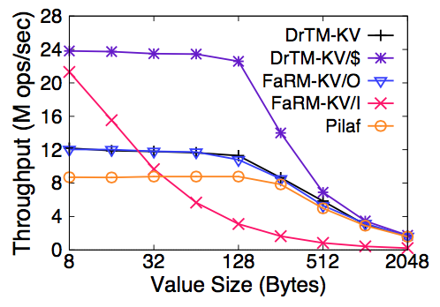
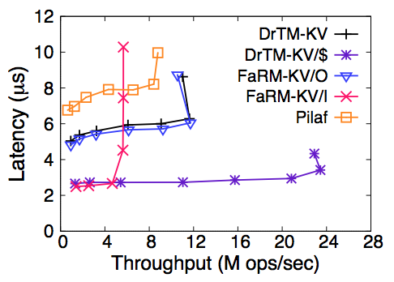
Read Performance of DrTM-KV
    DrTM-KV w/o caching provides a comparable performance
    DrTM-KV w/ caching (DrTM-KV/$) can achieve both lowest latency (3.4 μs) and highest throughput (23.4 Mops/sec)
FaRM: 2.1X, Pilaf: 2.7X
Throughput
Latency(V=64B)
Setting: 1 server and 5 clients (up to 8 threads), 20 million k/v pairs
peak throughput of random RDMA READ ≈ 26 Mops/sec

Slide 50
Agenda
  Transaction Layer
  Memory Storage
  Implementation
  Evaluation

Slide 51
Other Specific Implementation
    Transaction chopping: reduce HTM working set
    Fine-grained RTM’s fallback handler
    Atomicity Issues: RDMA CAS vs. Local CAS
    Horizontal scaling across socket: logical node
    Avoiding remote range query
    Platform: Intel E5-2650 v3 RTM-enabled
    Mellanox ConnectX-3 56GB InfiniBand

Slide 52
Agenda
  Transaction Layer
  Memory Storage
  Implementation
  Evaluation

Slide 53
Evaluation
10xCore
10xCore
56GBps IB NIC
RDMA
    Baseline: Latest Calvin (Mar. 2015)
    Platforms: A small-scale 6-machine cluster
    Each: two 10-cores, RTM-enabled Intel Xeon E5-2650
    (disabled HT), 64GB DRAM, Mellanox ConnectX-3 MCX353A 56Gbps InfiniBand NIC w/ RDMA¹
    Benchmarks²
    TPC-C
    SmallBank
40Gbps IB Switch
TPC-C
 | NEW | PAY | DLY | OS | SL
Ratio | 45% | 43% | 4% | 4% | 4%
Type | d+rw | d+rw | l+rw | l+ro | l+ro
SmallBank
 | SP | AMG | BAL | DC | WC | TS
Ratio | 25% | 15% | 15% | 15% | 15% | 15%
Type | d+rw | d+rw | l+ro | l+rw | l+rw | l+rw
¹ All machines run Ubuntu 14.04 with Mellanox OFED v3.0-2.0.1 stack.
² d and l stand for distributed and local. rw and ro stand for read-write and read-only.

Slide 54
Performance on TPC-C
New-order TX
≈ Standard-mix x45%
DrTM(S): run a separate logical node on each socket
Standard-mix
Standard-mix
26.9x
B⁺-tree is not NUMA-friendly
17.9x
16threads
8threads

Slide 55
Scalability on TPC-C
New-order TX
≈ Standard-mix x45%
Standard-mix
Each logical machine has fixed 4 threads
LM
LM
LM
LM
10xCore
10xCore
NOTE: the interaction btw. two logical nodes sharing the same machine still uses our RDMA-friendly 2PL protocol

Slide 56
Performance on Smallbank
The probability of distributed transactions

Slide 57
Durability
Due to additional writes to NVRAM (emulated by DRAM)
 |  | w/o logging | w/ logging
Standard-mix (txns/sec) |  | 3,670,355 | 3,243,135
New-order (txns/sec) |  | 1,651,763 | 1,459,495
Latency (μs) | average | 13.26 | 15.02
 | 50% | 6.55 | 7.02
 | 90% | 23.67 | 30.45
 | 99% | 86.96 | 91.14
Capacity Abort Rate (%) |  | 39.26 | 43.68
Fallback Path Rate (%) |  | 10.02 | 14.80
11.6%
11.3%
Setting: 6 machines with 8 threads

Slide 58
Limitations of DrTM
    Require advance knowledge of read/write sets of transactions
    Provide only an HTM/RDMA-friendly hash table for unordered stores, w/o B⁺-tree support
    Preserve durability rather than availability in case of machine failures

Slide 59
Conclusion
High COST of concurrency control in distributed transactions calls for new designs
New hardware technologies open opportunities
DrTM
    : The first design and impl. of combining HTM
    and RDMA to boost in-memory transaction system
    Achieving orders-of-magnitude higher throughput
    and lower latency than prior general designs

Slide 60


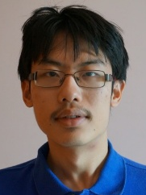




Thanks
DrTM
Questions
http://ipads.se.sjtu.edu.cn/pub/projects/drtm
Institute of Parallel and Distributed Systems

Slide 61
Backup

Slide 62
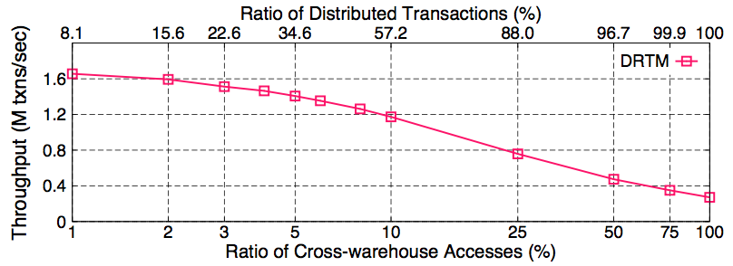
Impact from Distributed Transaction
Ration of Distributed Transactions (%)
New-order TX
Throughput (M txns/sec)
Ration of Cross-warehouse Accesses (%)
default

Slide 63
High Contention
New-order TX
≈ Standard-mix x45%
TPC-C: 1 warehouse/machine
Standard-mix
12.8x
7.8x
16threads
8threads
DrTM(S): run a separate logical node on each socket

Slide 64
Lease
Parts of records (0%-100%) does not write back (read)
1 of 10 records is chosen from 120 hotpot records
Read-write
Hotspot
64%
29%

Slide 65
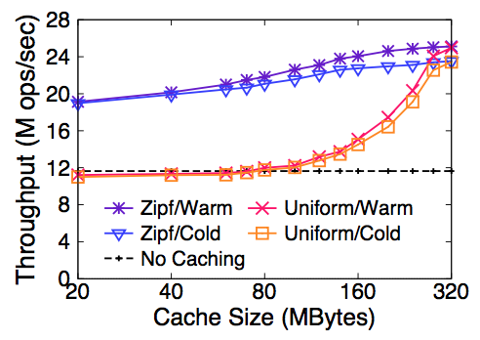
Location-based Cache
Skewed
Uniform
full cache
Setting: 1 server and 5 clients (up to 8 threads), 20 million k/v pairs
Traditional replacement policy (i.e., LRU)

Slide 66
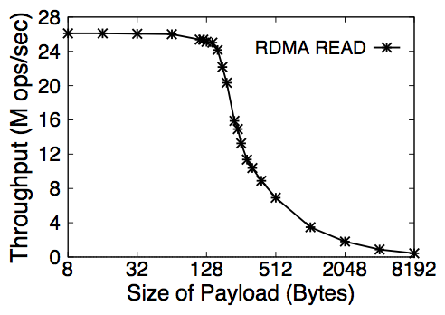
RDMA READ
Peak throughput ≈ 26 Mops/sec
Testbed: Mellanox ConnectX-3 MCX353A 56Gbps InfiniBand NIC w/ RDMA

Slide 67


False Conflict
write locked
read locked
RDMA_CAS
expired
TXN:
read A
write B
A
B
A
RD: read
WR: write
WB: write-back
REMOTE_READ(key, end_time)
_s = INIT
L:s = RDMA_CAS(key, _s, R_LEASE(end_time))
if s == _s //SUCCESS: init
read_cache[key] = RDMA_READ(key)
return end_time
else if s.w_lock == W_LOCKED
ABORT() //ABORT: write locked
else
if EXPIRED(END_TIME(s))
_s = s
goto L //RETRY: correct s
else //SUCCESS: unexpired leased
read_cache[key] = RDMA_READ(key)
return s.read_lease
L_: local
R_: remote
RDMA_CAS(key, _s, R_LEASE(end_time))
 | L_RD | L_WR | R_RD | R_WR | R_WB
State | RS | RS | WR | WR | WR
Value | RS | WS | RD | RD | WR
RS: read-set
WS: write-set
RD: read
WR: write
False conflict only impacts little performance not correctness

Slide 68
DrTM’s Failure Model
    Failure model
    Similar to WSP^{ASPLOS’12} and DTX^{SOSP’15}
    Assume flush-on-failure policy
    Fail-stop crash instead of arbitrary failures (e.g., BFT)
    Zookeeper
      Detect machine failures by a heartbeat mechanism
      Notify surviving machines to assist the recovery of crashed machines
Flush any transient state in registers and cache lines to non-volatile DRAM (NVRAM) and finally to a persistent storage (SSD) upon a failure by the power from UPS

Slide 69
Cooperative Recovery
    Crashed machine: recovery from logs
    Surviving machine: suspend & redo
MACHINE FAILURE
RECOVERY
①
UNLOCK in UNCOMMITTED
②
WB & UNLOCK in COMMITTED
③
LOCK in REMOTE_WRITE
④
UNLOCK in ABORT
⑤
LOCK in WRITE_BACK
M1
M2
M1
M2
M1
M2
M1
M2
M1
M2
LOCK
LOCK
WAIT
LOCK
WAIT
UNLOCK
WAIT
UNLOCK
WRITE BACK & UNLOCK
WRITE BACK & UNLOCK

Slide 70
Location-based Caching
    RDMA-friendly: focus on minimizing the lookup cost
Hashing Space
1
2
3
N
Location-based Cache
1
2
3
N
Cache Hit

Slide 71
Location-based Caching
    RDMA-friendly: focus on minimizing the lookup cost
Hashing Space
1
2
3
N
Location-based Cache
1
2
3
N
Cache Miss

Slide 72
Location-based Caching
    RDMA-friendly: focus on minimizing the lookup cost
Hashing Space
1
2
3
N
Location-based Cache
1
2
3
N
Fetch a bucket

Slide 73
Location-based Caching
    RDMA-friendly: focus on minimizing the lookup cost
Hashing Space
1
2
3
N
Location-based Cache
1
2
3
N
Cascading Cache

Slide 74
Content-based Caching
Content-based caching (e.g., replication) is hard to perform strong-consistent read and write locally, especially for RDMA
RDMA+
Write
Hashing Space
1
2
3
N
Invalidate or synchronize
Content-based Cache
Read

Slide 75
Related Work
    In-memory Transaction Processing
    General: Spanner^{OSDI’12}, Calvin^{SIGMOD’12}, Silo^{SOSP’13}, Lynx^{SOSP’13}, Hekaton^{SIGMOD’13}, Salt^{OSDI’14}, Doppel^{OSDI’14}, and ROCOCO^{OSDI’14}
    HTM: DBX^{EuroSys’14}, TSO^{ICDE’14} and DBX-TC^{TR’15}
    RDMA: FaRM^{NSDI’14} and DTX^{SOSP’15}
    Key-value Store with RDMA
    Pilaf^{ATC’13}, FaRM^{NSDI’14}, HERD^{SIGCOMM’14}, and C-Hint^{SoCC’14}
    Distributed Transactional Memory
    Ballistic^{DISC’05}, DMV^{PPoPP’06}, and Cluster-STM^{PPoPP’08}
    Lease
    Megastore^{CIDR’11}, Spanner^{OSDI’12}, and Quorum leases^{SoCC’14}

